Slide 1
ICPI July Onboarding Kick-Off

Slide 2
Agenda
Review Roles and Responsibilities
Confirm TC 1:1 and General Onboarding Agenda
Prepare for TC 1:1
Review Discussion Questions
Best Practices from Orientation
Open Discussion from POCs

Slide 3
Roles and Responsibilities
ICPI POCS: Session Leads
Content development
Technical Content and Hands-on Activity
Primary Presenters
Technical Content and Hands-on Activity
Facilitate session and manage breakout rooms
Recruit additional facilitators (ICEE can support, if needed)
TechChange: Allison and Nick
Support onboarding content/format development
Work with POCs to adapt content to the TC platform with structured activity
Supporting facilitators, lead us through team activities and discussions, manage technical logistics, i.e., organize breakout rooms
ICEE Team: Shazad, Jenny, Geoff, and Jessica
Organize POC:TC meetings
Coordinate with registrants
Prepare POCs

Slide 4
Day 1 Sessions (23rd) | Time | POC | Facilitators # | TC 1:1 | TC 1:1 Confirm
Check-In/Introductions | 9:00-9:30 | Jamie, Catherine, Jenny | 0 | 07/10 3-4pm Jenny/Jessica | Confirmed
Pre-Work Overview and KCs | 9:30-11am | Jamie and Catherine | 2 | 07/10 3-4pm Jenny/Jessica | Confirmed
Break | 11:00-11:05am
MER Structured Dataset Review | 11:10-12:40 | Shazad and Keifer | 3 minimum | 07/10 4-5pm Jenny/Jessica | Confirmed
Closing Day Survey | 12:40-12:45
Day 2 Sessions (24th) | Time | POC
DATIM | 9:30-11am | Couper, Imran | 3 minimum | 07/14 3-3:30pm Shazad/Jessica | Confirmed
Break | 11:00-11:05
Prevention | 11:10-12:40 | Kimi and Erin |  | 07/14 4:30-5pm Jenny/Jessica
Closing Day Survey | 12:40-12:45
Day 3 Sessions (27th) | Time | POC
Treatment Analytics | 9:30-11am | Nicole and Michelle |  | 07/14 4-4:30pm Shazad/Geoff
Break | 11:00-11:05
HTS Analytics | 11:10-12:40 | Shazad and Shaylee | 2 minimum | 07/10 4-5pm Jenny/Jessica | Confirmed
Closing Day Survey | 12:40-12:45
Day 4 (Opt-In) Sessions (28st) | Time | POC
Viral Load | 9:30-11am | Yaa and Ayesha | 2 | 07/14 3:30-4pm Jenny/Jessica | Confirmed
Key Populations | 9:30-11am | LaChandra Spencer | 2 | 07/17 3-3:30pm Shazad/Geoff | Confirmed
Break | 11:00-11:05
OVC | 11:10-12:40 | Madeline Schneider |  | 07/17 3:30-4pm Shazad/Geoff
TB/HIV | 11:10-12:40 | Catherine and Meaghan | 2 | 07/17 4-4:30pm Shazad/Geoff | Confirmed

Slide 5
General Discussion Questions
How do we manage breakout rooms?
1 facilitator per group or Roving facilitation
How many participants per breakout room?
5 recommended or Split in half
How do we group participants?
Length of time at PEPFAR or mixed or random
Do we record?
How many facilitators do you need for your session?
What platform do you want to use?

Slide 6
Prepare for TC 1:1
Why are POCs meeting with TC?
The POC/TC meeting will introduce the session content to TC
How will TC support the POC?
TC will offer support on how best to present the content on the various TC platforms
TC will support breakout groups and offer advice on the number of participants per breakout group, based on the activity
How can you prepare for your meeting?
Be ready to share your screen and present your content
Have your questions prepared for TC regarding Interactive Activity, i.e., Breakout group size and platform
Be open to creating a more virtually-conducive interactive activity, based on TC feedback using Mural or Google

Slide 7
New Student Orientation Best Practices

Slide 8
New Staff Orientation Overall Best Practices
Time
Add extra time for exercises and logging into platforms
Speak slowly and allow time for processing of content
More repetition is not enough repetition--until you are using this often, you really need to hear things over and over again.
Ensure Participation
Have someone monitor the chatbox and encourage questions
Review Emojis and different mechanisms for communicating
Hands-On Exercises
Everyone wants more Hands-On Exercises! Don’t talk to much, keep participants engaged with questions
Type the questions in the chat box, so all participants can see them when they are sharing screens
Put exercises on a shared google document

Slide 9
Orientation Attendee Feedback: Overall Layout
Display Feedback
Visually seeing someone else's screen is helpful, but the screen sharing doesn't allow them to see questions and see the screen at the same time.
ICPI staff member should share screen, instead of a group member sharing screen.
Put exercises on a google document
Onboarding Layout
Spread out the sessions over more days: things start to bleed together, because there is so much material.
It was hard to stay caught up on other work. Multi-tasking is difficult, so spacing sessions out would make it easier
Pretty impressed by training, but you need to build in more time for sessions due to connectivity.

Slide 10
Orientation Attendee Feedback: Overall Tips
Presenter Feedback
Don’t read directly from the PowerPoint. Make it more interactive
Encouraging cameras on makes it more realistic and increase my level of retention and attention
Encourage more answers in the chat box for more feedback
Exercise Feedback
Question and answer sessions are most helpful. Each question teaches tools and tricks that I hadn't thought of before.
Hands-on exercises are the most helpful

Slide 11
Orientation Attendee Feedback: Individual Sessions
Pano Session
Pano session was great to play in—I learned a lot.
MER Session
Shazad's session on "picking an indicator, pick a disaggregate" demonstrated this repetition on screen about using MSD.
The step-by-step guide is nice for a cheat sheet as you are going through the process on your own. Shazad had it written out, and it was helpful to see all the instructions and questions.
Needs to be pre-work to make sure people have access to accounts. Pivot table exercise went really well--only feedback is that the excel versions were somewhat incompatible
DATIM Session
Intro to DATIM was good to finally see things in a full picture
General Overview Session
General overview was the most helpful in terms of how everything fit together and works.
I would like a separate hands-on session specifically on using/manipulating data. The systems map is helpful.

Slide 12
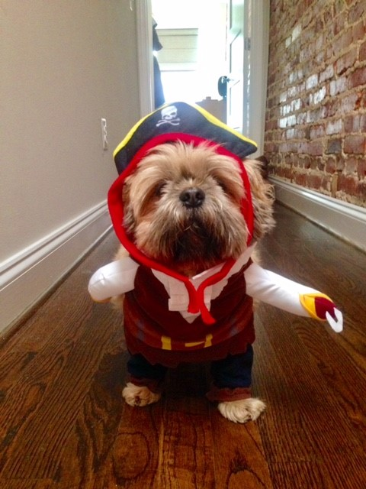
Questions? Comments? Feedback?

