Slide 1
ICPI Onboarding Survey Responses

Slide 2
Days 1-2

Slide 3
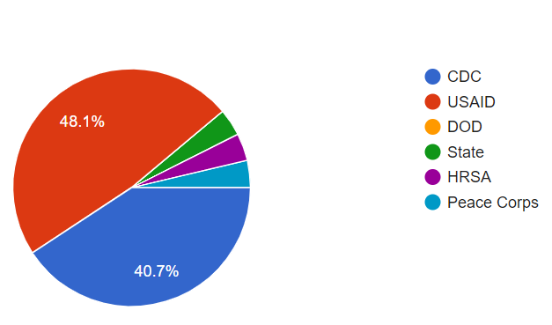
Overall Survey Participation
Agency
Session content was helpful
Overall, the sessions were very helpful in improving my overall understanding of the topics
The training content met my expectations
Overall, the trainers were effective and successful at presenting the content
Audience participation was clearly important to the presenters
Most of the content shared today was new to me

Slide 4
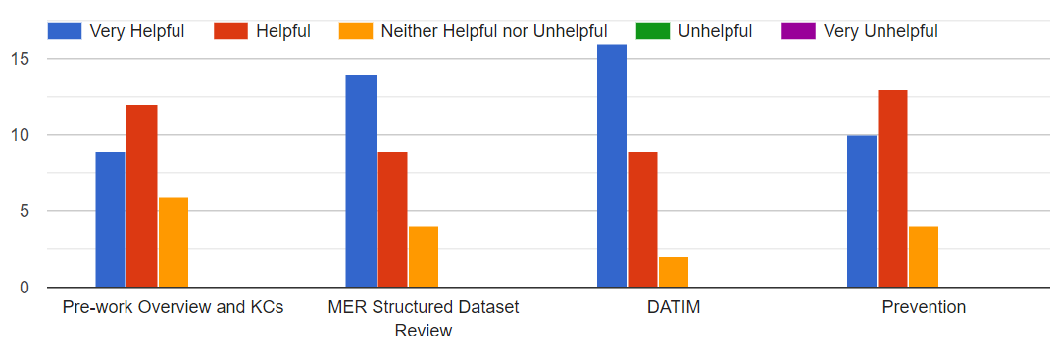
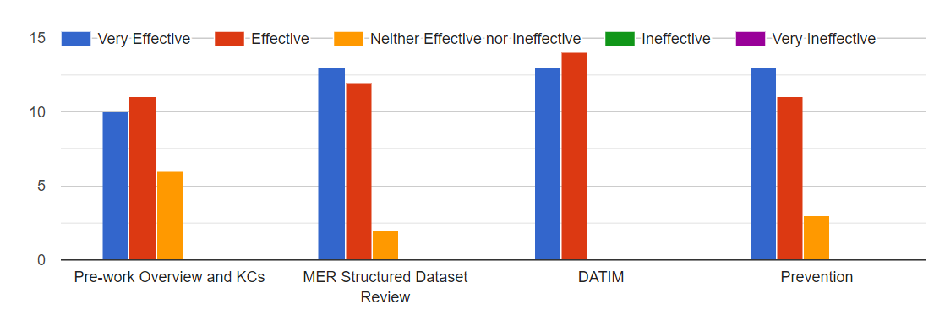
Individual Sessions
Session content was helpful
Presenter was effective at presenting content

Slide 5
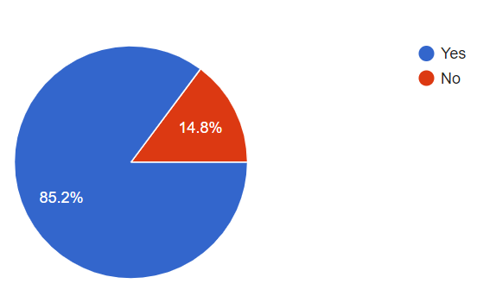
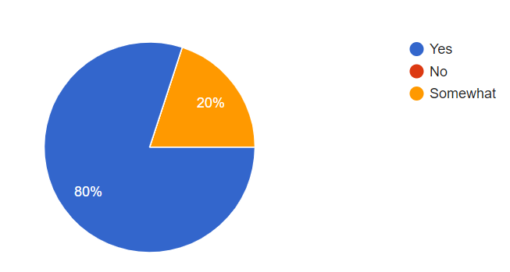
PVA Participation
Completed PVA
Completed Fundamentals
Found PVA Helpful

Slide 6
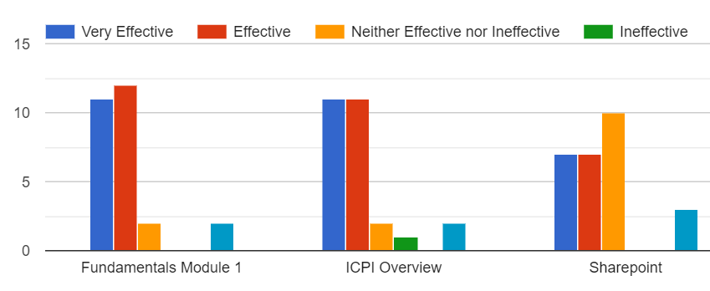
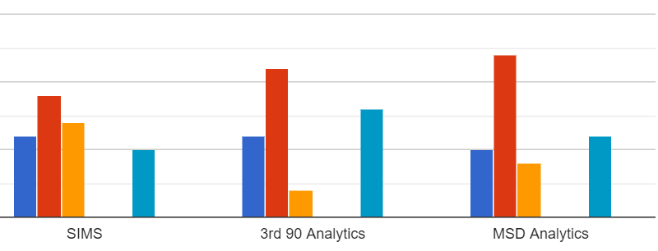
PVA Session Breakdowns
How effective the following pre-work modules were in helping you feel prepared for the July Onboarding Training?

Slide 7
Open Ended Responses
TOTAL Responses | 31
Give more time for hands-on work | 9
There is too much repetition in PVA | 5
Didn't do pre-work | 3
Version control of Documents so that the right document is shown | 2
Add Between the Spreadsheets to Pre-Work | 1
Suggest requiring everyone to download the material in advance | 1
Great Training | 1
Group exercise in prevention needed more explaning | 1
More hands-on work | 1
Helpful to have facilitators | 1
Lots of content but good training | 1
Love the virtual platform | 1
Make training longer | 1
More time to complete PVA | 1
Need to slow things down; too much information | 1
One pager on the correct internet browser for the platforms | 1
Private breakout rooms to attempt exercises on their own | 1

Slide 8
Days 3-4

Slide 9
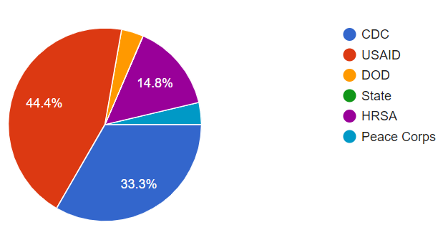
Overall Survey Participation
Agency
Session content was helpful
Overall, the sessions were very helpful in improving my overall understanding of the topics
The training content met my expectations
Overall, the trainers were effective and successful at presenting the content
Audience participation was clearly important to the presenters
Most of the content shared today was new to me

Slide 10
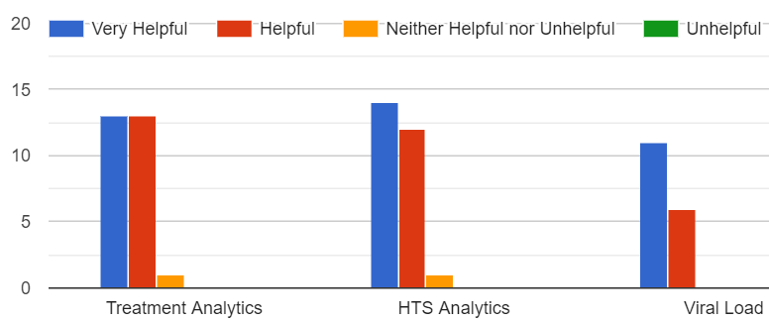
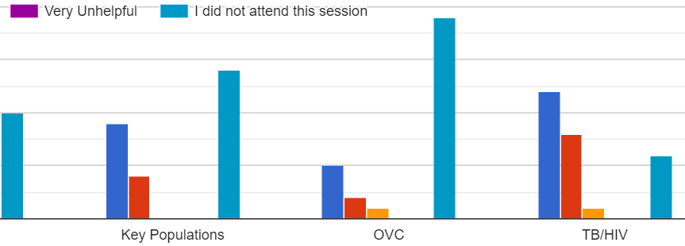
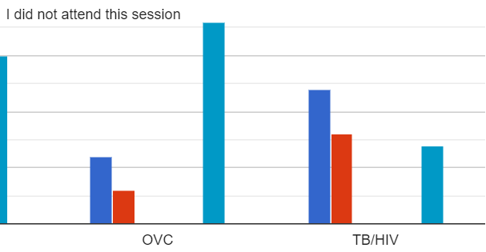
Individual Sessions
Session content was helpful
Presenter was effective at presenting content

Slide 11
Open Ended Responses
TOTAL Responses | 14
More time for breakout rooms. | 3
Overall, great work ICPI | 2
Add a beginner session on introduction to platforms | 1
Breakout out sessions by familiarity with Pivot tables for dossier work | 1
Breakout out sessions by proficiency level for dossier work | 1
Breakout sessions were extrememly helpful. | 1
For TB, give more context to TB_PREV numerator vs denominator by describing that it takes 3-6 months to complete treamtnet course. | 1
I think ongoing sessions by thematic area throughout the year would be really helpful for field staff who need constant refreshers. | 1
Improve Demonstrations and walk-though on Dossiers with Trainees | 1
More time for breakout rooms using pivot tables | 1
Try and minimize screen switching by putting google doc questions on the excel spreadsheet | 1

