Slide 1

genie_python and IBEX
Experimental Controls Team
ISIS

Slide 2
Contents
Getting started
Common Commands
Scripting
Converting from Open GENIE
Script Server
Long exercises
Notes:
Welcome to this introductory course on genie_python, a Python module that enables instrument control using Genie commands with Python.
We’ll learn how to: Start and stop runs, get and set block information, ipdate experiment details, call specialised instrument and user scripts, convert our old Open GENIE scripts to genie_python
At each stage, the course aims to assist learning with exercises and worked examples.
We will assume a basic working knowledge of Python.
genie_python does not cover data analysis. If you want to do analysis that can't be achieved with basic Python, we recommend the Mantid with Python training course.

Slide 3
Contents
Format
  Information in black
  Tasks in green
    Some tasks have [time limits]. Don’t worry if you don’t finish in the time
  genie_python code is in red
  Open GENIE code is in purple
You are in control
  Ask questions
  Choose the order and depth
    If you want to spend more or less time on a section please just let us know
Notes:
- Prepared some slides with info on (in black) and tasks to try (to green)
- You are in control this is to help you so can ignore slides. Ask questions whenever and you can choose the order
- Today’s session is scheduled to last for 3 hours

Slide 4
Recap of last time
Edit the current configuration to:
  Start the simple IOC
  Contain a block called “MY_BLOCK” pointing at SIMPLE:VALUE1
[5 minutes]

Slide 5
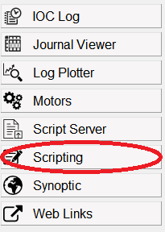
Getting started
Open a scripting window in IBEX
Output "Hello, world!" to the console
Output the square of all the integers between 1 and 10
[10 minutes]
Notes:
The best way to run genie_python commands is from the scripting perspective of the IBEX client.
To open a scripting window:
Start the IBEX client
Open the scripting perspective
The exercise is mostly a warm up to make sure:
People are comfortable with their PC setup
Their server is running
They have prerequisite Python knowledge

Slide 6
Python 2/3
genie_python uses Python 3
Python 2 is now depreciated but is still popular in places and so be wary when looking at online tutorials etc.
Notes:
Quick note about python 2/3.
This is just to make them aware of the changes that will be coming in the next couple of years but don’t get too deep into the technical differences

Slide 7
Common Commands

Slide 8
Calling functions
Access genie functions via the ‘g’ namespace.
  E.g. g.get_version() or g.cset()
Access help calling help() on a function name.
  E.g. help(g.cset)
Notes:
Functions accessed via the ``g`` namespace
You should have noticed immediately after you typed ``g.`` that an auto-complete window appeared:
The window lists the available commands, and the arguments they take, in brackets.
A description of the highlighted functions and its arguments is also given.
The list will be refined as you type more characters.

Slide 9
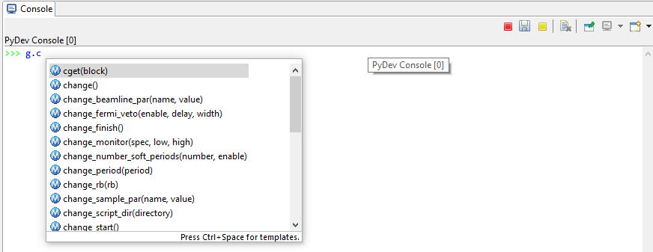
Autocomplete
Tab autocomplete will suggest available functions.
Pressing CTRL + . will bring the list back.

Slide 10
Switching run states
g.begin(): Begins a new run
g.pause(): Pauses the current run
g.resume(): Resumes the current run
g.end(): Ends the current run
g.abort(): Aborts the current run
g.get_runstate(): Gets the state of the current run
Notes:
Run through the basic run state commands
Warn users not to assume the resultant state when using these commands. For example, you may run ``g.begin()`` and then expect the instrument to be running. That may be true, but it could also be waiting, vetoing, or still setup. It's a good idea to put checks into your scripts that you've reached the expected state.

Slide 11
Waiting
Wait for a specific event before continuing. Use a “g.waitfor_...” function:
What do you think the following commands do?
  g.waitfor_time(seconds=10)
  g.waitfor_time(minutes=10)
  g.waitfor_uamps(10)
  g.waitfor_block("MY_BLOCK", lowlimit=10)
  g.waitfor_move()
  g.waitfor_runstate(“Running”, 60)
Use autocomplete to bring up a list of available g.waitfor functions
Notes:
``g.waitfor_time(seconds=10)``. Wait for 10 seconds
``g.waitfor_time(minutes=10)``. Wait for 10 minutes
``g.waitfor_uamps(10)``. Wait for the total received current to reach 10 uamps
``g.waitfor_block(block="MY_BLOCK", lowlimit=10)``. Wait for the block "MY_BLOCK" to be greater than or equal to 10

Slide 12
Update and store
You can update and store DAE results using:
  g.updatestore()
Saves a snapshot of data from the DAE into memory and store it to disk without having to end the current run.
Notes:
Mention this is done automatically on end run

Slide 13
Experiment details
You can change various experiment details with one of the “change_...” functions:
g.change_title("New title")
g.change_user(“Adrian and John")
g.change_rb(10)
What other “change” commands are there?
You can get properties using the equivalent “get_...” command:
g.get_title()
g.get_rb()
Notes:
Use auto-complete or genie_python reference manual to look up change commands

Slide 14
Experiment setup
You can change various elements of the experiment setup using genie python. E.g.:
g.change_tcb(): Change the time channel binning
g.change_tables(): Change the wiring, spectra and detector table locations
g.change_monitor(): Change the monitor to a specified spectrum and range
Using the following commands, you can stop a run from starting while you’re still applying changes:
g.change_start(): Marks the start of a change
g.change_finish(): Marks that the current set of changes is complete.

Slide 15
Worked example
# Only start if we're in the correct state
if g.get_runstate() == "SETUP":
g.begin()
# Check that the run has started successfully
if g.get_runstate() == "RUNNING":
# A function that does the sequence of # operations associated with the run
print("Doing experimental stuff")
else:
print("Could not reach a running state")
Notes:
Get the attendees to put the script in via the terminal

Slide 16
Blocks: g.get_blocks & g.cshow
g.get_blocks: Gets a list of the currently available blocks.
  g.get_blocks()
g.cshow: Shows the properties of a named block/all blocks
  If given a name (e.g. MY_BLOCK) it will return a string containing properties of the block
  If called without arguments, it will show the same information for all blocks, with each block on a new line
    g.cshow(“MY_BLOCK”)

Slide 17
Blocks: g.cget
Gets properties of a named block as a dictionary of values
Unlike g.cshow, a block name must be specified
Properties can be accessed as standard Python
g.cget(“MY_BLOCK”)

Slide 18
Blocks: g.cset
Sets the value for a particular block
Assumes that either a setpoint exists for the underlying value or the block itself points at a setpoint
Can be called with block names as named arguments. This is useful for setting multiple blocks
  g.cset(MY_BLOCK=1, MY_OTHER_BLOCK=2)
The block can also be passed in by name. This is useful when setting advanced block properties
  g.cset("MY_BLOCK", lowlimit=1, highlimit=10, runcontrol=True)

Slide 19
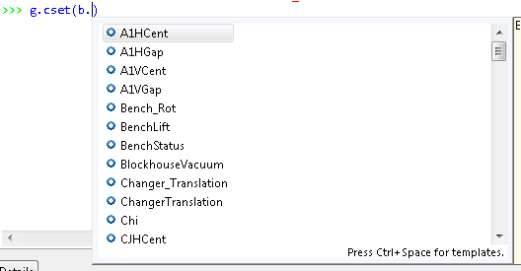
Blocks: b.
Typing a block name every time you do a cset/get can lead to errors
Typing b. will give you an autocomplete list of all available blocks, which you can use anywhere you would normally use a block name

Slide 20
Try using the previous commands to get and set the value of the blocks in the current configuration.

Slide 21
Scripting

Slide 22
Python scripts are files with the extension .py
Makes complex code easier to edit and maintain
Scripts can use any Python and genie_python functionality that you have already learnt.
Two types of scripts in IBEX:
  Instrument scripts. Aimed at instrument scientists, or instrument-specific functions that multiple users may wish to access.
  User scripts. Specific users need for particular experiments.

Slide 23
User scripts
User scripts are located in C:\Scripts\
Many editors available. We like Notepad++
Can be loaded by using the load_script function, e.g. g.load_script(‘run_my_experiment.py')
  g.load_script looks automatically in C:\Scripts\. A full path can be given for other locations

Slide 24
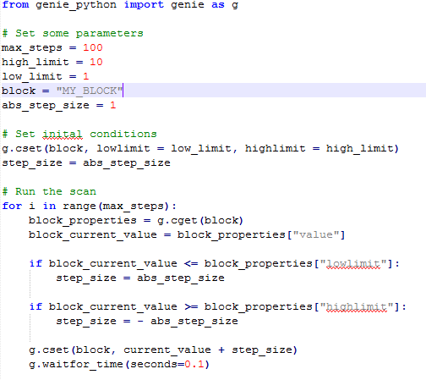
Worked example
Notes:
Address genie_python error for code outside functions – they do not need to worry about it for now

Slide 25
Exercise
Create a user script
Make sure it has from genie_python import genie as g
Change the title of the run to Exercise 1
Start a run
Wait for 1 uamps (maximum wait 10 seconds) before pausing
Set the value of MY_BLOCK to 5, with a high limit of 10, a low limit of 1 and put it under run control
Resume the run
Set the value of MY_BLOCK to 20 and confirm (using genie_python) that the instrument has entered a waiting state
Decrease the value of MY_BLOCK down in steps of 1 until it reaches 10. Wait for 1 second between steps. Notice how the run state changes back to running when the block value drops below 10.
End the run
[20 minutes]
Notes:
g.change_title("Exercise 2")
g.begin()
g.waitfor(uamps=1, max_wait=10)
g.pause()
g.cset("MY_BLOCK", 5, lowlimit=1, highlimit=10, runcontrol=True)
g.resume()
g.cset(MY_BLOCK=20)
print "The instrument {0} waiting“.format(“is” if g.get_runstate()=="WAITING“ else “is not”)
for i in range(int(g.cget("MY_BLOCK")['value']), 4, -1):
g.cset(MY_BLOCK=i)
g.waitfor(seconds=1)
g.end()

Slide 26

Run Exercise
Functions loaded from user scripts using g.load_script(...) will be available to call like any other function. For example:
Run the user function you wrote earlier
[2 minutes]
Notes:
- Again, running should be easy but most likely where they will run into problems. Check the scripting window startup for signs of issues loading inst scripts

Slide 27
Instrument Scripts
Instrument scripts are located in:
  C:\Instrument\Settings\config\<Instrument name>\Python\inst\
IBEX puts all Instrument scripts under version control.
Instrument scripts are loaded automatically when you open the scripting perspective, or by calling reload(inst).
Instrument scripts should start with from genie_python import genie as g (otherwise genie_python commands will not be available)
Notes:
Explain what it means for scripts to be under version control. Why is that good?

Slide 28
Exercise
We recommend all executable code within a script should be contained within functions and classes. For example:
Create an instrument script set_up_instrument.py in C:\Instrument\Settings\config\<Instrument Name>\Python\inst\
In this script add:
  from genie_python import genie as g
  A function called "set_up_instrument"
  The function should set the title to "My experiment"
  The function should set the username to your name
[10 minutes]
def my_function(arg1, arg2):
print("The first argument is {}, the second argument is {}".format(arg1, arg2))
Notes:
def set_up_instrument():
g.change(title="My experiment", user="Adrian")
def get_uamps_run():
g.begin()
period = g.get_period()
for i in range(10):
print "Total current after {0}s: {1}.format(i+1, g.get_uamps(period))
g.end()

Slide 29
Run Exercise
Instrument script functions can be called with inst.[function_name](args), for example:
  inst.my_method("MY_BLOCK")
The IBEX scripting perspective will provide auto-completion for instrument methods so you can see what is available
Run the instrument function you wrote earlier
[2 minutes]
Notes:
- Again, running should be easy but most likely where they will run into problems. Check the scripting window startup for signs of issues loading inst scripts

Slide 30
Modify
Every new scripting perspective will be a clean slate.
Sometimes you might want to change a script and update it without having to change scripting terminal.
  Instrument scripts: Run the command reload(inst)
  User scripts: Rerun g.load_script(…)
Modify your user script to set the title to something different
Reload the script
Run it again and confirm the behaviour has changed
[5 minutes]

Slide 31
Scripts Recap
Instrument Scripts:
  Contain non-user-specific functionality
  Are loaded using reload(inst)
  Functions are accessed via inst module, e.g. inst.function_name()
  Need to explicitly import genie_python
User Scripts:
  Contain user-specific functionality
  Are loaded using g.load_script(“script_name.py”)
  Functions are accessed directly, e.g. function_name()
  Do not need to explicitly import genie_python

Slide 32
Importing modules
You may want to call a function from one file in another file.
Calling an instrument function from a different instrument script
  Use the import command:
    from counts import vanadium
    def calibration():
    for i in range(5):
    vanadium()
Calling an instrument function from a user script
  Use inst. prefix
Calling a user function from an instrument script
  Not a good idea
Calling a user function from a different user script
  Same as calling a function from one instrument script in another

Slide 33
Converting from Open GENIE

Slide 34
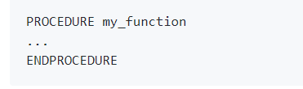

Procedures vs. functions
Notes:
No ENDPROCEDURE needed in Python, indentation makes it implicit

Slide 35
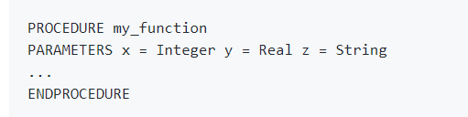

Procedures vs. functions
Notes:
Arguments don’t need typing in Python

Slide 36


Loops
Notes:
The endpoint of Python’s range function is not inclusive
No ENDLOOP needed in python

Slide 37
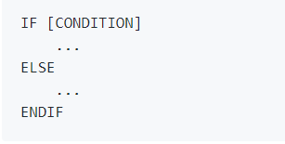
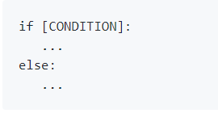
Conditionals
Notes:
No ENDIF needed in python

Slide 38
Commands
The majority of Open GENIE commands have a close equivalent in genie_python:
  BEGIN becomes g.begin()
  CHANGE TITLE=‘New title’ becomes g.change_title(“New title”)
Most arguments will be very similar between Open GENIE and genie_python. E.g.
  CSET/CONTROL TEMP1=5 LOWLIMIT=1 HIGHLIMIT=10 becomes g.cset(TEMP1=5, runcontrol=True, lowlimit=1, highlimit=10)
Notes:
NOTE Python is case sensitive and the arguments, apart from the block name, are in lower case

Slide 39
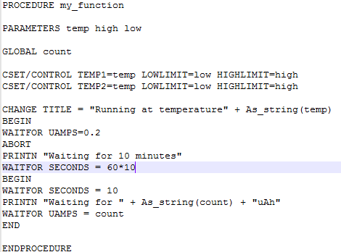
Worked example: Open GENIE
Notes:
Go through this step-by step with the attendees so they’re happy with the conversion process:
https://github.com/ISISComputingGroup/IBEX_user_manual/wiki/genie_python-and-IBEX-%28Converting-from- Open GENIE%29

Slide 40
Worked example: Python
def my_function(temp, low, high, count=50):
for block in ["TEMP1", "TEMP2"]:
g.cset(block, temp, lowlimit=low, highlimit=high, runcontrol=True)
g.change_title("Running at temperature {}".format(temp))
g.begin()
g.waitfor_uamps(0.2)
g.abort()
minutes_to_wait = 10
print("Waiting {} minutes“.format(minutes_to_wait))
g.waitfor_time(minutes=minutes_to_wait)
g.begin()
g.waitfor_time(seconds=10)
print("Waiting for {}uAh".format(count))
g.waitfor_uamps(count)
g.end()
def my_specific_function():
my_function(temp=20, low=1, high=50)
Notes:
Rather than use the value 10 for the number of minutes to wait, we've set it as a variable. That means if we change the value, we only need to change it in one place.
We've used the minutes argument in waitfor_time rather than having to apply the conversion factor between minutes and seconds ourselves.
We've used the syntax "...".format(arg1, arg2) to build our output strings. There are lots of ways to build strings in Python. Alternatively you can just use "..." + str(arg1) + "..." + str(arg2) + "..." but we like this way because it makes it easier to read and you don't have to remember to use str(...) to convert the types
Full conversion steps at: https://github.com/ISISComputingGroup/IBEX_user_manual/wiki/genie_python-and-IBEX-%28Converting-from- Open GENIE%29

Slide 41
Script Server

Slide 42



What is a script server?
Commands
Scipting console:
Client
NDX
Script
Script Server:
Results
Client
NDX

Slide 43
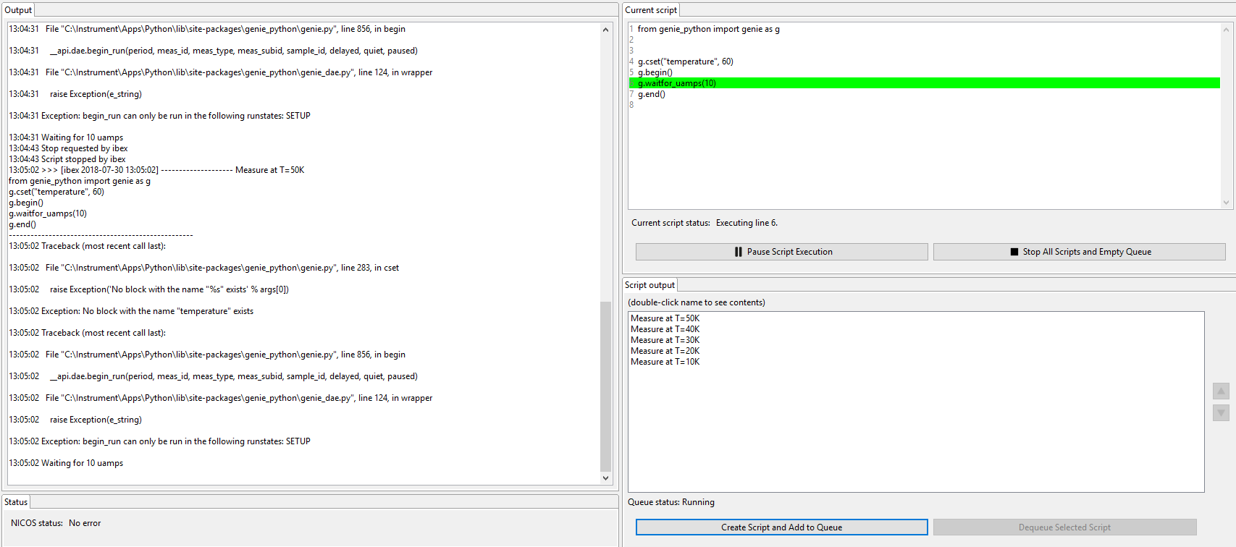
Script server view

Slide 44
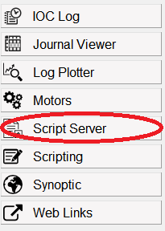


How to use the Script server
Select the Script Server view.
Add a script to the queue by clicking on the button in the bottom right
Look at the output in the “output” window

Slide 45
Script Server
You need to include
from genie_python import genie as g
at the top to use genie_python commands.
The script server executes Python scripts.
All the same genie_python commands work just as in the scripting window.

Slide 46
Script Server
Open the script server window in IBEX
Write a script to print "Hello, world!“
Write a script to print the square of all the integers between 1 and 10

Slide 47
Exercise
In the “Scripting” view, prints the numbers between 1 and 100, pausing for a second between each print statement.
During the loop, close the client and then reopen it. What is the status of the loop?
Now do the same using the Script Server by submitting a script to print the numbers between 1 and 100. Then close and reopen the client. What is the status of the loop?

Slide 48
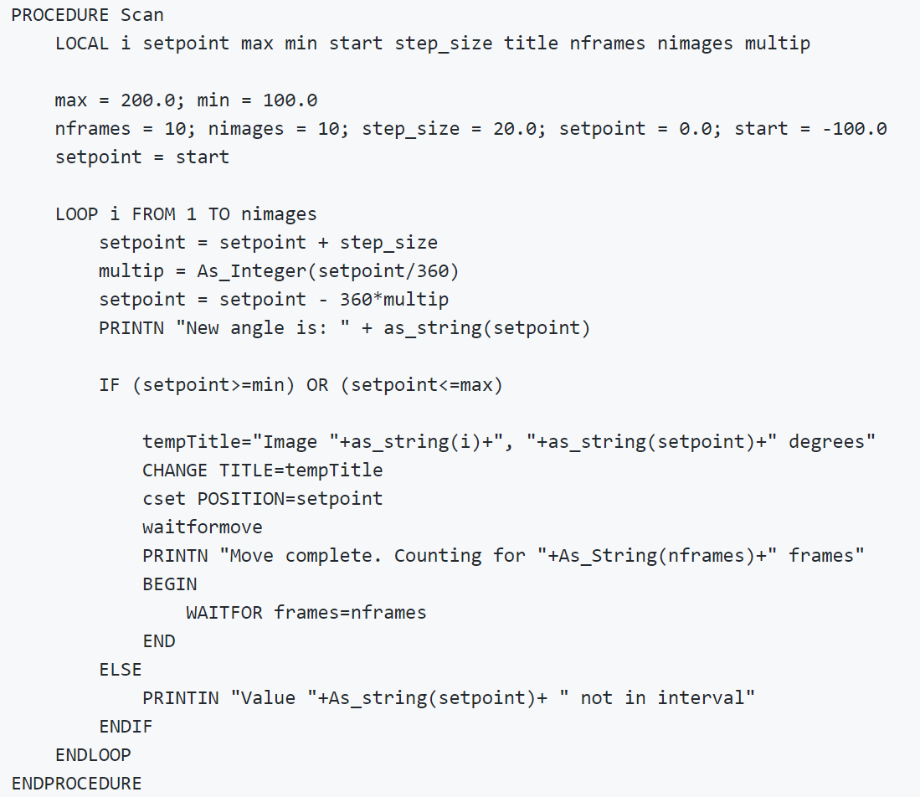
Exercise: Translate to genie_python
[30 minutes]
Notes:
https://github.com/ISISComputingGroup/IBEX_user_manual/wiki/genie_python-and-IBEX-%28Exercise-solutions%29
Should be quite straightforward. Encourage attendees to actively think about the script they are writing, notably:
the simplification “setpoint = (start + i*step_size) % 360” to avoid needing to increment step size and do modulo in one step
There is a mistake in the script people should spot. IF () OR () should be IF () AND ()

Slide 49
Exercise
Create a new instrument script containing a function
  The function sets the title to "Ramping [block name] from [initial value] to [final value]“
    The block name, initial and final values should all be provided as input arguments
  The method begins a run and then changes the value of the block incrementally in steps of size 1
  Once the target is reached, the method ends the run
Put a line at the top of your instrument script outside the function definition that prints the current title
Create a new user script containing a function
  The function runs the new instrument script on two different blocks
Load and run your new user-script function
Where was the print statement at the top of your instrument script executed?
[30 minutes]
Notes:
See https://github.com/ISISComputingGroup/IBEX_user_manual/wiki/genie_python-and-IBEX-%28Exercise-solutions%29

Slide 50
References
User Manual
  http://shadow.nd.rl.ac.uk/IBEX_user_manual/Home
Course notes
  http://shadow.nd.rl.ac.uk/IBEX_user_manual/genie_python-and-IBEX-(Introduction)
Genie Python Manual
  http://shadow.nd.rl.ac.uk/genie_python/sphinx/genie_python.html
Notes:
User manual and genie python manual

