Slide 1
Lesson 5: Controller SDK
2019

Slide 2
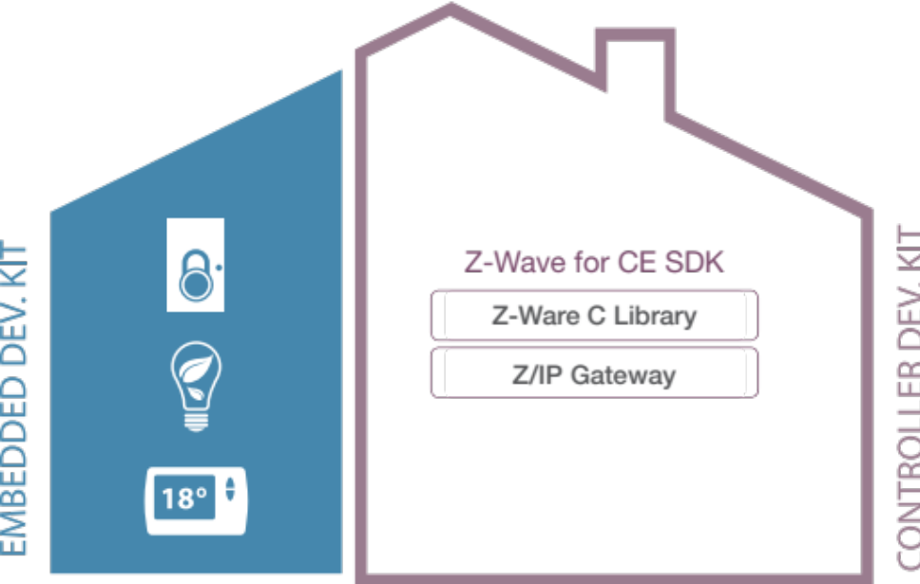
Controller Dev Kit – Overall use cases
Intelligence in the Home
  Contains a working IoT gateway prototype.
  Easy to deploy by downloading the Z/IP Gateway and Z-Ware.
  Z-Ware C Library converts Z-Wave devices to objects for easy integration
  Z-Ware Web API allow for easy App development
Notes:
This lesson will introduce you to the Z-Wave Controller SDK.

Slide 3


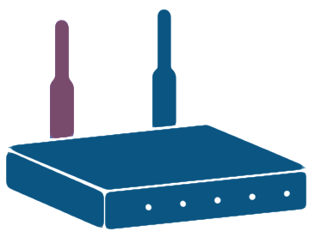
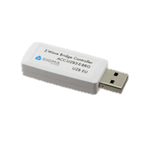
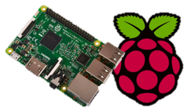
Concept
Z-Ware API
Z-Wave to IP
Linux
UZB Z-Wave
Bridge Controller
Raspberry Pi 3

Slide 4
Fast Gateway Development
Z-Wave Gateway – Z-Ware & Z/IP Gateway middleware
  Standardized interoperable Z-Wave gateway solution
Why
  Quickly integrate Z-Wave into excising solutions/services
  Focus your resources on smart home services
  Consistent ecosystem quality and easy upgrade of new features
  Fast time to market
Z-Ware
Abstracts Z-Wave into C objects and Web API
Device Objects
Command Class implementation
Scene and event manager
Z/IP Packaging and DTLS
Z/IP Gateway
Abstracts Z-Wave into UDP/IP
Network Management
Security S2
SmartStart
Mailbox for Batt. Devices
Multi-channel support

Slide 5
What Is It
Z/IP Gateway
Z-Wave to IP bridging
Network management
Message mailbox
Security (S0 and S2)
Smart Start
Multi-Channel encapsulation
Network statistics (IMA)
TLS and DTLS for IP security

Slide 6
What Is It
Z-Ware
Z/IP Client
Nodes as objects
Device state caching
Scene manager
Portal extension (WebAPI)
UI’s and Apple HomeKit support

Slide 7

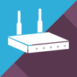


Faster to market - Gateway
Gateway
OCF…
OpenT2T
Alexa Skill
Product Client
HomeKit
Z-Wave Gateway API’s
Z-Wave Protocol
Notes:
Use http API and - Enable skills to cover multiple gateway vendors

Slide 8


Faster to market - Gateway
Z-Ware Apps
Example APP’s
Gateway
HTTP API
OCF…
Z-Ware Webserver
OpenT2T
Z-Ware Web
Alexa Skill
Product Client
HomeKit
C API
Z-Wave Gateway API’s
C middleware
Z-Ware C-Lib
UDP/IP
Z/IP Gateway
IP wrapper for Z-Wave cmds
Z-Wave Protocol
UART/USB
Z-Wave protocol
Z-Wave Protocol
Notes:
Use http API and - Enable skills to cover multiple gateway vendors

Slide 9
Faster to market - Gateway
Z-Wave Gateway Software enables:
  Quickly integrate Z-Wave into existing solutions/services
  Focus your ressources on smart home services, less need of Z-Wave specific development
  Consistent ecosystem quality and easy upgrade of new Z-Wave features
  Fast time to market
What does it require?
  Linux hardware platform
  (Android Things support in beta now, Android support coming Q1-2019)
  Mains powered
Gateway/controller products NOT possible w. Z-Wave
  Battery driven, remote controller – need to be made as slave
  Other RTOS than Linux (Android support coming)
Z-Wave Gateway
Z-Ware
Abstracts Z-Wave into
C
web API
Z/IP Gateway
Abstracts Z-Wave into UDP/IP
Network Management
Security S2
SmartStart
Mailbox for Batt. Devices
Z/IP Packaging
Multi-channel support
Z/IP gateway is mandatory for all Z-Wave 700 gateways

Slide 10
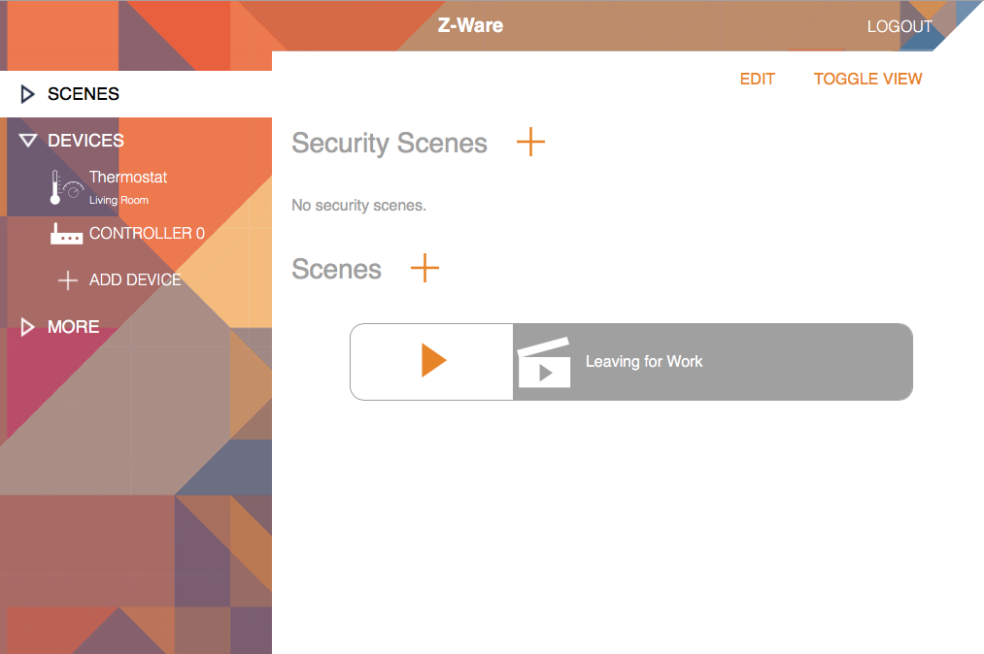
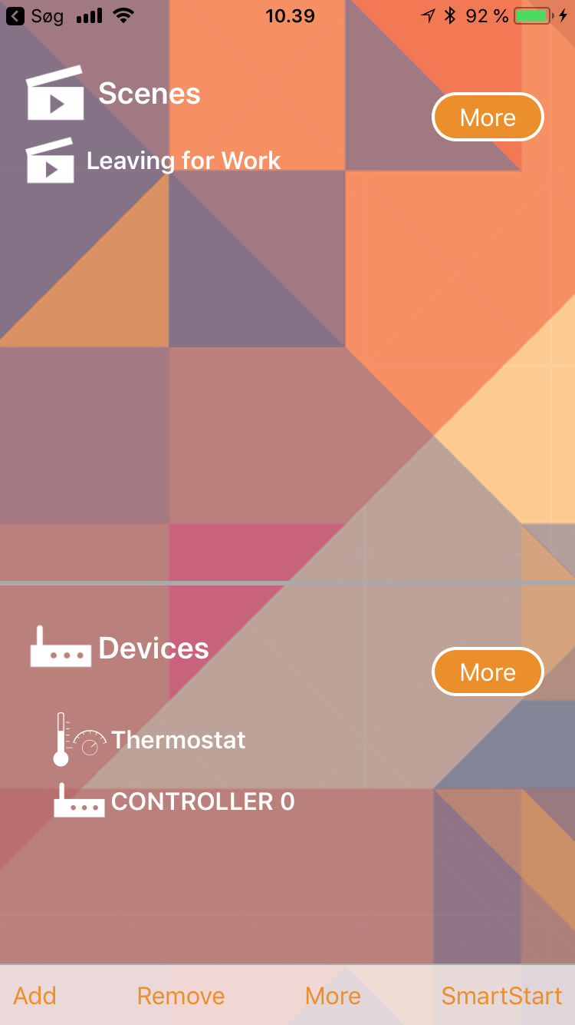
Getting started with Z/IP & Z-Ware

Slide 11
Demonstration: End-to-end demonstration of Z-Wave
Goal of Demonstration
Using the Controller SDK and Embedded SDK, setup a slave device that can be controlled using a web-interface.
What you will learn
You will get an overview of the entire tool chain used in a Z-Wave Eco System.
Notes:
This demonstration will be using the Switch On/Off as the slave device, which the students has come to know during the last exercises.
Using the Controller SDK, this demonstration will show how the Switch On/Off can be controlled from a website.
The last part of the demonstration will show how to use the “Z-Ware Bin Switch” example showing the students how to use the C-API.

Slide 12
Where to go from here?
Want to dig deeper into the Controller SDK?
From Simplicity Studio, find the guide:
INS14281 - Z-Wave 700 Getting Started for Controller Devices
This guide will cover all of the following, which was needed for the demonstration:
How to setup the Z/IP GATEWAY
How to setup Z-Ware
Running an example using the C-API
Running an example using the Web-API

Slide 13
How to ensure customer success for Controller Development?
Controller Development is a much more complex product than a Slave Device.
Make sure to guide customers to the Getting Started information.
Guide customers to Z-Wave Support Channel. We are here to help!

Slide 14
Thank you!
silabs.com
End of Lesson 5: Controller SDK

