Slide 1
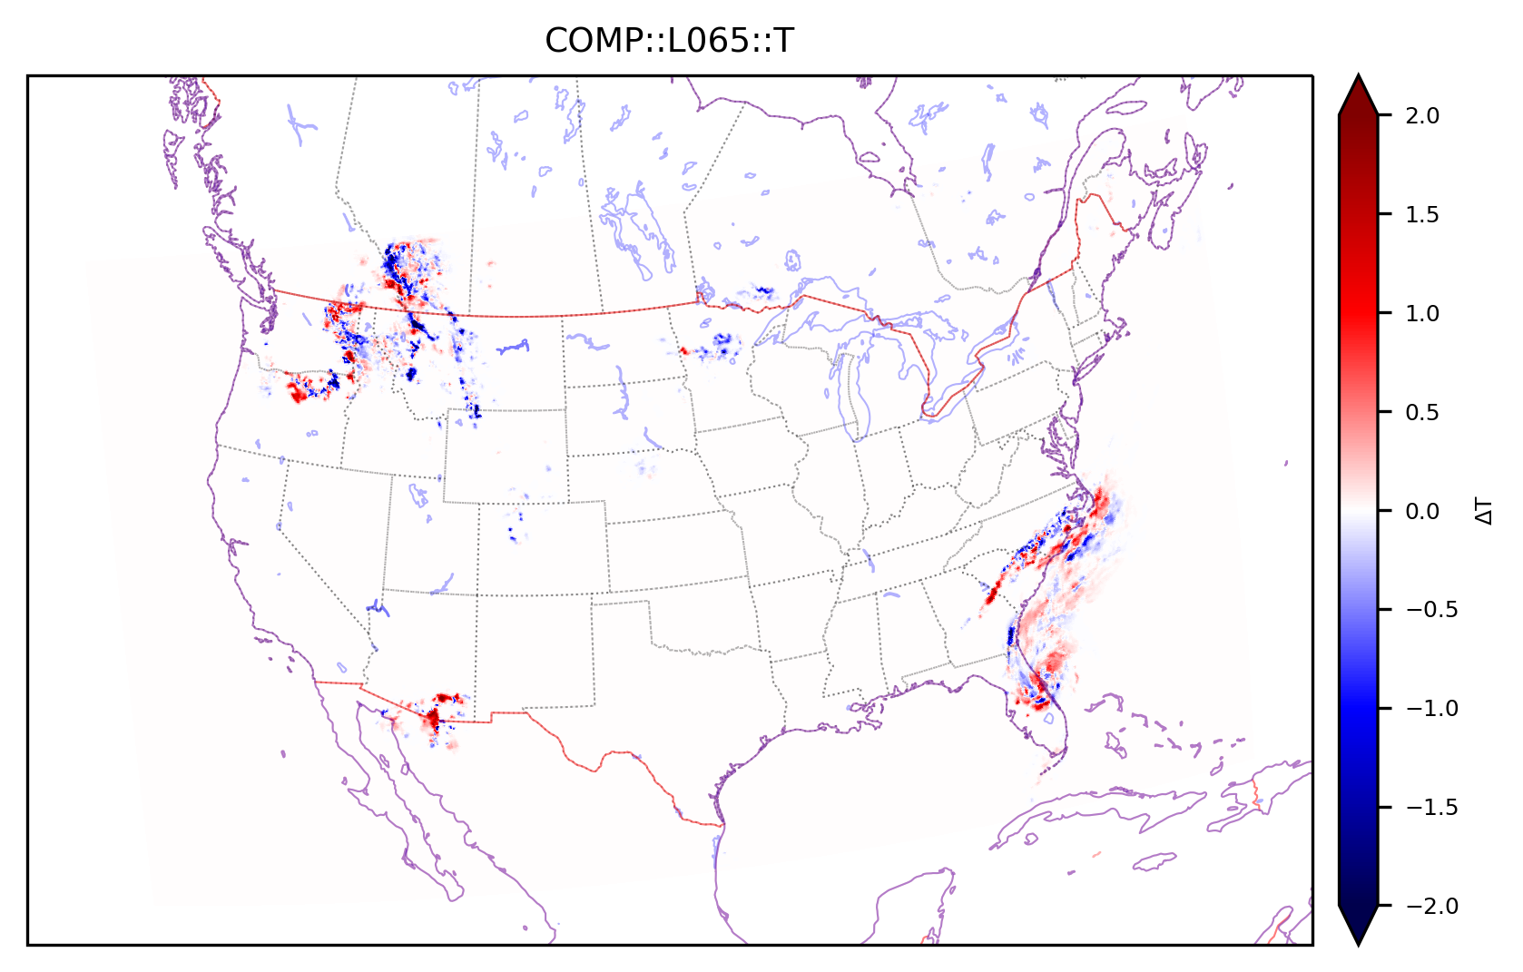
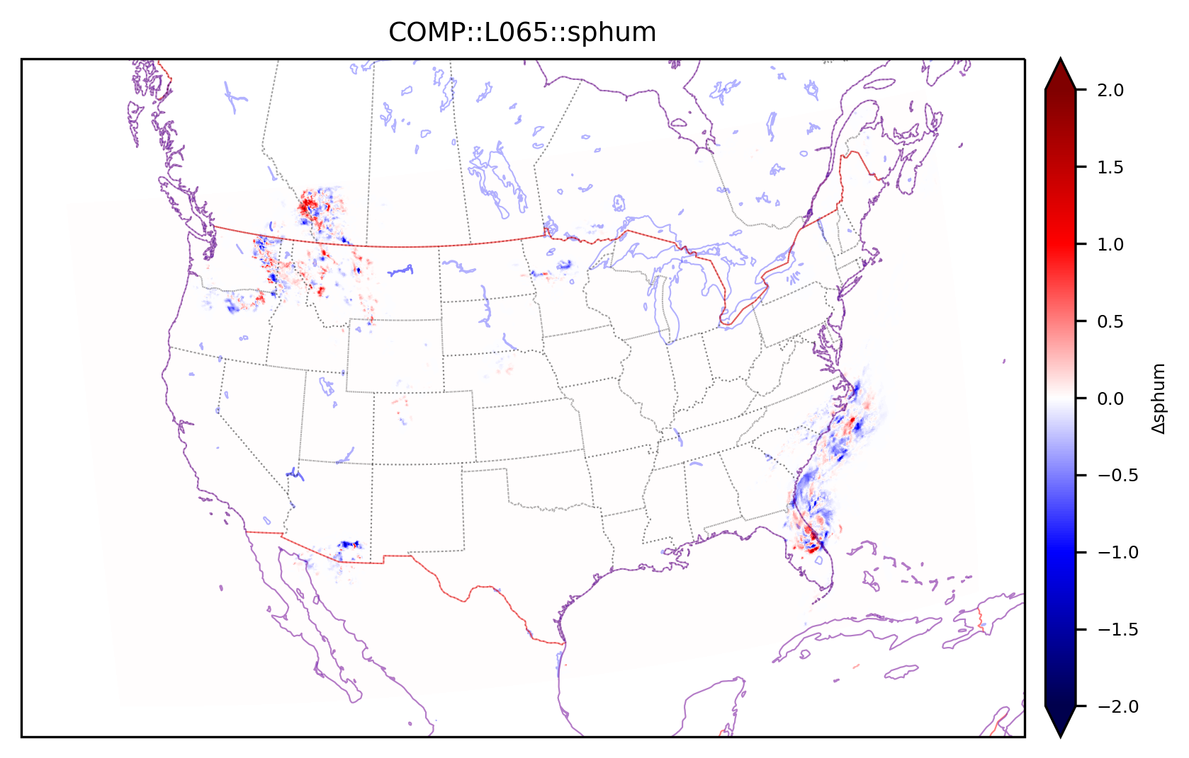
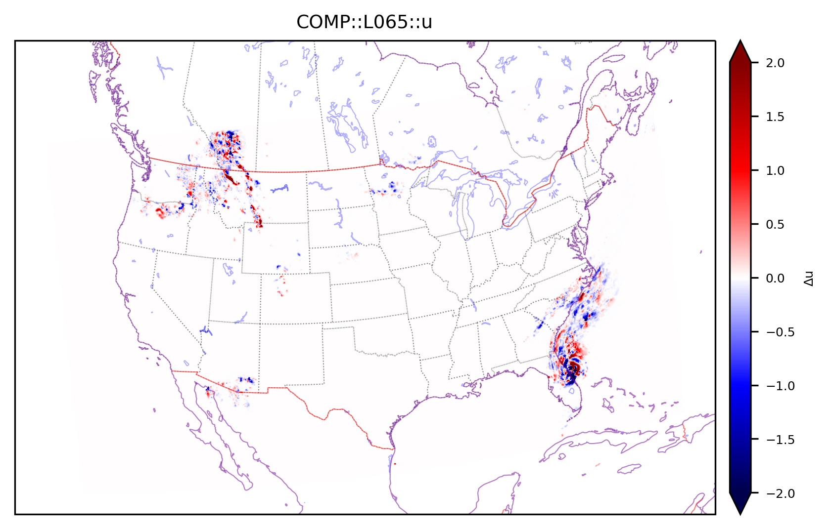
Reflectivity DA with Hybrid EnVar in PR#543
Analysis increment in lowest level at 16z on 20220929
(Here, only reflectivity is assimilated with Pure EnVar)
Static B: 0%
Ensemble B: 100%
Temperature (K)
Specific humidity (g/kg)
Zonal wind (m/s)
Meridional wind (m/s)

Slide 2
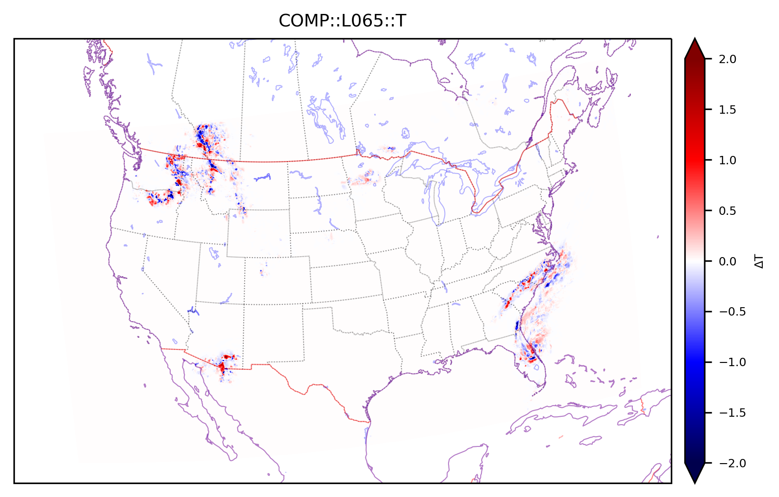
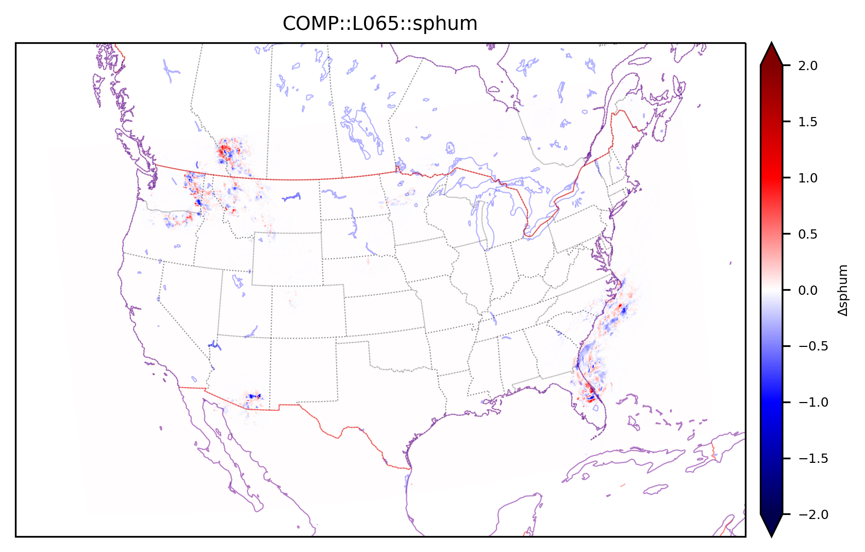
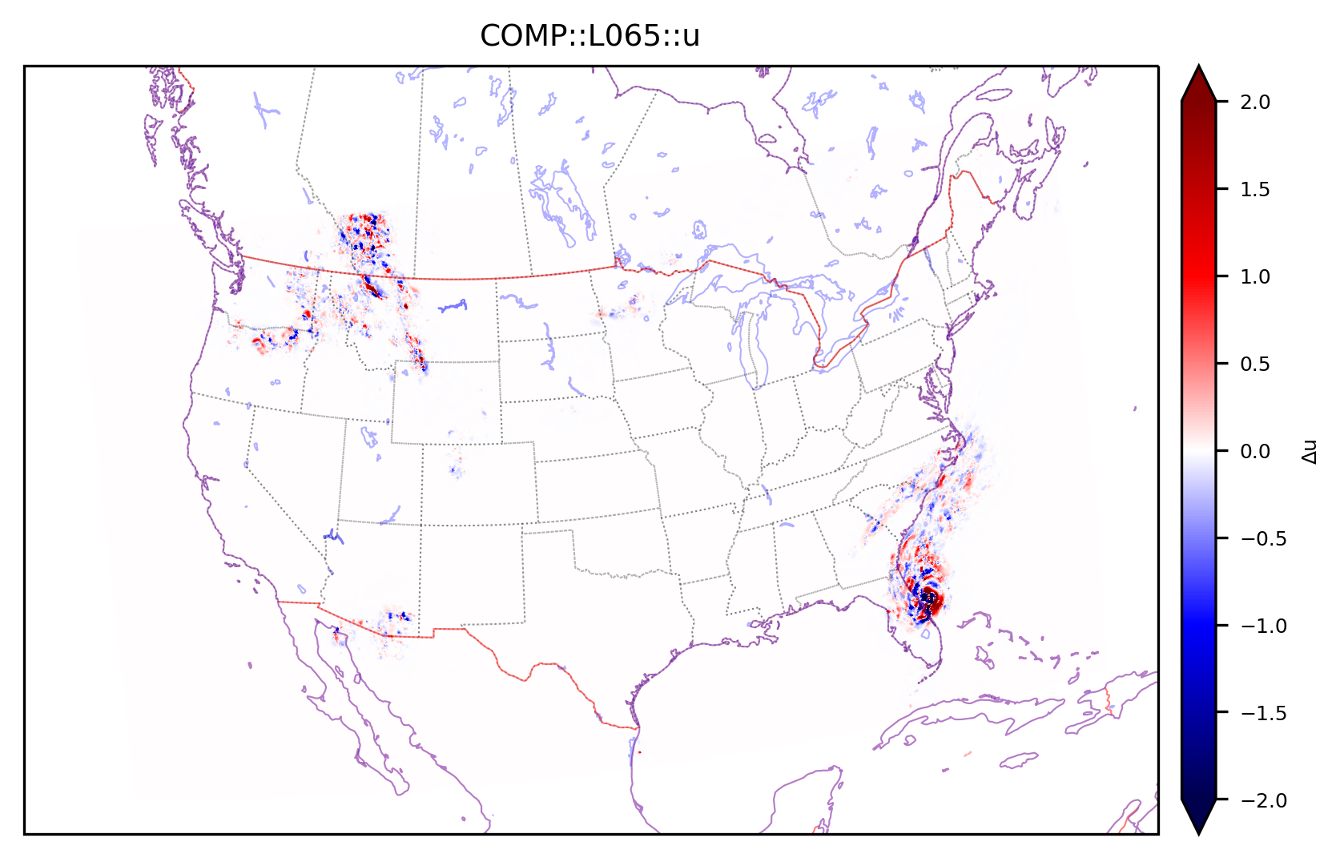
Reflectivity DA with Hybrid EnVar in PR#543
Analysis increment in lowest level at 16z on 20220929
(Here, only reflectivity is assimilated with Hybrid EnVar)
Static B: 15%
Ensemble B: 85%
Temperature (K)
Specific humidity (g/kg)
Analysis increment becomes smaller slightly due to smaller ensemble B and substantial zero static B.
Zonal wind (m/s)
Meridional wind (m/s)

