Slide 1

g
OSM Online Meeting #13
Open Source Malaria 2-Month Planning
Thur 5th July 4am East Coast US, 9am UK, 10am CET, 6pm Sydney
To Join: go to http://webconf.ucc.usyd.edu.au/osm-5july2018/

Slide 2
g
The OHOH Compound - David

Slide 3
g
Recent Potency Data - Ed

Slide 4

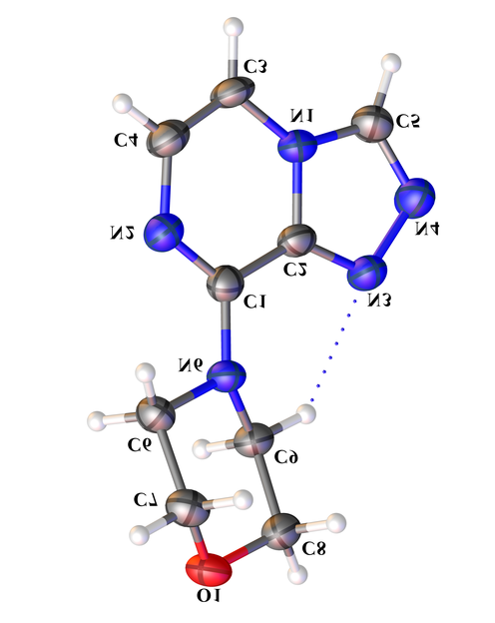
Indole Hit and Tele-substitution - Marat

Slide 5
g
New Metabolic Data - Mat

Slide 6
g
Series 4 – Priority Actions in July/Aug

Slide 7
g
Series 4 Paper 1 – July/Aug Actions

Slide 8
g
Review of Series 3 and Next Targets - Tha

Slide 9
g
Series 3 Target Identification - Ho
Identified as part of screening campaign: Thousands of chemical starting points for antimalarial lead identification Nature 01 May 2010, 465(7296):305-310 http://dx.doi.org/10.1038/nature09107
Screened nearly 2 million compounds in GlaxoSmithKline's chemical library for inhibitors of P. falciparum. Also known as CHEMBL581088, CID 44528665, TCMDC-135294
Mode of action unknown. Metabolomic profile different from other known antimalarials.
Target Prediction using ChEMBL data
Based on Ligand-based target predictions in ChEMBL (http://chembl.blogspot.com/2014/04/ligand-based-target-predictions-in.html) NB most targets are human proteins.
Download models and use Jupyter Notebook to provide interface.
Notebook available here:https://www.macinchem.org/reviews/ipython/chemblmodels.php

Slide 10
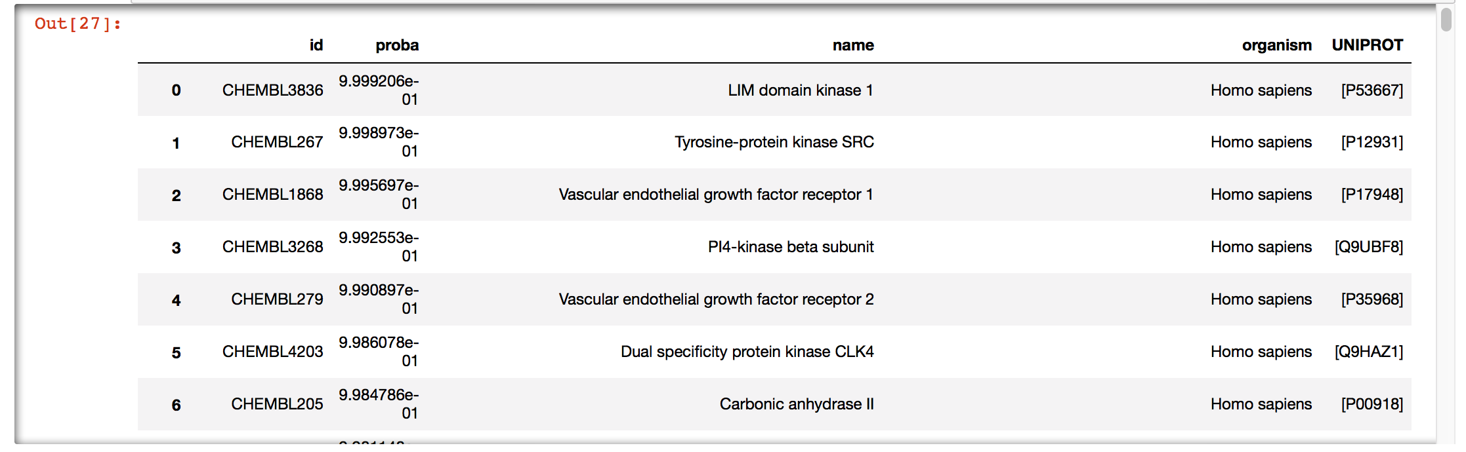
g
Series 3 Target Identification - Ho
Top predictions mainly kinases and Carbonic Anhydrase.
Carbonic Anhydrase is know potential anti-malarial target (https://dx.doi.org/10.1016%2FS2221-1691(11)60034-8) but selectivity over human enzyme is potential liability
Not possible to predict P. falciparum target kinase but some are known (https://doi.org/10.1046/j.1432-1327.2001.02403.x), but clearly off-target activity may be an issue

Slide 11
g
Series 3 Target Identification - Ho
Inverse docking against Pf kinases
Dock OSM-S-106 against all Pf essential (Lucet, Future Med. Chem 2012) kinases, using both crystal structures and homology models.
Docking performed with smina, an Autodock Vina variant, using the Vinardo scoring function and flexible side chains. This is an aggressive approach, with higher sensitivity but also higher false positives.
Top results confirmed visually.

Slide 12
g
Series 3 Target Identification - Ho
Kinase Production
Funded collaboration with University of Kansas Core Labs.
Top two crystal structures from inverse docking, PfA-R (Protein Kinase A, regulator domain) and CLK1 kinase, currently being cloned and prepared for protein production.
We will crystallize kinases with OSM-S-106 and other hits.
We can also use purified protein for biochemical and binding assays.

Slide 13
g
Series 3 Target Identification - Ho
Suggested Actions
Test against P. falciparum and human Carbonic Anhydrase
Continue to explore P. falciparum kinase targets
  Would be better test more than just MMV025100
  Should we be thinking about developing a kinase inhibitor set that might be directed towards non-human targets (not just plasmodium)?

Slide 14
g
Pharmacophore Competition
Original competition was run, using test dataset that was not public. Winners established Sept 2017 (OSM_To_Do_List#538).
Test dataset has just been published (June 11th 2018)
DOI: 10.1038/s41598-018-26819-1
We should now use the new data to refine the existing models further.
Aim: be predictive about what to make – i.e. proposed structures are(not) likely to be potent.
If all models can be revised, we should co-publish.
Additional need for paper: structures docked with homology model

Slide 15
g
Other Action Items for July/Aug

Slide 16
g
Summary on How to Provide Suggestions/Input
Now, in this meeting (recorded)
On relevant Github issue pages (best)
On your own favoured blog/site, and then ping OSM (Twitter, or email).
Directly via email but please ensure that comments/contributions can be placed into the public domain with attribution.

