Slide 1

g
OSM Online Meeting #13
Open Source Malaria 2-Month Planning
Thur 5th July 2018 4am East Coast US, 9am UK, 10am CET, 6pm Sydney
To Join: go to http://webconf.ucc.usyd.edu.au/osm-5july2018/
Anyone can contribute to this meeting, but if you’re not speaking, please mute your mic.
Use the chat window to make notes, ask questions. The chat history will be saved.
The meeting will be recorded and uploaded to OSM’s public YouTube channel
Aim of this meeting is to summarise recent results and plan principal activities for July and August.
Smaller To Do items that we don’t get a chance to talk about: please add those to OSM_To_Do_List#568

Slide 2
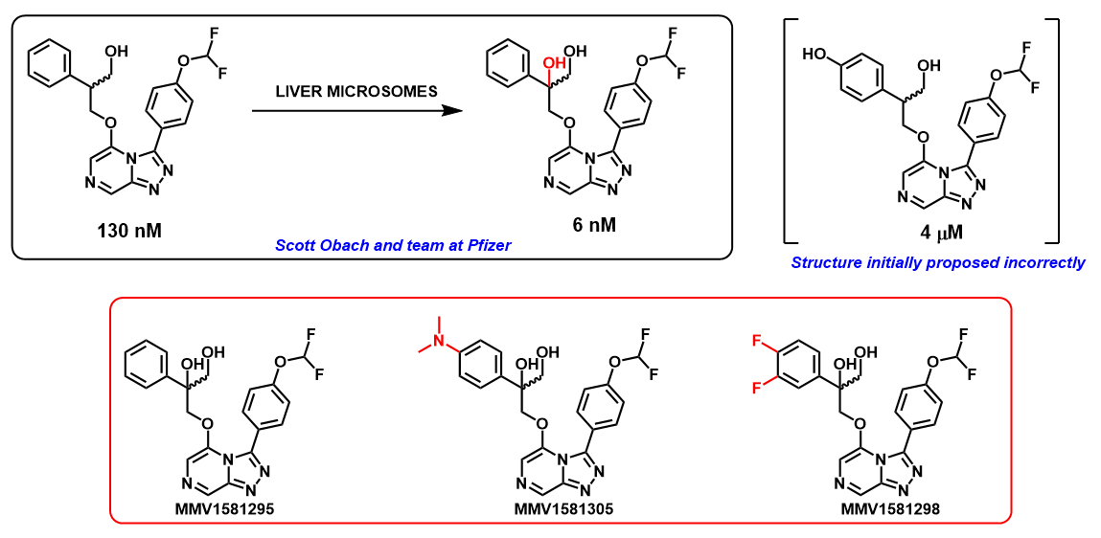
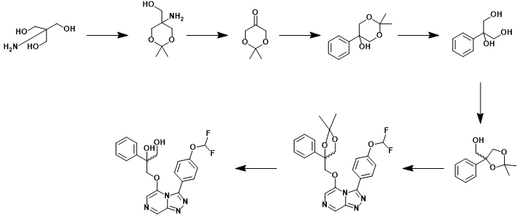
g
The OHOH Compound - David
More info at these GitHub issues:
Original biosynthesis: To_Do_List/#513
Identification of correct compound: Series4/#33
OHOH synthesis: Series4/#36

Slide 3
Recent Potency Data - Ed
g
Latest Batch Sent : Series4#54

Slide 4
g
Target Compounds - Ed

Slide 5
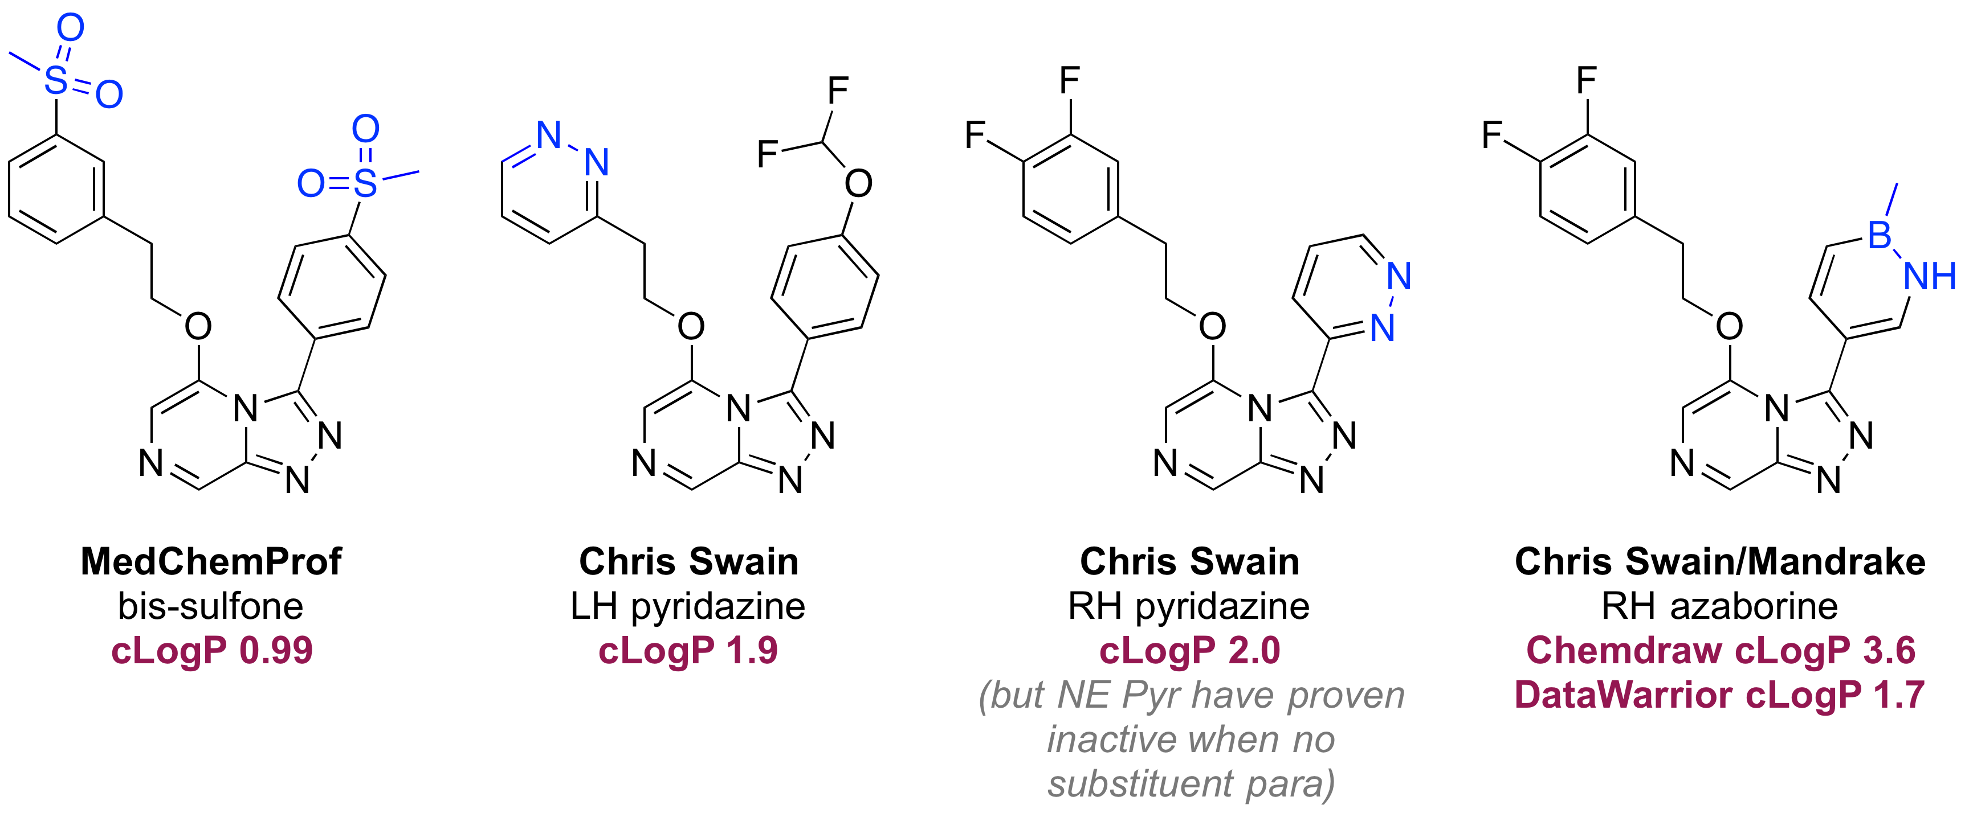
g
Azaborine back on agenda?
OSM_To_Do_List#388

Slide 6
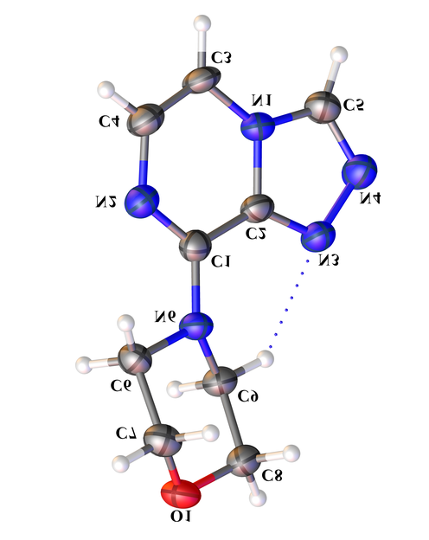
g
Synthetic Chemistry and Tele-substitution - Marat
Structure Corrections: Series4#48

Slide 7
g
New Metabolic Data - Mat

Slide 8
g
Series 4 – Priority Actions in July/Aug
Completion of Ed’s next structures
Completion of David’s final structures
Marat: Scoping out of telesubstitution
Completion of IVIVC (Mat)
Re-starting and running second phase of pharmacophore competition (see later)
Paper: Next slide

Slide 9
g
Series 4 Paper 1 – July/Aug Actions
Paper can be edited by anyone – people are actively encouraged to take ownership of sections and write.
Paper: http://tinyurl.com/OSM-S4-Paper1
Associated Issues can be used for extended discussion: https://github.com/OpenSourceMalaria/OSMSeries4Paper1/issues
TO DO: awaiting confirmation of potency of Pfizer compound. If good, key properties must be measured (sol, CLint etc), then those compounds are used as the “punchline”. Then:
Complete potency data import into wiki, to generate complete SAR picture
Decide which compounds to feature in paper
Complete experimental data for those compounds
Sections Needing Writing: i) Generic synthetic chemistry summary for ethers and amides (?); ii) Summary evidence for Mech of Action (Ed); iii) Metabolomics (anyone want to proof/shorten section from Creek Lab?); iv) Write up of in vitro metabolic data; v) Write up of in vivo activity.
Separate papers for:
Pharmacophore competition
Telesubstitution

Slide 10
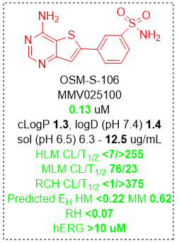
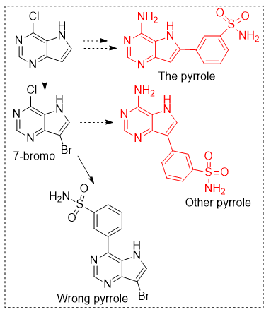
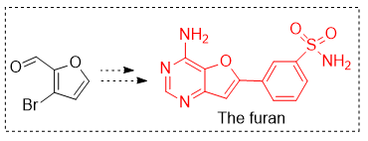
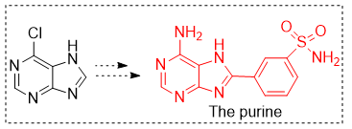
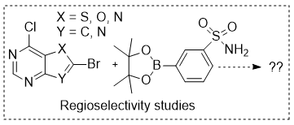
g
Review of Series 3 and Next Targets - Tha
Separate repo for Series 3: https://github.com/OpenSourceMalaria/Series3

Slide 11
g
Series 3 Target Identification - Ho
Identified as part of screening campaign: Thousands of chemical starting points for antimalarial lead identification Nature 01 May 2010, 465(7296):305-310 http://dx.doi.org/10.1038/nature09107
Screened nearly 2 million compounds in GlaxoSmithKline's chemical library for inhibitors of P. falciparum. Also known as CHEMBL581088, CID 44528665, TCMDC-135294
Mode of action unknown. Metabolomic profile different from other known antimalarials.
Target Prediction using ChEMBL data
Based on Ligand-based target predictions in ChEMBL (http://chembl.blogspot.com/2014/04/ligand-based-target-predictions-in.html) NB most targets are human proteins.
Download models and use Jupyter Notebook to provide interface.
Notebook available here:https://www.macinchem.org/reviews/ipython/chemblmodels.php

Slide 12
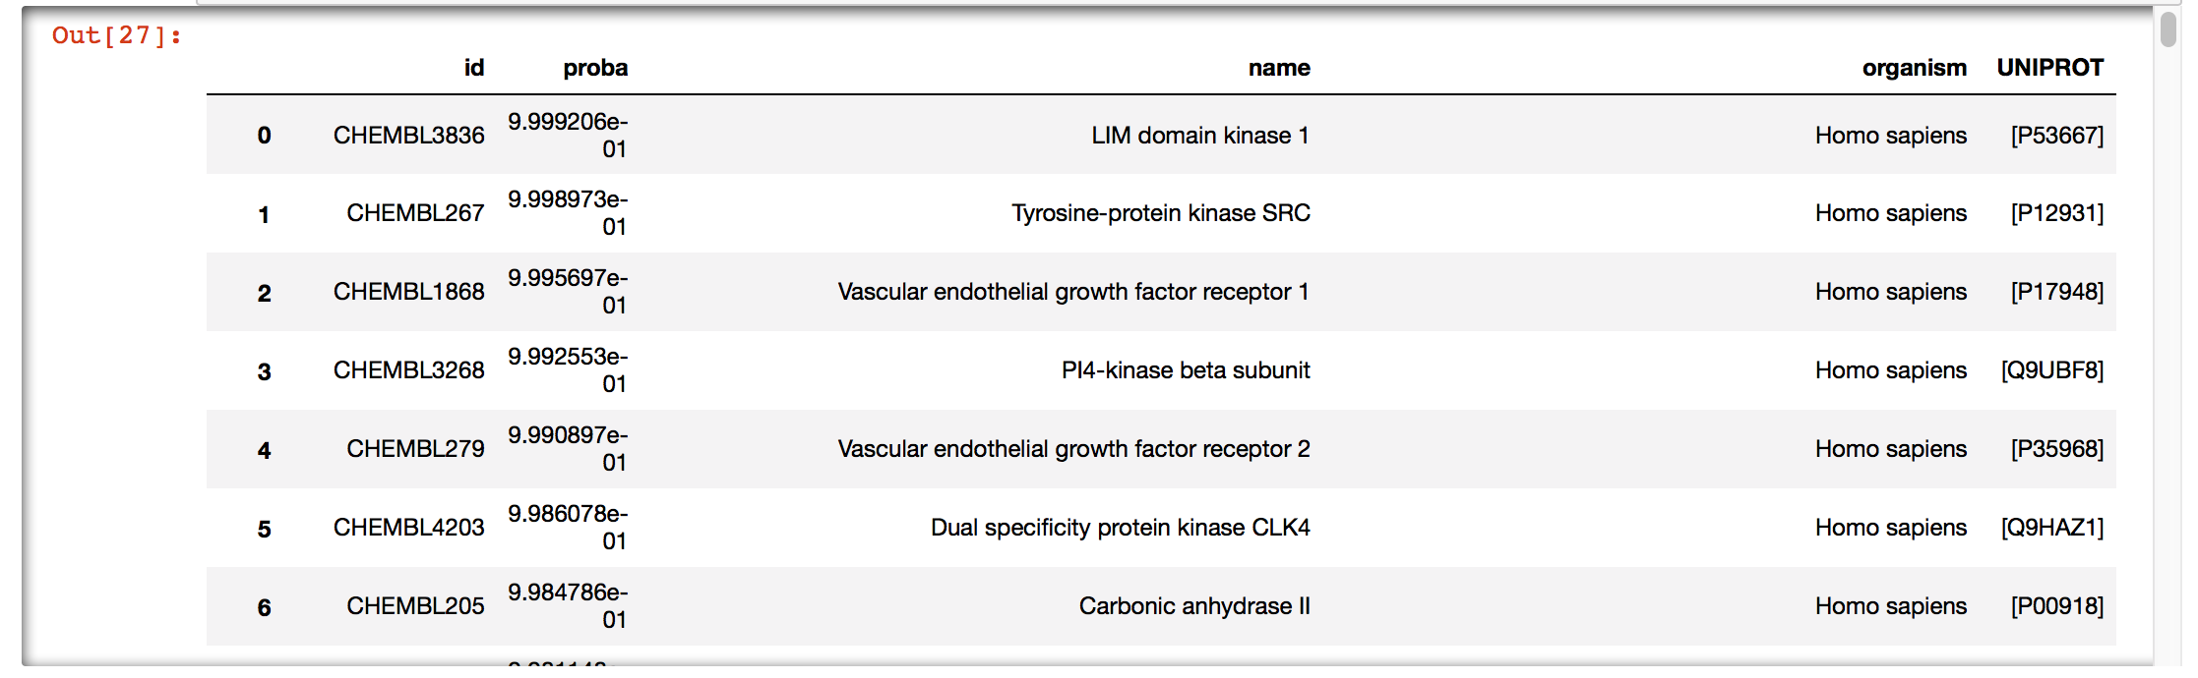
g
Series 3 Target Identification - Ho
Top predictions mainly kinases and Carbonic Anhydrase.
Carbonic Anhydrase is know potential anti-malarial target (https://dx.doi.org/10.1016%2FS2221-1691(11)60034-8) but selectivity over human enzyme is potential liability
Not possible to predict P. falciparum target kinase but some are known (https://doi.org/10.1046/j.1432-1327.2001.02403.x), but clearly off-target activity may be an issue

Slide 13
g
Series 3 Target Identification - Ho
Inverse docking against Pf kinases
Dock OSM-S-106 against all Pf essential (Lucet, Future Med. Chem 2012) kinases, using both crystal structures and homology models.
Docking performed with smina, an Autodock Vina variant, using the Vinardo scoring function and flexible side chains. This is an aggressive approach, with higher sensitivity but also higher false positives.
Top results confirmed visually.

Slide 14
g
Series 3 Target Identification - Ho
Kinase Production
Funded collaboration with University of Kansas Core Labs.
Top two crystal structures from inverse docking, PfA-R (Protein Kinase A, regulator domain) and CLK1 kinase, currently being cloned and prepared for protein production.
We will crystallize kinases with OSM-S-106 and other hits.
We can also use purified protein for biochemical and binding assays.

Slide 15
g
Series 3 Target Identification - Ho
Suggested Actions
Test against P. falciparum and human Carbonic Anhydrase
Continue to explore P. falciparum kinase targets
  Would be better test more than just MMV025100
  Should we be thinking about developing a kinase inhibitor set that might be directed towards non-human targets (not just plasmodium)?

Slide 16
g
Griffith Uni – Series 4 Ureas and Carbamates

Slide 17
g
Planned Targets at MCPHS – Chase Smith
Target #1
May require protection / deprotection strategy for triol.
Target #2
Return to Scaffold Hop Ideas
Target #3

Slide 18
g
Pharmacophore Competition
Original competition was run, using test dataset that was not public. Winners established Sept 2017 (OSM_To_Do_List#538).
Test dataset has just been published (June 11th 2018)
DOI: 10.1038/s41598-018-26819-1
We should now use the new data to refine the existing models further.
Aim: be predictive about what to make – i.e. proposed structures are(not) likely to be potent.
If all models can be revised, we should co-publish.
Additional need for paper: structures docked with homology model

Slide 19
g
Other Action Items for July/Aug
Need second email newsletter, and 5-6 news items to go in (Mat, others?)
Volunteers for a video newsletter, and to trial automated captioning.
Tech Ops wiki needs content dragged in from openwetware and elsewhere (Mandrake?)
Must start Meetings/Publicity/Talks Repo (Mat)
Too many Issues open, needing to be folded into wiki and closed (Mat, everyone) – must avoid orphaning of discussions.
Public posting of Conor Graham LSF/fluorination work, followed by shipping compounds to Rob Britton for LSF.
Clarity on Liver Stage Data and Eudysmic Ratio of OSM-S-218 (Series4#35 - David)

Slide 20
g
Summary on How to Provide Suggestions/Input
Now, in this meeting (recorded)
On relevant Github issue pages (best)
On your own favoured blog/site, and then ping OSM (Twitter, or email).
Directly via email but please ensure that comments/contributions can be placed into the public domain with attribution.

