Slide 1
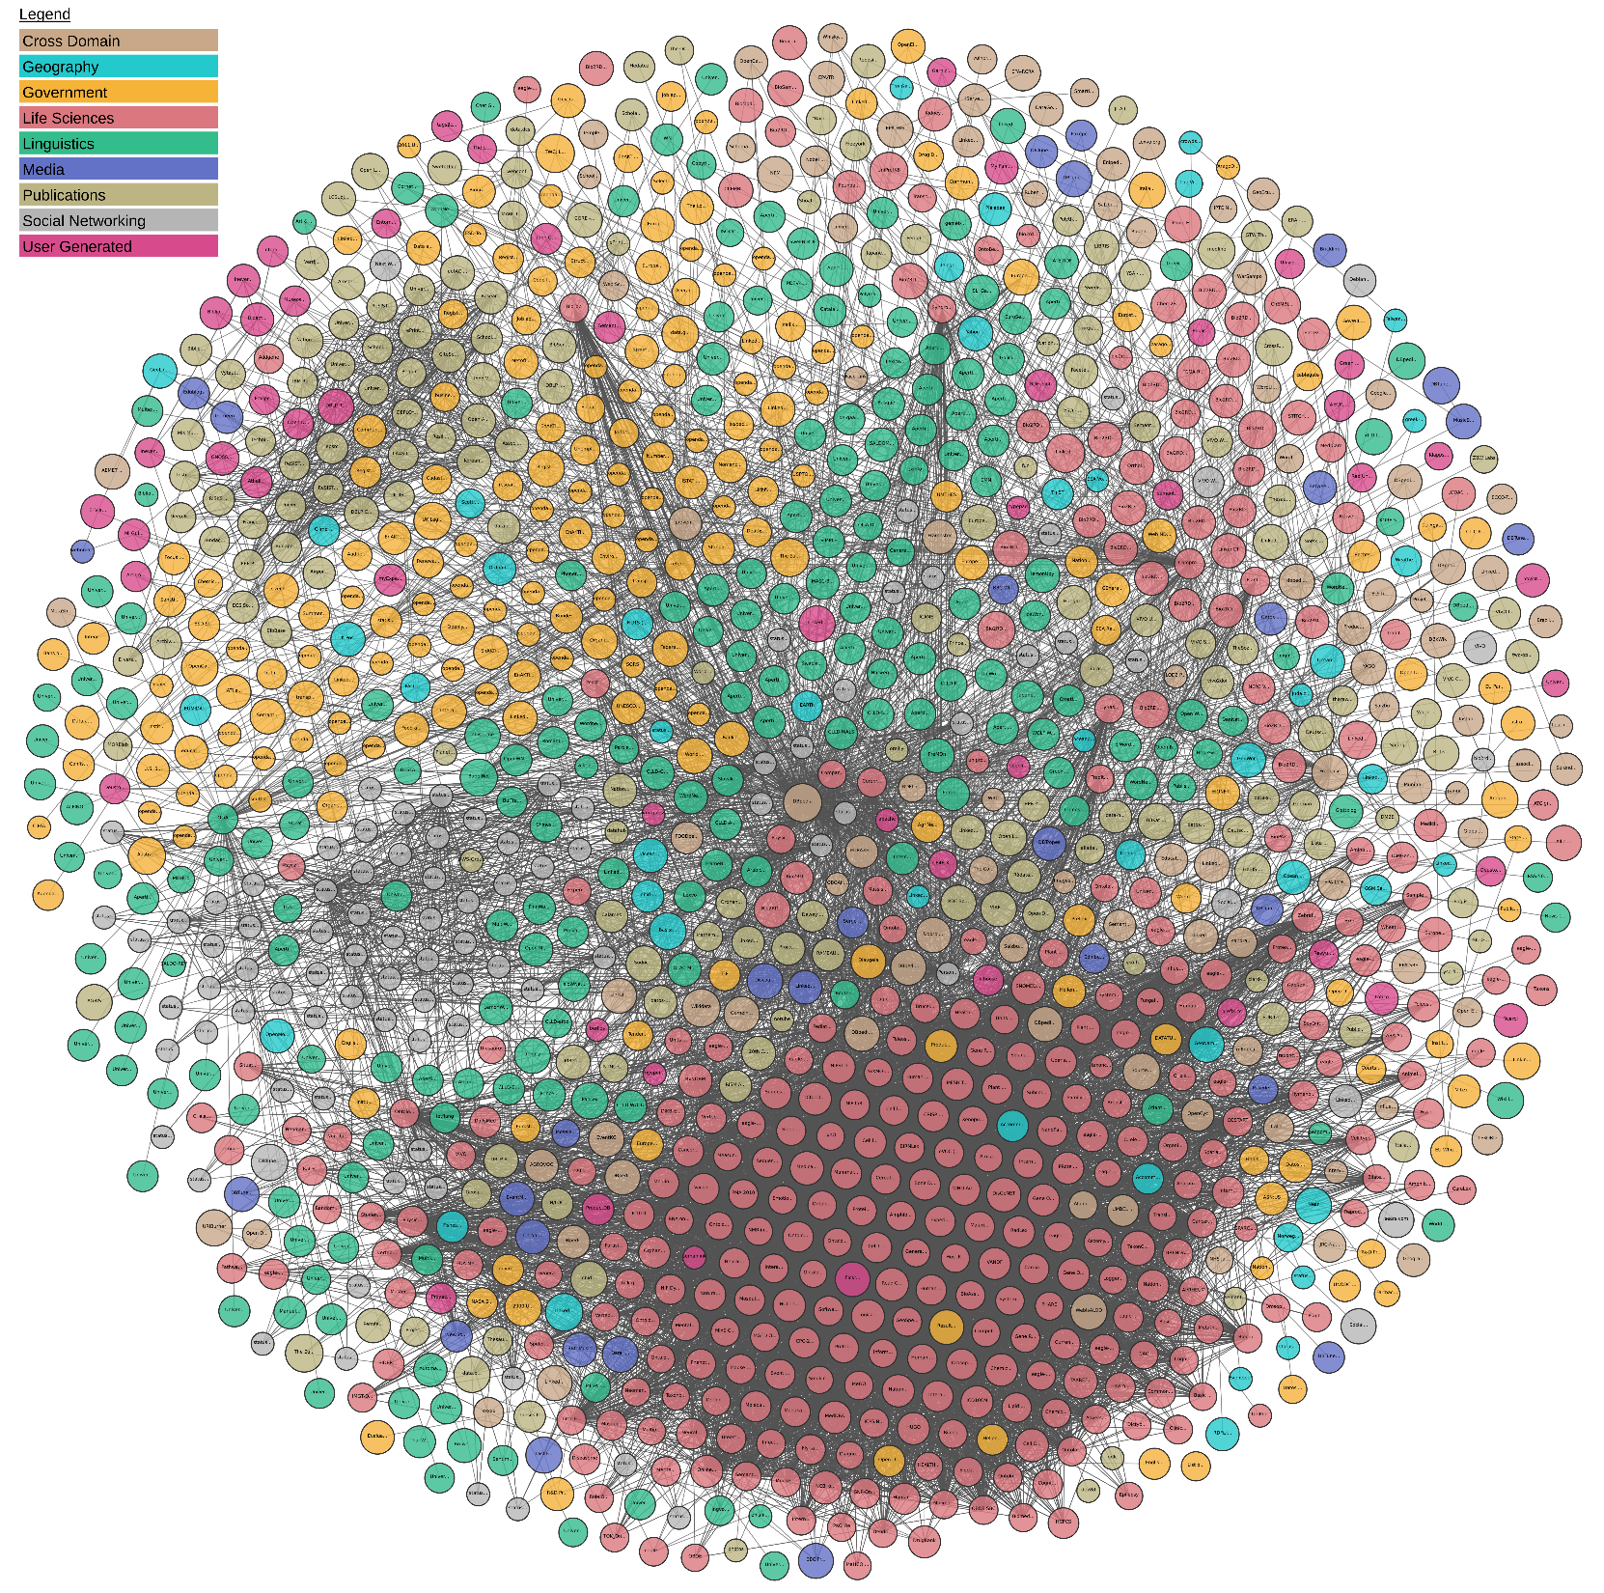
TAXREF
Linking Open Data cloud diagram, 2019. J.P. McCrae, A. Abele, P. Buitelaar, A. Jentzsch, V. Andryushechkin and R. Cyganiak. http://lod-cloud.net/

