Slide 1
I want to start with a story…
Notes:
I want to start with a story…

Slide 2
You
Your Friend
Notes:
Imagine that you and a friend are on a walk. You’re both somewhat unfamiliar with the area.
Suddenly, in the middle of the sidewalk, you encounter a fire hydrant
-- Image Reference
http://www.iconsdb.com/black-icons/fire-hydrant-icon.html

Slide 3
Notes:
In this case, you manage to go around because there is a driveway, but they are temporarily forced onto the street which is dangerous.

Slide 4
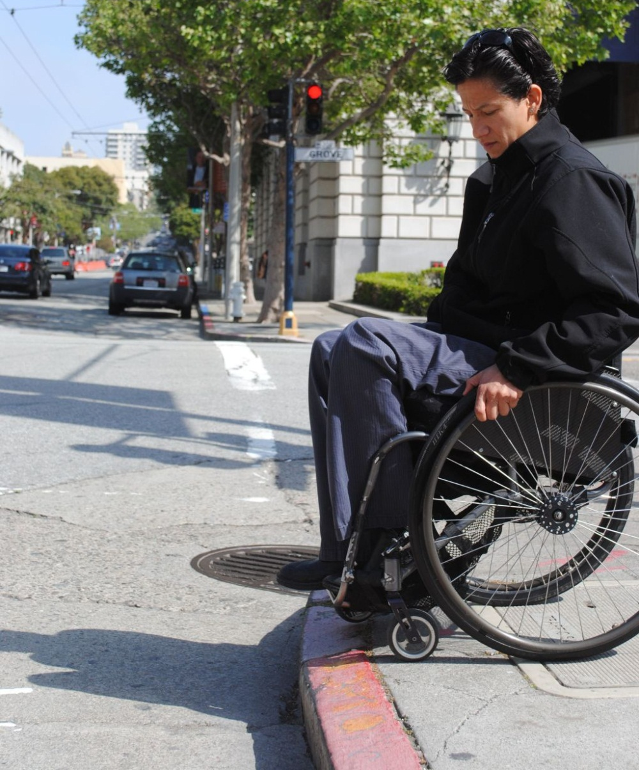
No curb ramp!
Notes:
Now, you get to the end of the block and discover that there is no curb cut. You are forced to turn around and find another way.
The problem is not only the sidewalks remain inaccessible, but there are currently few mechanisms to find out about the accessibility of a route in advance

Slide 5
The problem is not just that there are inaccessible areas of cities, but also that there are currently few methods to determine them a priori
No curb ramp!
Notes:
Now, you get to the end of the block and discover that there is no curb cut. You are forced to turn around and find another way.
The problem is not only the sidewalks remain inaccessible, but there are currently few mechanisms to find out about the accessibility of a route in advance

Slide 6
“
”
The National Council on Disability noted that there is no comprehensive information on “the degree to which sidewalks are accessible” in cities.
National Council on Disability, 2007
The impact of the Americans with Disabilities Act: Assessing the progress toward achieving the goals of the ADA
Notes:
U.S. National Council on Disability noted that they could not find comprehensive information on the “degree to which sidewalks are accessible”
---
National Council on Disability. (2007). The impact of the Americans with Disabilities Act: Assessing the progress toward achieving the goals of the ADA.

Slide 7
Two Goals
Invent new methods to gather information on the accessibility of the physical world at unprecedented levels
Build new types of accessibility applications never before possible with this data

Slide 8
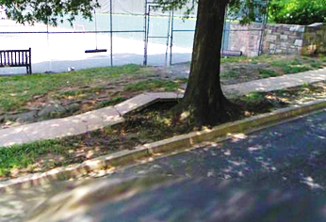
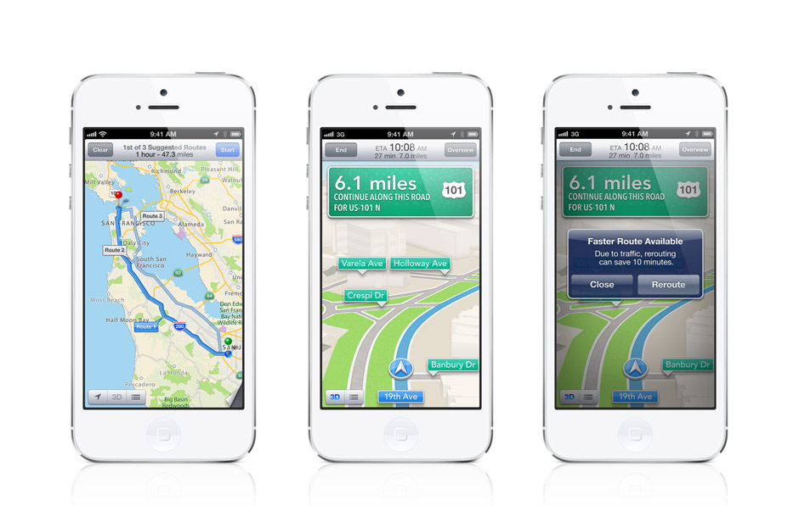
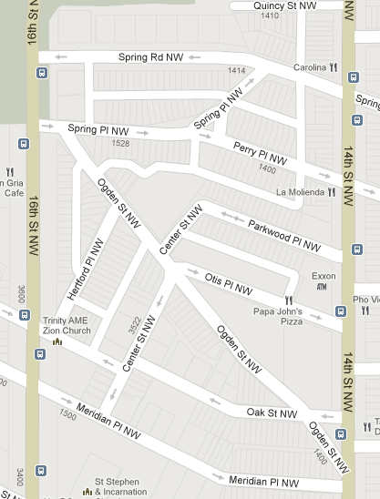
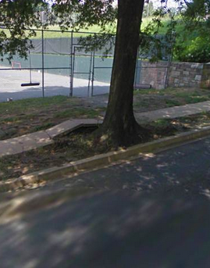
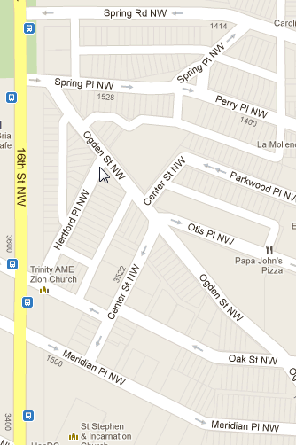
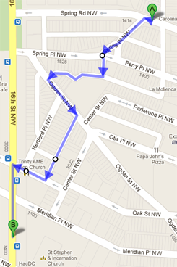
Route Recommendations Based on Ability
1st of 3 Suggested Routes 16 minutes, 0.7 miles, 1 obstacle
1st of 3 Suggested Routes 16 minutes, 0.7 miles, 1 obstacle
Suggested Route 1 7 mins, 0.3 miles remaining, at obstacle 1
A
A
Surface Problem Avg Severity: 3.6 (Hard to Pass)
Click to rate or reclassify
Route 1
!
Route 2
!
Click to rate severity
!
!
Surface Problem
Avg Severity: 3.6 (Hard to Pass)
Recent Comments:
“Obstacle is passable in a manual chair but not in a motorized chair”
!
Take picture
B
Upload note
Routing for: Manual Wheelchair
Routing for: Manual Wheelchair
Your location

Slide 9
