Slide 1
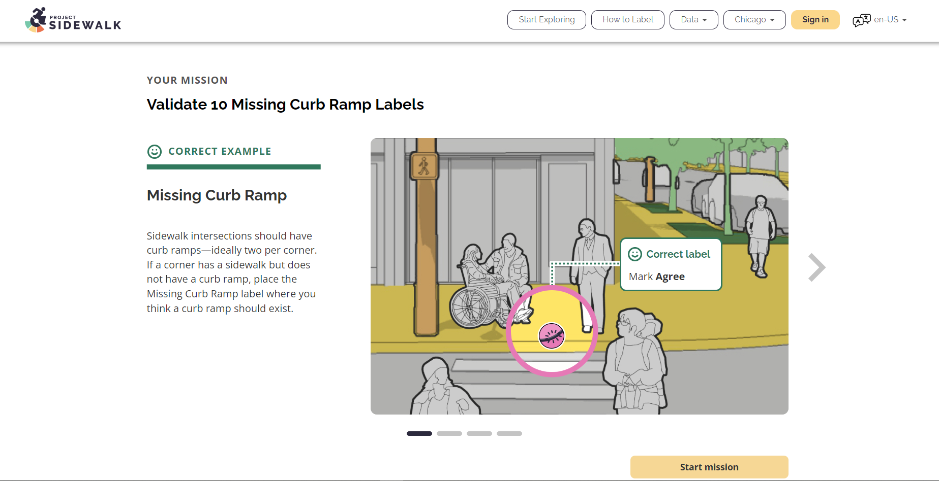
Could probably reduce this gap by 50-75%
Move this Start mission button in line with the banner indicators
Move this left so that it is indented as much as the start mission button on the right

