Slide 1
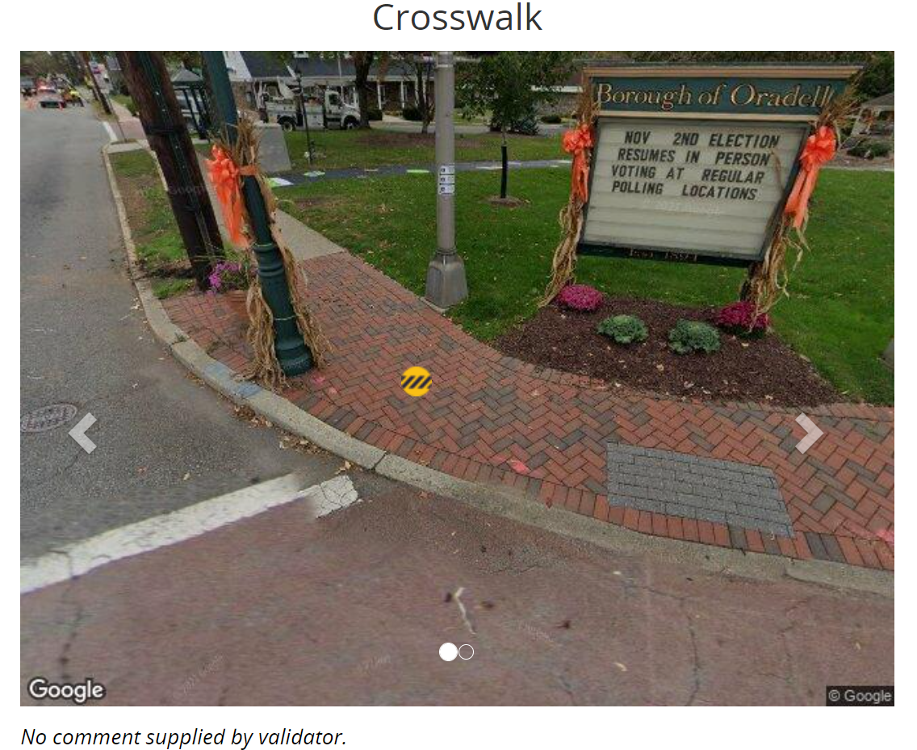
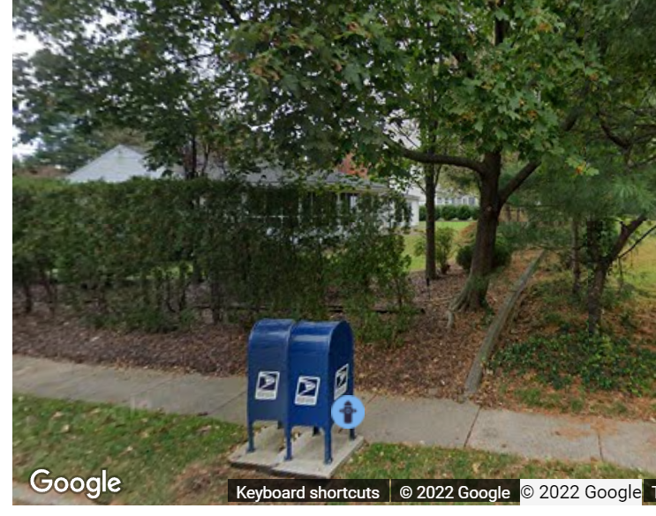
Obstacle
Validator’s comment: this is not a crosswalk
Validator’s comment: this mailbox is not on the pedestrian path

