Slide 1
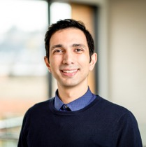
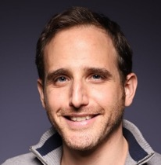
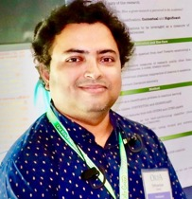





The FIRST Shared Task on Multi-Perspective Scientific Document Summarization
SDP@COLING 2022
MuP 2022:
The FIRST Shared Task on
Multi-Perspective Scientific Document Summarization
SDP@COLING 2022
Arman Cohan¹
Guy Feigenblat²
Tirthankar Ghosal³
Michal Shmueli-Scheuer⁴
3
4
1
2

Slide 2
Summarization of Scientific documents
Generating summaries of scientific documents is challenging
  Documents are typically long and require domain expertise
Most existing scientific summarization datasets have a single gold summary
Only one gold summary fails to capture multiple perspectives
Systems trained on single gold summaries may fail to capture salient points with regards to specific perspectives/facets

Slide 3
MuP: Multi-Perspective Scientific Document Summarization
Shared task on Scientific Document Summarization with the following goals:
  Make progress towards scientific document summarization
  Explore methods that can generate multi-perspective summaries
  Help robust training of models
    Capture different types of possible summaries
  Potential for controlling generation towards specific perspectives

Slide 4


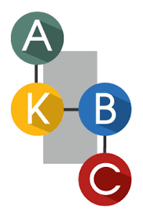


MUP Dataset
Dataset from OpenReview
    ML/NLP Related conferences
Based on Peer Reviews

Slide 5
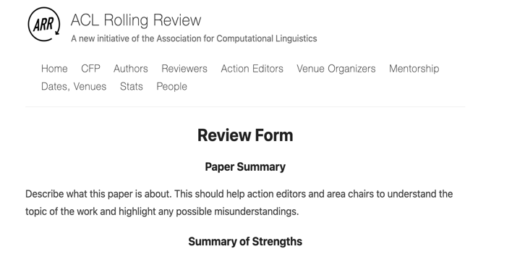
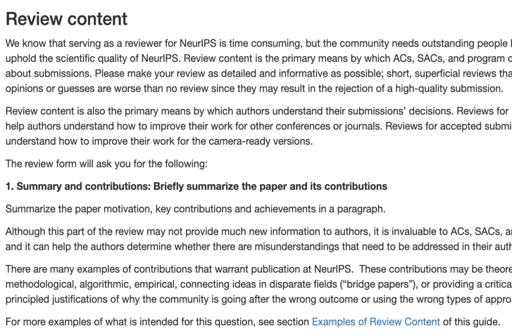
Dataset – Collection & creation
Extract common fields from OpenReview:
  Title, Author, Summary, Review
If Summary field does not exist use the first paragraph of the review
Use automated filters to remove subjective summaries or criticism
Human evaluation showed 95% accuracy of the filters

Slide 6

MUP Dataset
12K total papers
27K summaries
  On average 2.57 summary per paper
Available on our github repo and also on Huggingface Datasets
https://github.com/allenai/mup
https://huggingface.co/datasets/allenai/mup

Slide 7
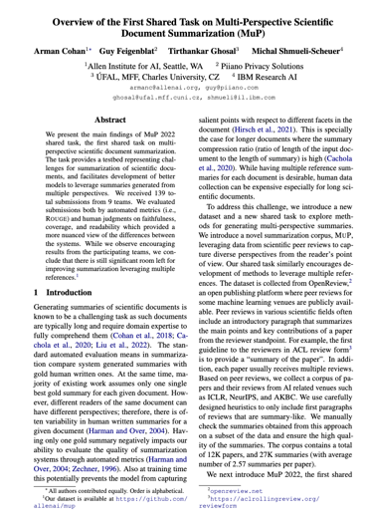
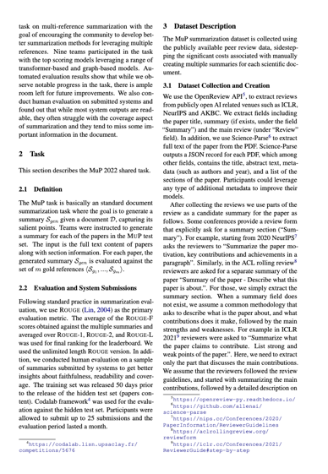
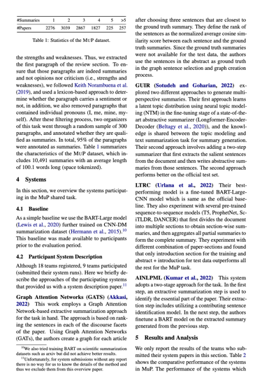
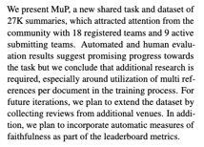
The task format
Given a scientific paper, generate a summary
Summaries that capture reader’s viewpoint rather than author’s
Prior work shows qualitative differences between these two types of summaries (Cachola et al., 2020)

Slide 8
Evaluation
Quantitative Evaluation:
ROUGE
  ROUGE-1, -2, -L metrics.
  The average of the ROUGE-F used for leaderboard ranking
Human Evaluation:
Human evaluation on a sample of submitted summaries
  Faithfulness
  Readability
  Coverage

Slide 9
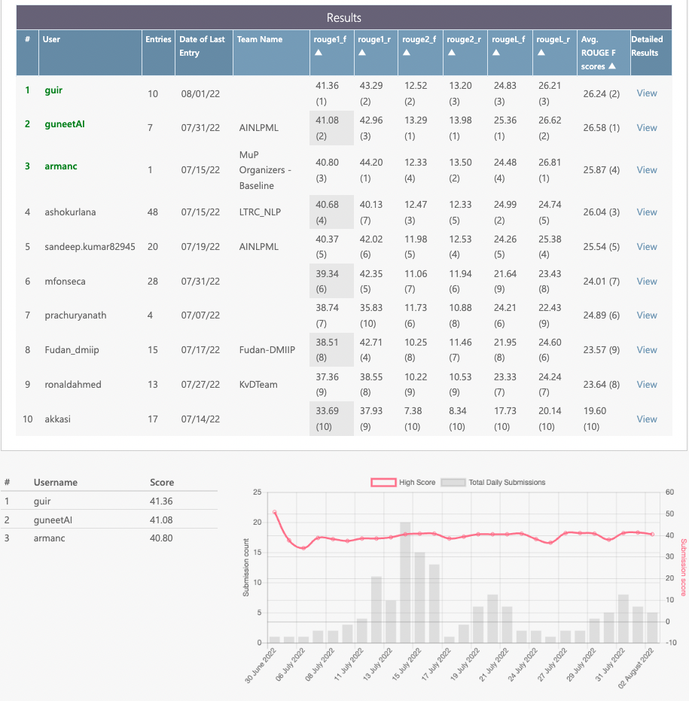

Leaderboard
We provide a leaderboard for the shared task to facilitate participation and measuring progress
We use the CodaLab platform
https://codalab.lisn.upsaclay.fr/

Slide 10
Statistics of participation
  9 participating teams
  100+ submitted runs
  4 system reports and presentations

Slide 11
BASELINE and participating systems
Stay tuned for select system presentations after this session
Also checkout virtual posters
We provide a simple BART baseline for the task
  BART-Large trained on CNN/DM summarization dataset
Variety of approaches explored by participating systems:
  Extractive approach based on Graph attention networks (Akkasi, 2022)
  Two stage extractive + abstractive, Neural Topic Model with LED: GUIR (Sotudeh and Goharian, 2022)
  Exploration of various Seq2Seq pretrained methods: LTRC (Urlana et al., 2022)
  Structure-aware extractive approach + Abstractive approach: AINLPML (Kumar et al., 2022)

Slide 12
Overview of Results

Slide 13
Leaderboard results
Overall ROUGE scores were high, suggesting good progress towards the task
The ROUGE performance difference between systems were small

Slide 14
Leaderboard results
Overall ROUGE scores were high, suggesting good progress towards the task
The ROUGE performance difference between top systems were small
We perform additional human evaluation to gain better insights

Slide 15
Human evaluation
We annotated 20 randomly selected papers along with all system submissions for those papers (systems with submitted reports)
Manual annotation was challenging: ~40 minutes on avg per paper for domain experts
We rate the systems on a Likert scale (1-5), w.r.t three main qualities:
  faithfulness, readability, coverage

Slide 16
Human evaluation – Detailed comments
Consistent with the automated evaluation results, AINLPML outperforms the rest of the systems
GATS achieves highest faithfulness and lowest Readability. Expected as their approach is extractive
GUIR and AINLPML achieve highest coverage scores
Readability of abstractive systems is typically high.
Team / System | Faithfulness | Readability | Coverage
BART (baseline) | 4.1 | 3.6 | 3.9
LTRC | 4.4 | 4.6 | 3.6
GATS | 5.0 | 2.7 | 2.4
GUIR | 4.1 | 4.2 | 3.9
AINLPML | 4.4 | 4.7 | 3.9
Notes:
For baseline it suffers from incomplete last sentence (could be fixed by postprocessing)

Slide 17
Insights
BART-CNNDM was a strong baseline!
Combined Extractive + abstractive methods performed well
Teams made good progress towards faithfulness & readability
Coverage remains an open issue
Using specific properties of scientific papers (e.g., structure) can help improve summarization quality
Some teams performed interesting analysis on which sections to use as input and found that the introduction section is one of the most informative ones.

Slide 18
INSIGHTS
No team explored scientific entities (tables, figures, equation, citations, etc.) or text surrounding them.
The overall results were not much higher than our provided baseline
  Still a lot of room for improvement
Most systems usually treated the task as a general scientific summarization problem
We did not see much focus on multi-perspective aspect of the dataset/task
Notes:
Some of the gold summaries referred to specific results about tables or equations, which might further improve results.

Slide 19
What’s next?
Stay tuned for MuP-2023!
We are exploring possible extensions/improvements:
Data expansion from other sources
Additional fine-grained annotations
Controlled generation w.r.t different perspectives

Slide 20
Thanks!
Please join the shared task presentations happening right after this
https://meet.google.com/var-bjro-cgp
Also please check out the virtual poster sessions

