Slide 1
SW360
Change API for dependencies
How to use these APIs?
https://github.com/eclipse/sw360/issues/1538
A new function to make the dependency management of a project more flexible

Slide 2
Contents
01
Background
02
GUI for dependencies
03
API for dependencies
04
Migrate database

Slide 3
1. Background
Mr Qiu creates a new issue
https://github.com/eclipse/sw360/issues/1538

Slide 4
1. Background

Slide 5
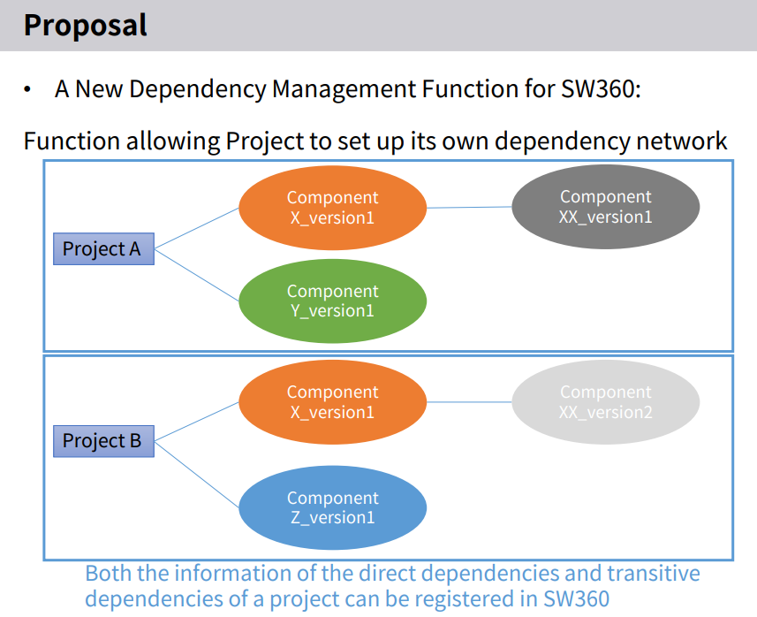
1. Background

Slide 6
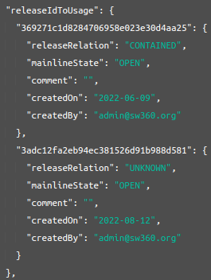
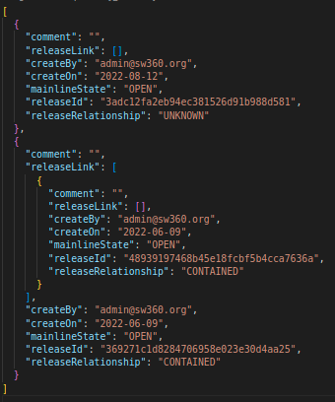
1. Background
Way of storing dependencies in project table (current)
• Way of storing dependencies in project table (proposal):
Store only direct dependencies.

Slide 7
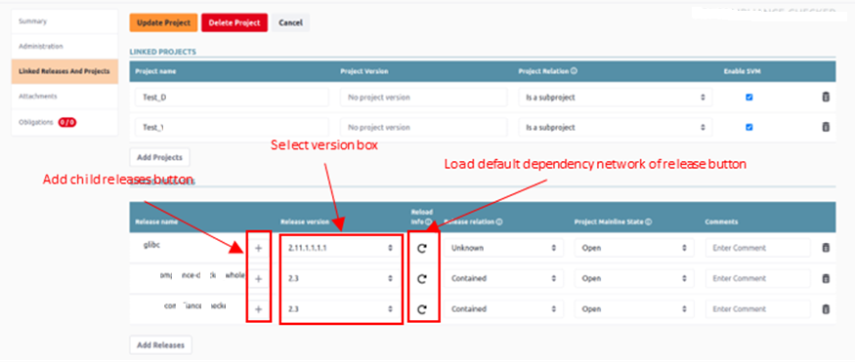
2. GUI for dependencies
Change the GUI of the Linked Releases And Projects tab (at Edit project page)

Slide 8
2. GUI for dependencies
Keep the GUI of related functions, update the logic in each related function to make it compatible with new Dependency Network features.
Related functions
License Clearing tag
Clearing Request
ECC tag
Rest API function
Import/Export function
Change Log function
SPDX import

Slide 9
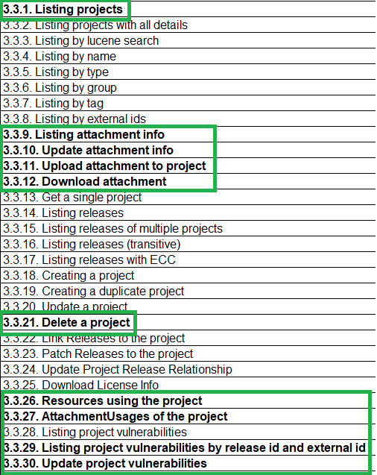
3. API for dependencies (no change)
10/30 API: No change, you can use this API just like before.

Slide 10
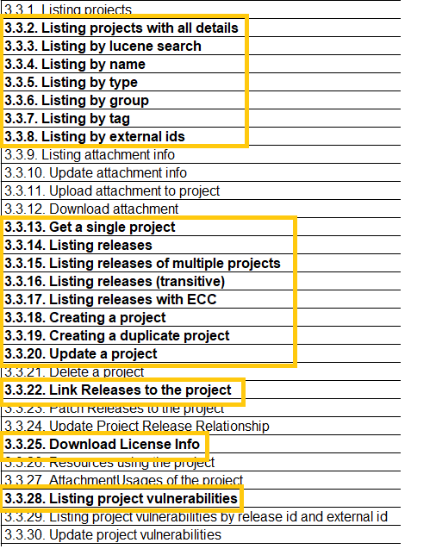
3. API for dependencies (updated)
18/30 API: Updated

Slide 11
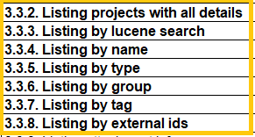
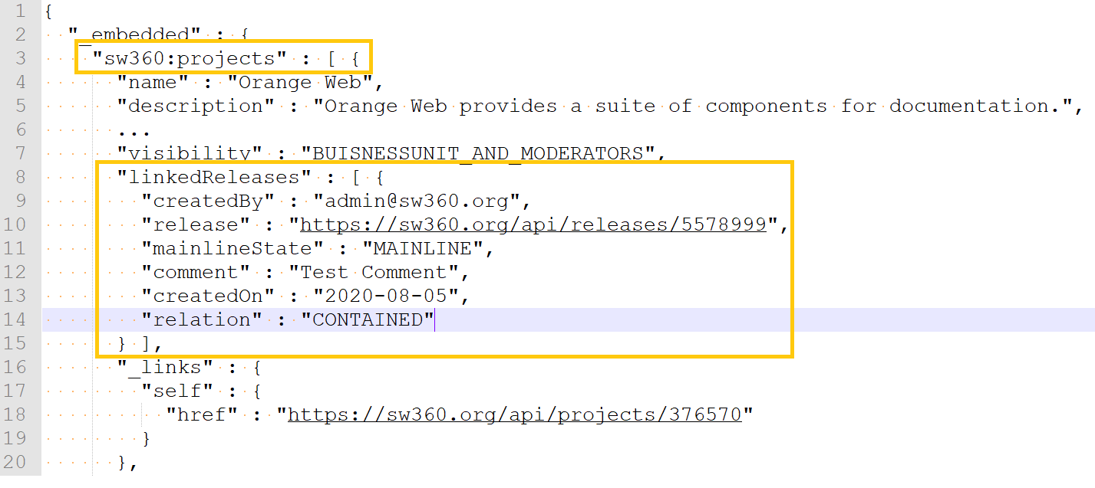
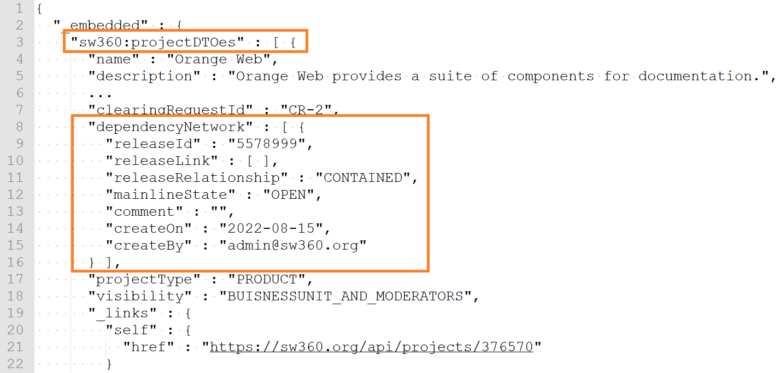
3. API for dependencies (updated)
Request Body: No change
Response Body:

Slide 12
3. API for dependencies (updated)
Request Body: No change
Response Body: No change the structure, just change the content to be compatible with new Dependency Network features.

Slide 13
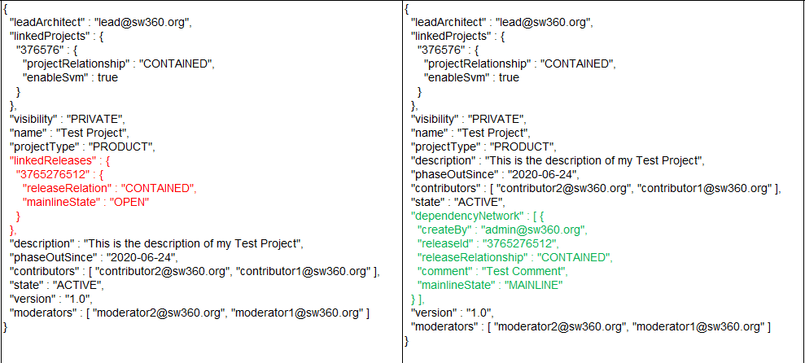
3. API for dependencies (updated)
Request Body:
BEFORE
AFTER

Slide 14
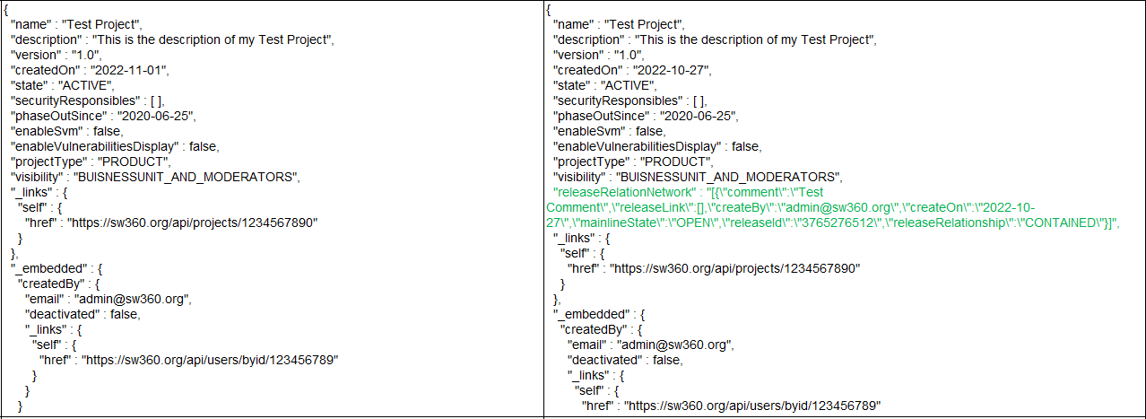
3. API for dependencies (updated)
Response Body:
BEFORE
AFTER

Slide 15
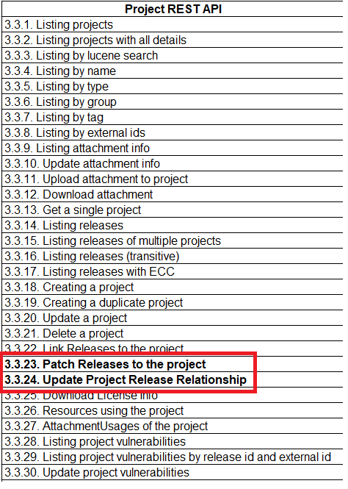
3. API for dependencies
2/30 API: Removed. We can not use these APIs in the new field and format.
In case, you would like to:
Patch Releases to the project
Update Project Release Relationship
Please use the “3.3.20: Update a project” API instead.

Slide 16
3. API for dependencies (NEW)
Get project’s dependency network.

Slide 17
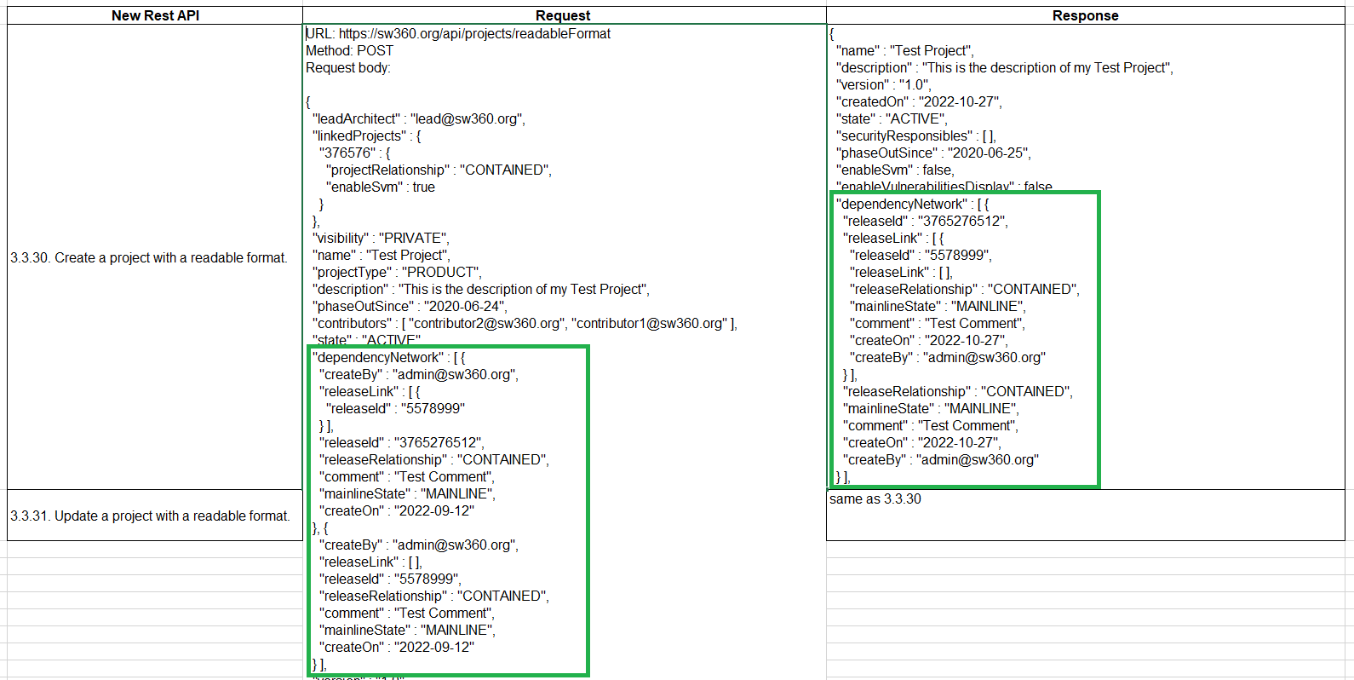
3. API for dependencies (NEW)
Create a project with a readable format. (POST method)
Update a project with a readable format. (PATCH method)

Slide 18
4. Migrate database
Created a migrate script to convert the content of the releaseIdToUsage field to releaseRelationNetwork field
https://github.com/toshiba/sw360/blob/release/dependency-network-management/scripts/migrations/052_migrate_project_dependency_network.py

Slide 19
Thank you

