Slide 1
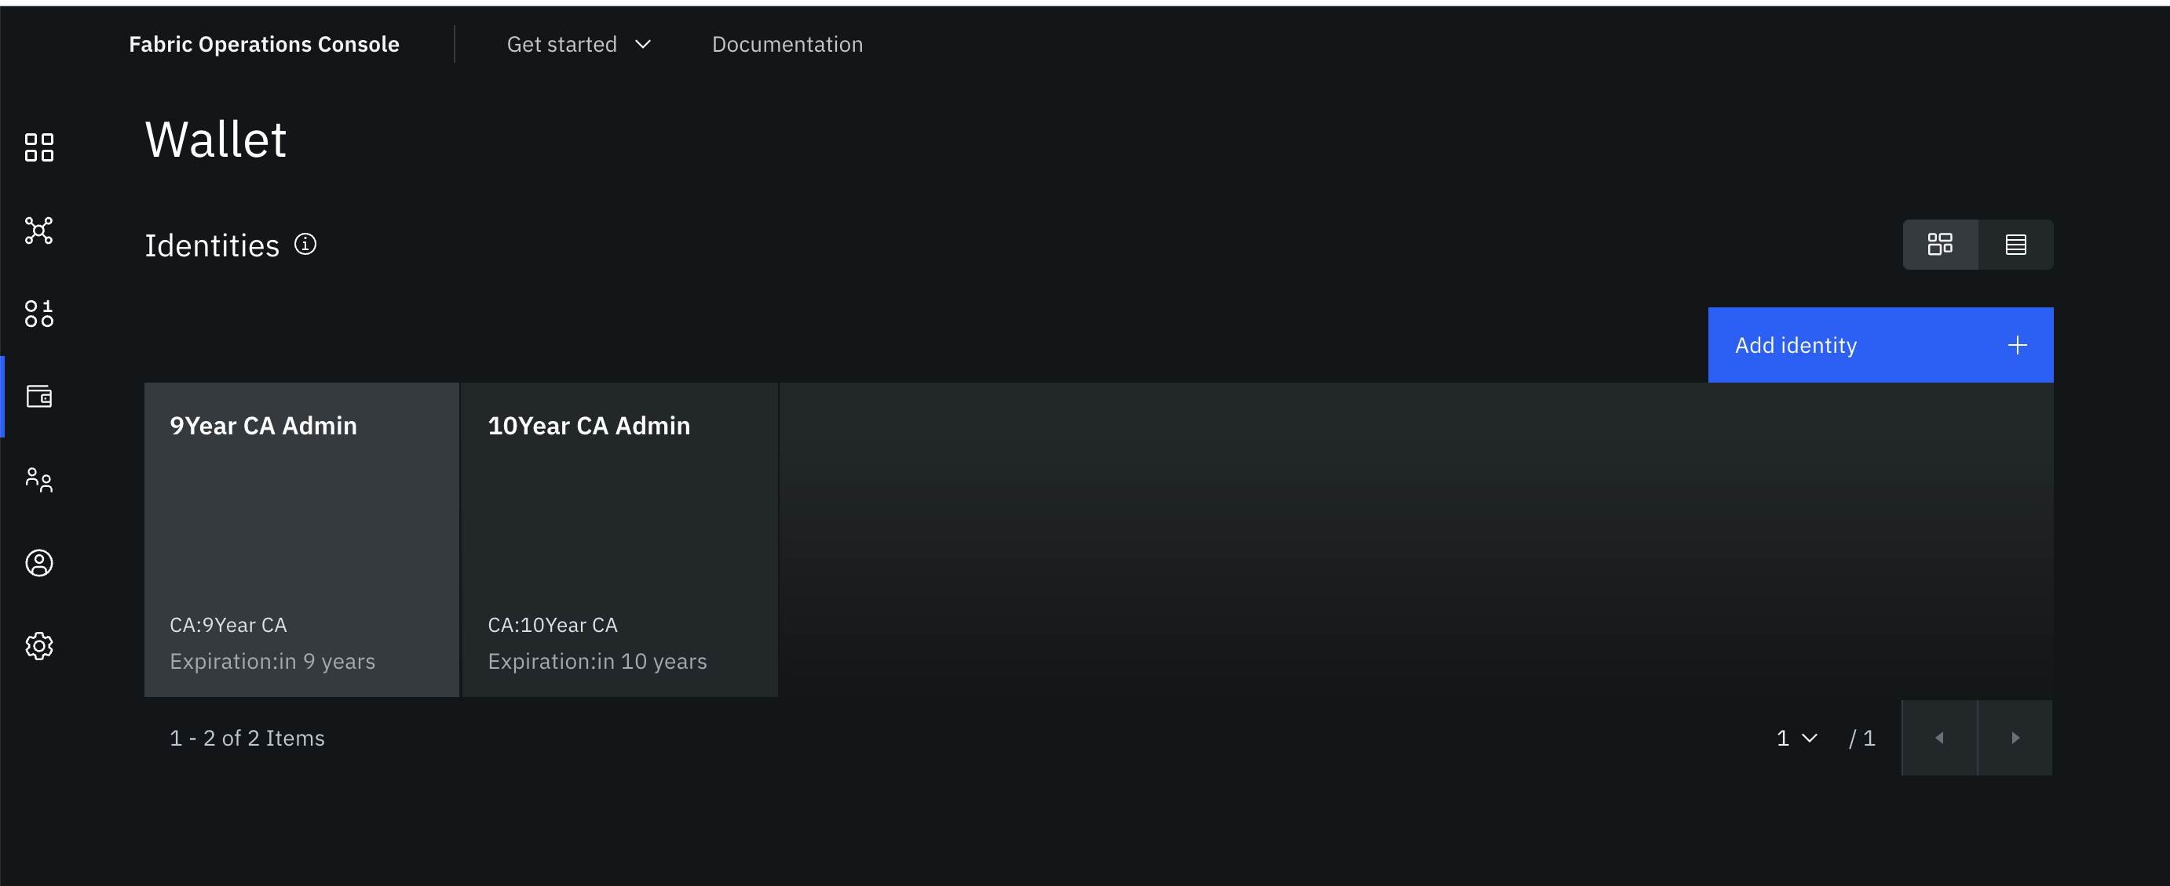
Wallet List Before Creating a 50 Year Expiration Certificagte

Slide 2
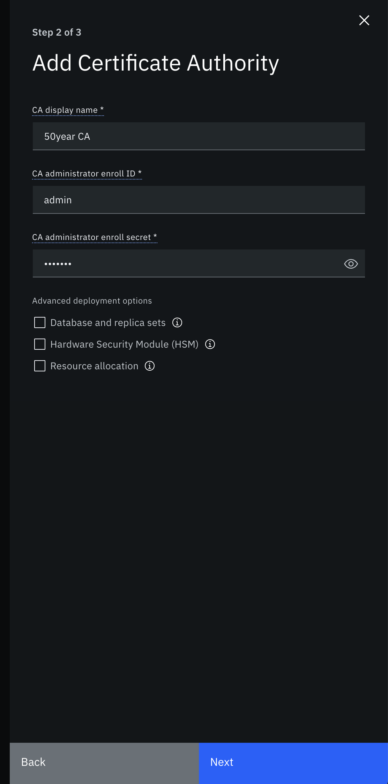
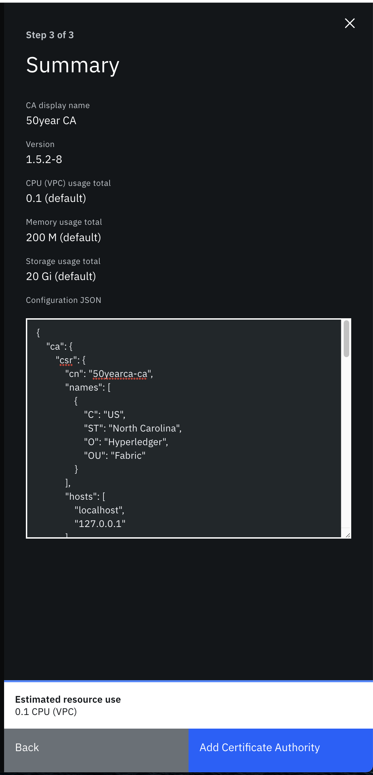
Create a CA to issue 50 Years Expiration Certificates
JSON File for CA creation

Slide 3
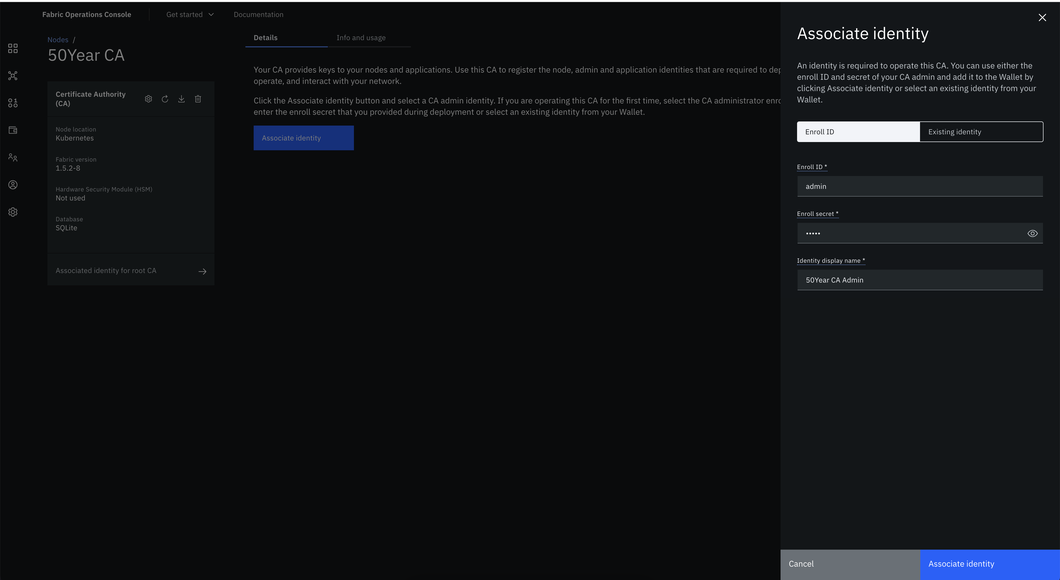
Associate and Issue Certificate for CA Admin

Slide 4
Wallet List After Creating a 50 Year Expiration Certificagte

