Slide 1
Bitcoin Price Prediction using Machine Learning
Guided By
Ms. Jayshree Dev
Submitted By:
Rishabh Kedia - 1901106451
Sanjay Kumar Nayak - 1901106429
Manas Ranjan Munda - 1901106416
Shuvam Kumar Panda - 1901106435

Slide 2
Table of Contents
Introduction
Objective
Motivation
Our Approach
Convolutional Neural Network
Long Short Term Memory
Bidirectional Long Short Term Memory
Results
Conclusion

Slide 3
Introduction
What is a Bitcoin?
Bitcoin (BTC) is a virtual currency designed to act as money and a form of payment outside the control of any one person, group, or entity.
What is Sentiment Analysis?
- Sentiment analysis is the process of analysing online pieces of writing to determine the emotional tone they carry, whether they’re positive, negative, or neutral.

Slide 4

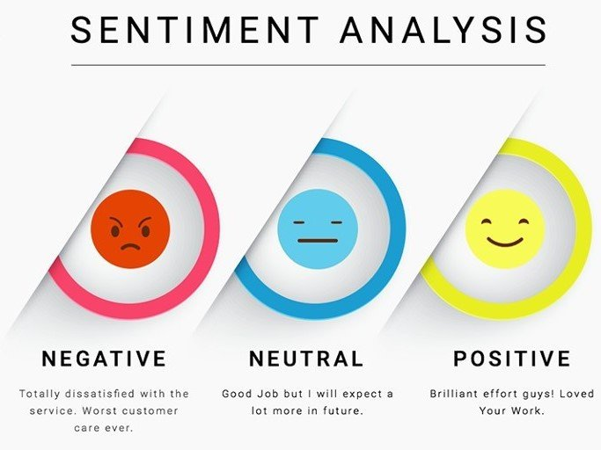

Slide 5
Objective
To predict Bitcoin price using sentiment analysis from Twitter dataset.
Twitter is a popular social media platform where users share their thoughts and opinions about a wide range of topics, including Bitcoin and other cryptocurrencies. The dataset of tweets related to Bitcoin can be used for sentiment analysis.
Bitcoin is a popular investment asset, and predicting its price can help investors make informed decisions about buying or selling. Accurately predicting Bitcoin's price can help investors make better investment decisions, leading to greater returns.

Slide 6
Motivation
The main motivation behind predicting Bitcoin price prediction includes:-
  Risk Management
  Trading
  Industry Development
In summary, the motivation behind predicting Bitcoin's price is primarily financial gain, but there is also a broader motivation to better understand the cryptocurrency industry and its potential impact on the global financial system

Slide 7
Our Approach
We are using four models Voting Classifier, CNN, Bi-LSTM and LSTM to predict the bitcoin price
Out of all the models that were tested, the Voting Classifier model was found to be the most accurate for predicting Bitcoin prices using sentiment analysis
Voting Classifier > CNN > Bi-LSTM > LSTM

Slide 8
Convolutional Neural Network(CNN)
CNN which is a type of neural network commonly used in computer vision tasks such as image recognition and classification
CNNs are composed of multiple layers, including convolutional layers, pooling layers, and fully connected layers
In the context of Bitcoin price prediction using sentiment analysis, a CNN model may be used to extract relevant features from the text data, such as sentiment or keywords, and use these features to make predictions about future Bitcoin prices

Slide 9
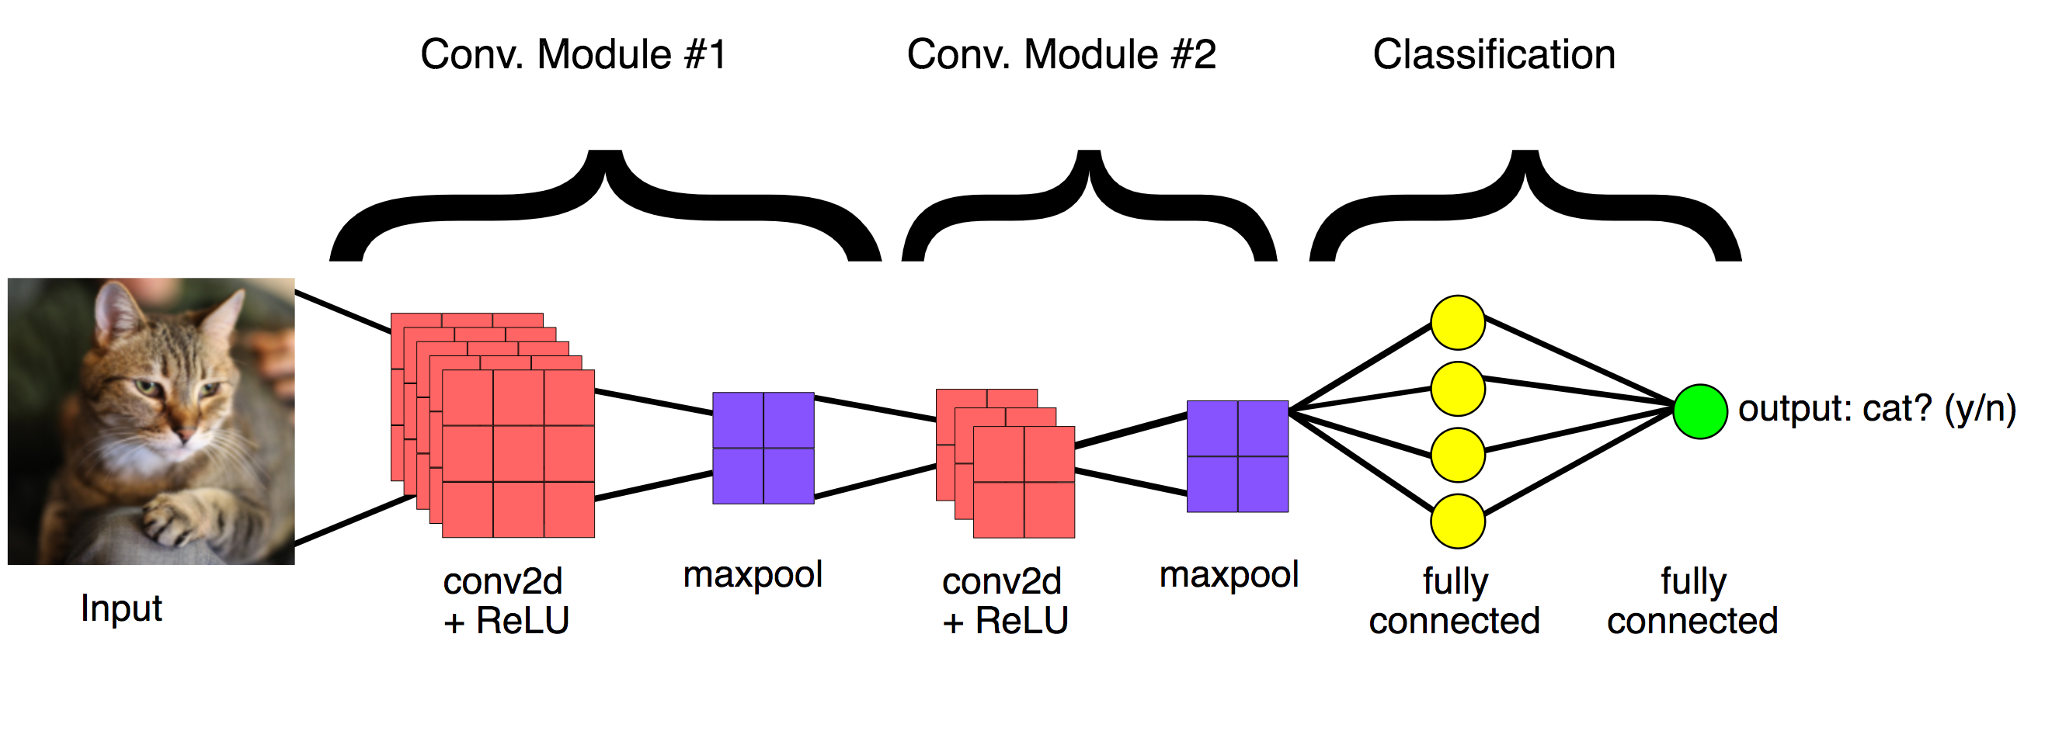
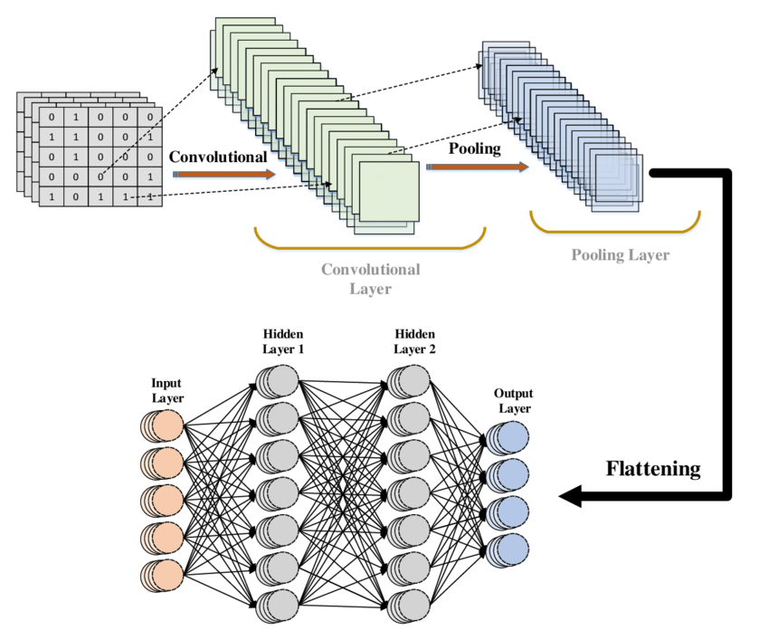
Convolutional Neural Network(CNN)

Slide 10
Long Short Term Memory(LSTM)
LSTM stands for Long Short-Term Memory, which is a type of recurrent neural network (RNN) architecture that is commonly used in natural language processing and time series analysis
Here's a general overview of how LSTMs can be used in sentiment analysis:
  Pre-Processing
  Tokenization
  Embedding
  Sequence Processing
  Output Classification

Slide 11
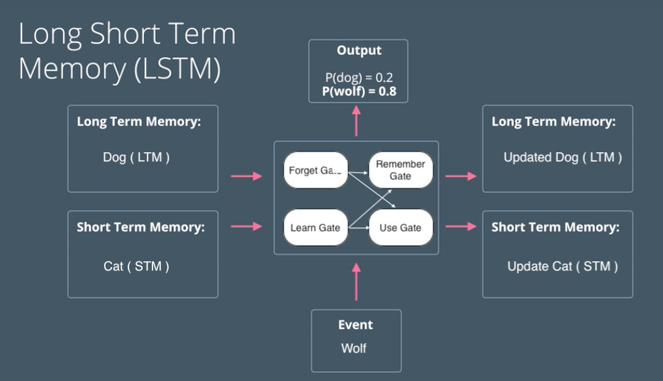
Long Short Term Memory(LSTM)

Slide 12
Bidirectional Long Short Term Memory
This is a type of recurrent neural network (RNN) architecture that is commonly used in natural language processing and speech recognition tasks. It is an extension of the LSTM model that allows the network to process input sequences in both forward and backward directions
During training, the forward and backward LSTM layers process the input sequence independently, and the final output of the Bi-LSTM network is obtained by concatenating the output of both the forward and backward LSTM layers.
In the context of Bitcoin price prediction using sentiment analysis, a Bi-LSTM model may be used to analyse historical Bitcoin prices and sentiment data over time, and use this information to make predictions about future prices. The sentiment data may be processed using word embeddings and fed into the Bi-LSTM model, along with the historical price data.

Slide 13
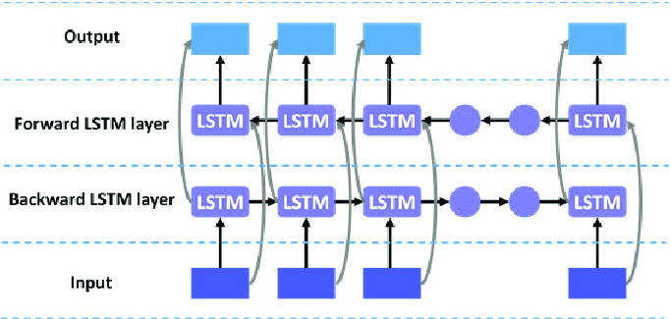
Bidirectional Long Short Term Memory

Slide 14
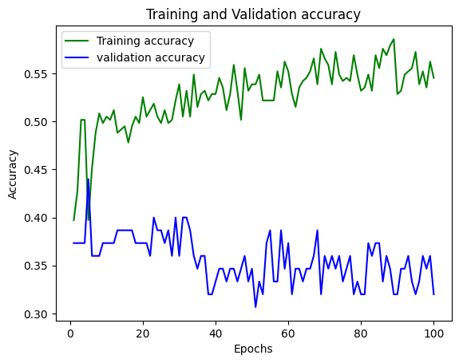
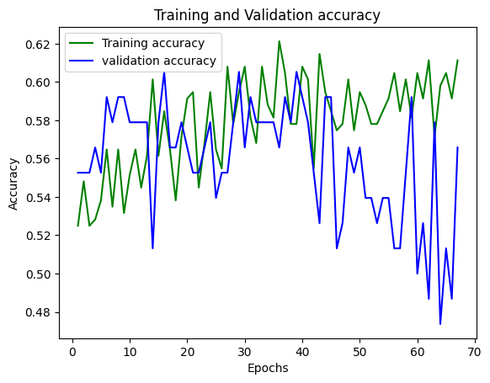
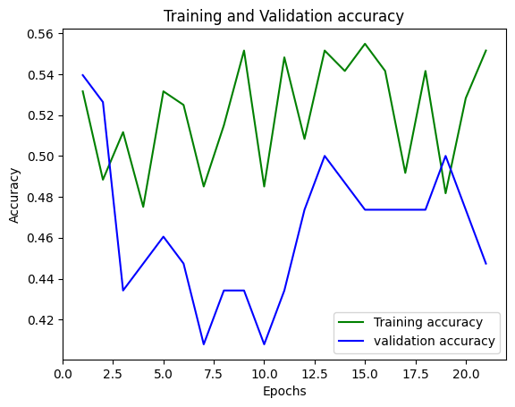
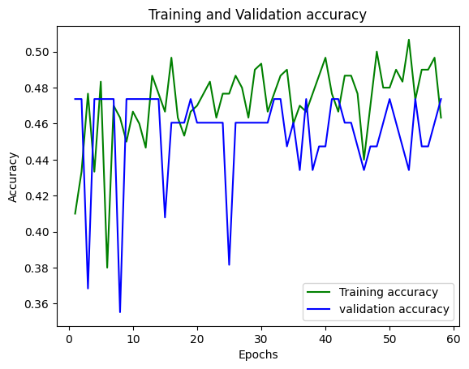
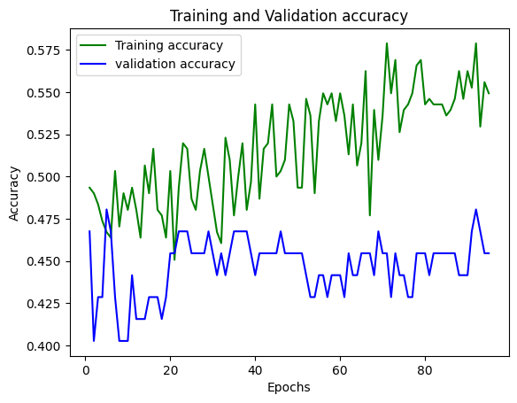
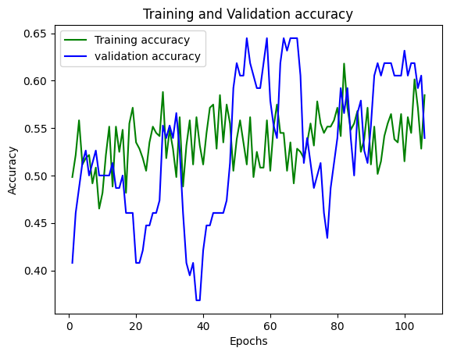
Results

Slide 15
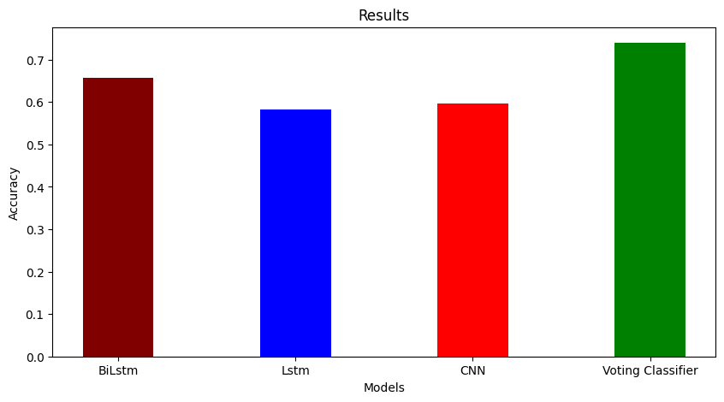
Comparison of Models

Slide 16
Conclusion
Our work compared the performance of a number of different neural models for predicting fluctuations in Bitcoin prices from Twitter tweet data
The underlying hypothesis of this work is that opinions expressed in social media can function as useful predictors of such fluctuations
Here, it was shown that a model based on a 2-layer CNN with a 2-day time lag and 3 lagged features performs reasonably well, with a 64.7% accuracy over 10 classes
The usage of LSTM model to predict the magnitude(accuracy = 38% ) and Trend (accuracy = 62%) of the fluctuation in bitcoin price, resulted in a total accuracy of 56.2%
The usage of Bi LSTM model to predict the magnitude(accuracy = 37.8% ) and Trend (accuracy = 65%) of the fluctuation in bitcoin price, resulted in a total accuracy of 57.2%
We combined the direction prediction of Bi LSTM with the magnitude prediction of the CNN algorithms and used this Voting Classifier to get 65.3% accuracy

Slide 17
References
Critien, Jacques Vella, Albert Gatt, and Joshua Ellul. "Bitcoin price change and trend prediction through twitter sentiment and data volume." Financial Innovation 8, no. 1 (2022): 1-20.
Abraham J, Higdon D, Nelson J, Ibarra J (2018) Cryptocurrency price prediction using tweet volumes and sentiment analysis
Agarwal A, Xia B, Vivash I, Rambo O, Pisonia RJ (2011) Sentiment analysis of twitter data. In: Proceedings of the workshop on language in social media (LSM 2011), pp 30–38
Baker M, Warbler J (2007) Investor sentiment in the stock market. J Econ Perspex

Slide 18
THANK YOU

