Slide 1
International Conference
On
Big Data, Machine Learning and Applications
(BigDML 2021)
December 19-20, 2021
Organized By: National Institute of Technology, Silchar
Paper ID: 96
Title: Revisiting Facial Keypoint Detection – An Efficient Approach Using Deep Neural Networks
Author(s) Name: Prathima Dileep, Bharath Kumar Bolla, Sabeesh Ethiraj
Author(s) Affiliation: UpGrad Education Private Limited, Mumbai, India., Salesforce ,India
Presented By: Prathima Dileep and Bharath Kumar Bolla

Slide 2
Presentation Content AGENDA
01
Motivation & Background
02
Problem Statement
03
Aim & Objective
04
Literature Review
05
Methodology & Analysis
06
Evaluation
07
Conclusion
08
Contribution to knowledge
09
Limitations & Future Recommendations

Slide 3
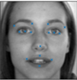
Motivation & Background
Introduction:
In computer vision, to extract facial information, localization of facial keypoints is an essential step.
Facial keypoints are the distinguishing characteristic points on the face.
Motivation:
Applications include computer interaction, emotion detection, biometric, drowsiness detection, security surveillance, facial dismorphology and so on.

Slide 4
Problem Statement
With the evolution of detection methods, the concentration was mainly on the improvement of model metric like RMSE, MAE. They have achieved state of the art metric values of 1.5. But huge model contributes to bigger model size and higher inference time

Slide 5
Research Goals
AIM:
Main Aim is to build the best, faster and lean neural network architecture
Objectives:
Is to build a Custom CNN model and two Deep Neural Network models with pre-trained weights of Mobile Net and NasNet architecture.
To evaluate the models with standard metrics of Root Mean Square Error (RSME), Inference Time and model size.
Check the impact of various augmentation and Imputation methods on prediction accuracy.
Evaluate Kerast-autotuner vs Manually tuned custom models

Slide 6
Research Questions
Is it possible to further reduce the model size and execution time with improvement in neural network architecture?
Will Data Augmentation and Imputation help in training the model for better metrics of RMSE?

Slide 7
Literature Review
Facial Keypoint Detection study is two decades old
Its approaches can be classified into
Traditional Approach (more details in next slide)
Deep Learning Based

Slide 8
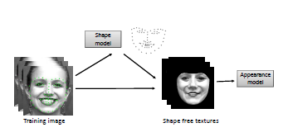
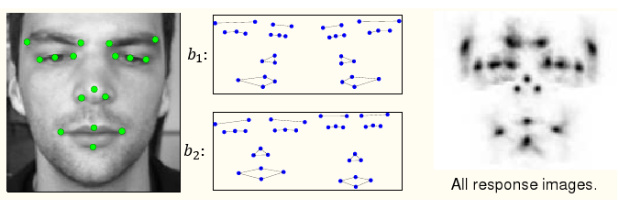
Literature Review Cont..
Traditional Approaches
Holistic Method Regression Based Method
Constrained Local Method

Slide 9
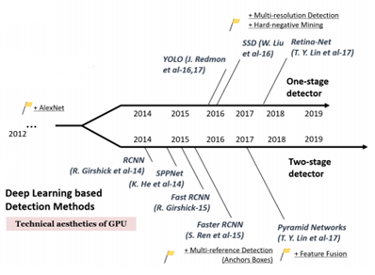
Literature Review Needs to be modified
Deep Learning Methods
Roadmap of Deep Learning Detection Methods

Slide 10
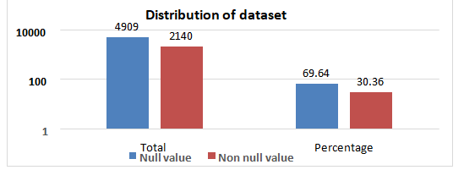
Methodology
DATASET:
Dataset is sourced from kaggle
There are 7049 images in the dataset representing 15 facial keypoints
Images are grayscale(one channel dimension) of size 96*96.
Data has null values and hence scope for imputation. The Null value distribution is

Slide 11
Methodology II
PROCESS FLOW
Data Preprocessing:
Data Imputation
FFI
KNN Imputer
Data Augmentation
Data Sourcing
Data Pre-Processing
Training
Data Modelling
HyperParameter Tuning
Testing
Finalization
Comparison

Slide 12
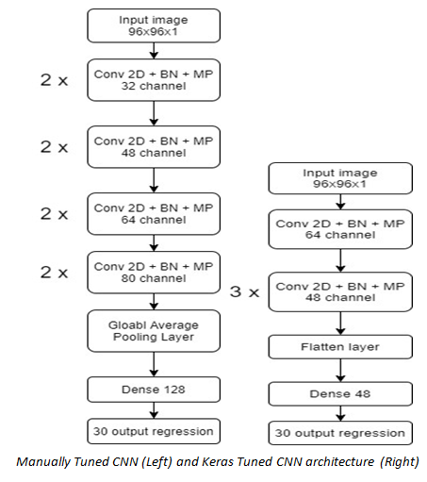
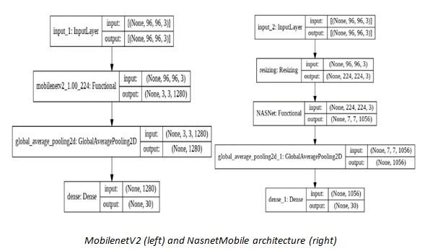
Methodology III
Models & Architecture
Custom CNN
Transfer Learning with MobileNetV2
Transfer Learning with NasNet
Optimization Techniques
Keras Tuner
Keras Transfer Learning and fine tuning

Slide 13
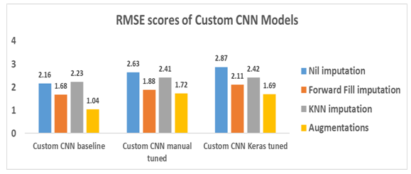
Evaluation I
Our Custom CNN manually tuned model achieved lower or comparable RMSE with Keras-tuned CNN model
In all the cases data augmentation is yielding lower RMSE than KNN imputation

Slide 14
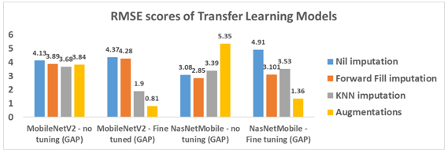
Evaluation II
In all the cases data augmentation is yielding lower RMSE than KNN imputation
MobilenetV2 yielded lower RMSE than NasNetMobile

Slide 15
Evaluation III
Evaluation Metrics Used:
Custom Models | Total parameters | Model size (MB)
Baseline CNN model | 1,890,366 | 7.6
Manually Optimized CNN | 235,834 | 1.0
Keras Optimized CNN- No imputation | 306,750 | 1.27
Keras Optimized CNN - Forward fill | 246,478 | 1.03
Keras Optimized CNN - KNN imputed | 246,062 | 1.58
Keras Optimized CNN - Augmentation | 364,318 | 1.50
MobilenetV2 | 2,257,984 | 9.66
NasNetMobile | 4,301,426 | 18.48

Slide 16
Evaluation III
Evaluation Metrics Used:
Model | No impute (sec) | Forward Fill (sec) | KNN Impute (sec) | Aug(sec)
CNN Baseline model | 1.99 | 1.97 | 1.98 | 2.01
CNN Manual tuned model | 1.4 | 1.33 | 1.34 | 1.34
CNN Keras tuned | 2.72 | 1.52 | 4.19 | 3.58
MobileNetV2 - Baseline | 0.89 | 0.86 | 1 | 0.83
MobileNetV2 - Fine tuned | 0.84 | 0.82 | 0.82 | 0.88
NasNetMobile - Baseline | 8.46 | 8.4 | 8.17 | 7.87
NasNetMobile - Fine tuned | 7.95 | 7.96 | 8.01 | 7.68
Manually tuned custom model has lower inference time on CPU than Keras tuned model
MobilenetV2 yielded lower RMSE than Manually tuned custom model

Slide 17
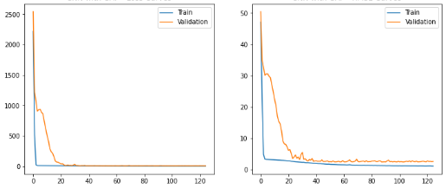
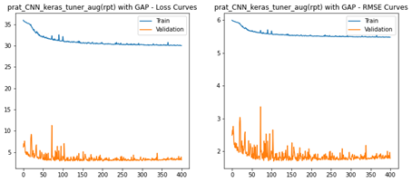
Evaluation IV
Evaluation Metrics Used: Training Curves
Manually Tuned Custom
Keras Tuned Custom
Keras tuned models show overfitting on the data whereas manually tuned model training curves doesn’t exhibit such pattern

Slide 18
Inference
Manual tuned, Keras auto-tuned, MobilenetV2 , NASNetMobile (L-R)

Slide 19
Conclusion
Manually optimized custom CNN models outperform others in terms of model size, and model parameters.
MobileNetV2 outperforms all other models with the fastest inference time.
In both custom CNN and transfer learning models, augmented models have lower RMSE scores, proving that augmentation is superior to imputation.
The experiments demonstrate that architectural efficiency significantly impacts model performance and inference time
Manually tuned custom models performed better than Keras-autotuner in terms of model size and inference time
Moreover, our models have the lowest RMSE compared to other state-of-the-art architectures performed on the same dataset

Slide 20
Questions

