Slide 1
Redfish Receiver Proposal
Notes:
This presentation was automatically generated by PowerPoint Copilot based on content found in this document: https://nvidia.sharepoint.com/sites/NBU-Adv-Dev-Professionals/Shared%20Documents/General/Projects/Galen/Collector/RedFish/redfish%20contrib%20proposal.docx AI-generated content may be incorrect.

Slide 2
Agenda
• | Redfish Overview
• | Redfish Receiver Configuration
• | Redfish Receiver Design and Key Features

Slide 3
Redfish Overview
A standard protocol by DMTF for managing hardware
Designed for converged, hybrid IT, and Software Defined Data Centers (SDDC)
Redfish improves older standards such as IPMI, SMASH and DASH
by exposing a standardized, vendor-agnostic, RESTful API for managing servers, storage, networking & converged infrastructure.
It offers a simple, secure and scalable platform management, including firmware updates and configuration management.
Redfish Forum includes industry leaders: Broadcom, Cisco, Dell, HPE, IBM, Intel, Lenovo, Microsoft, etc.
Widespread adoption by major server vendors, cloud providers, and open-source solutions
Redfish is being used in NVIDIA clusters for managing hosts and Data Processing Units (DPUs)
Notes:
Redfish is being adopted and deployed by major server vendors such as Dell EMC, HPE, and Lenovo, as well as cloud providers like Microsoft Azure, Google Cloud, AWS, and IBM Cloud. It's also being used in open-source solutions and by standardization organizations, among others. Original Content: Today, Redfish is seeing widespread adoption and deployment by: · Major server vendors, e.g. Dell EMC, HPE, Lenovo, etc. · Cloud providers, e.g. Microsoft Azure, Google Cloud, AWS, IBM cloud. · Open-source solutions · Standardization organizations · Etc.

Slide 4
Redfish Protocol
Redfish resources are identified by Universal Resource Identifiers (URI)
A GET operation on a URI returns a representation of the resource typically in formats such as JSON or YAML.
Redfish has a RESTful API architecture, with a single service root URI for accessing resources.
There is separation of protocol from the data model ensures flexibility and interoperability.
Redfish supports CRUD operations (Create, Read, Update, Delete) for managing resources.
Notes:
Redfish is being adopted and deployed by major server vendors such as Dell EMC, HPE, and Lenovo, as well as cloud providers like Microsoft Azure, Google Cloud, AWS, and IBM Cloud. It's also being used in open-source solutions and by standardization organizations, among others. Original Content: Today, Redfish is seeing widespread adoption and deployment by: · Major server vendors, e.g. Dell EMC, HPE, Lenovo, etc. · Cloud providers, e.g. Microsoft Azure, Google Cloud, AWS, IBM cloud. · Open-source solutions · Standardization organizations · Etc.

Slide 5
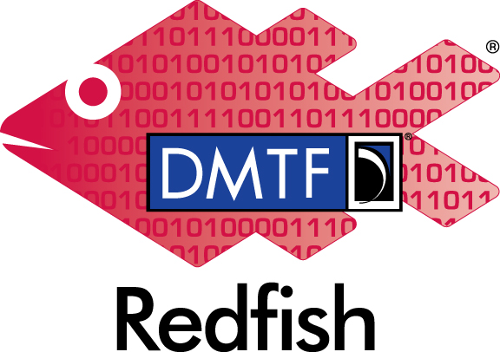
Redfish Receiver Configuration
The configuration is divided to 3 parts:
Global Configuration –
Encompasses the overall configuration settings for all redfish servers within the redfish collector. It includes parameters that are universally applicable to the entire collection of servers (i.e. collection interval).
Redfish-Server Configuration
configuration details are specified on a per-redfish-server basis.
This includes essential information required to establish a connection with each individual redfish server (i.e. ip address, port number)
Collection Group Configuration-
The Collection Group abstraction simplifies the configuration by defining groups of sets of property URIs (resources to collect from the Redfish server)
Aggregate multiple servers of the same type (e.g. hosts from the same vendor, same devices, etc.).
All that is required to enable the REDFISH receiver is to include it in the receiver definitions.
Notes:
Redfish is being adopted and deployed by major server vendors such as Dell EMC, HPE, and Lenovo, as well as cloud providers like Microsoft Azure, Google Cloud, AWS, and IBM Cloud. It's also being used in open-source solutions and by standardization organizations, among others. Original Content: Today, Redfish is seeing widespread adoption and deployment by: · Major server vendors, e.g. Dell EMC, HPE, Lenovo, etc. · Cloud providers, e.g. Microsoft Azure, Google Cloud, AWS, IBM cloud. · Open-source solutions · Standardization organizations · Etc.

Slide 6
Configuration Example
redfishreceiver:
Global
Collection interval: 10s
Servers
Server name:
Hostname:
TLS configuration
Collections
Servers
Server name #1
Server name #2
...
Properties
/redfish/v1
Notes:
This slide presents the configuration of the Redfish Receiver. The global collection interval is set to 10 seconds. The server name and hostname are specified, along with collections and properties. Multiple servers can be listed, including their properties such as the Redfish version. Original Content: receivers: redfishreceiver: global: collection_interval: 10s servers: - <server name>: hostname: <hostname or address> collections: - servers: - <server name #1> - <server name #2> - … properties: - /redfish/v1 - …

Slide 7
Redfish Receiver Design
The Redfish receiver is implemented and tested by our team, including the following features:
Full Flow - Collecting the collection URI properties from all Redfish receivers during the collection interval and wrapping them into OTLP metrics.
Multithreading - Utilizing Go routines for efficient processing.
TLS Encryption and Authorization Support
Failure Tolerance - Adaptive re-connection retry for Redfish servers.
Testing Comprehensive - validation to ensure functionality and reliability.
Notes:
Redfish is being adopted and deployed by major server vendors such as Dell EMC, HPE, and Lenovo, as well as cloud providers like Microsoft Azure, Google Cloud, AWS, and IBM Cloud. It's also being used in open-source solutions and by standardization organizations, among others. Original Content: Today, Redfish is seeing widespread adoption and deployment by: · Major server vendors, e.g. Dell EMC, HPE, Lenovo, etc. · Cloud providers, e.g. Microsoft Azure, Google Cloud, AWS, IBM cloud. · Open-source solutions · Standardization organizations · Etc.

