Slide 1

Distributional impacts on residential energy security across multiple income groups under decarbonization policy
Ying Zhang¹, Yang Ou²,
Stephanie Waldhoff¹, Brian O’Neill¹,
Kelly Casper³, Jon Sampedro⁴, Gokul Iyer¹
¹Joint Global Change Research Institute,
Pacfic Northwest National Laboratory, USA
²Peking University, China
³U.S. Environmental Protection Agency, USA
⁴Basque Centre for Climate Change, Spain

Slide 2
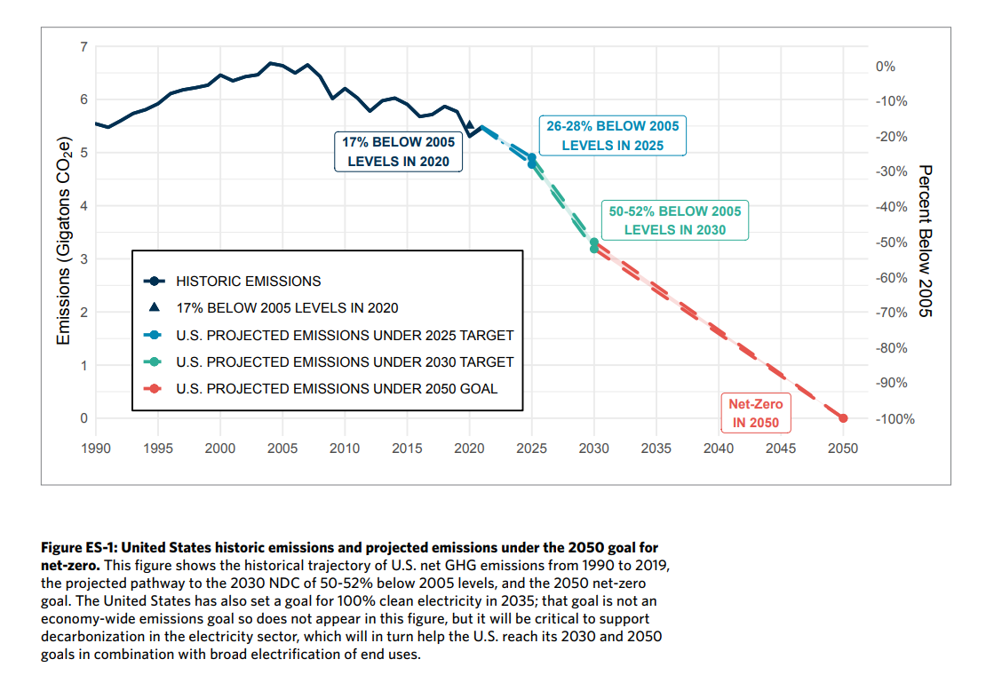

Motivation
Decarbonization policies play a crucial role in addressing climate change.
Existing research has primarily centered on exploring decarbonization pathways in energy supply.
Little research has been done on the decarbonization impacts on residential energy security

Slide 3
Motivation
Existing modeling research on long-term decarbonization has primarily focused on sectoral transitions and technological changes needed in energy supply and demand.
However, little research has been done on the implications of such transitions for demographic or socioeconomic subgroups particularly at subnational scales.
Understanding these distributional implications will be crucial to design effective policies and facilitate public support in the transition to net-zero emissions.

Slide 4
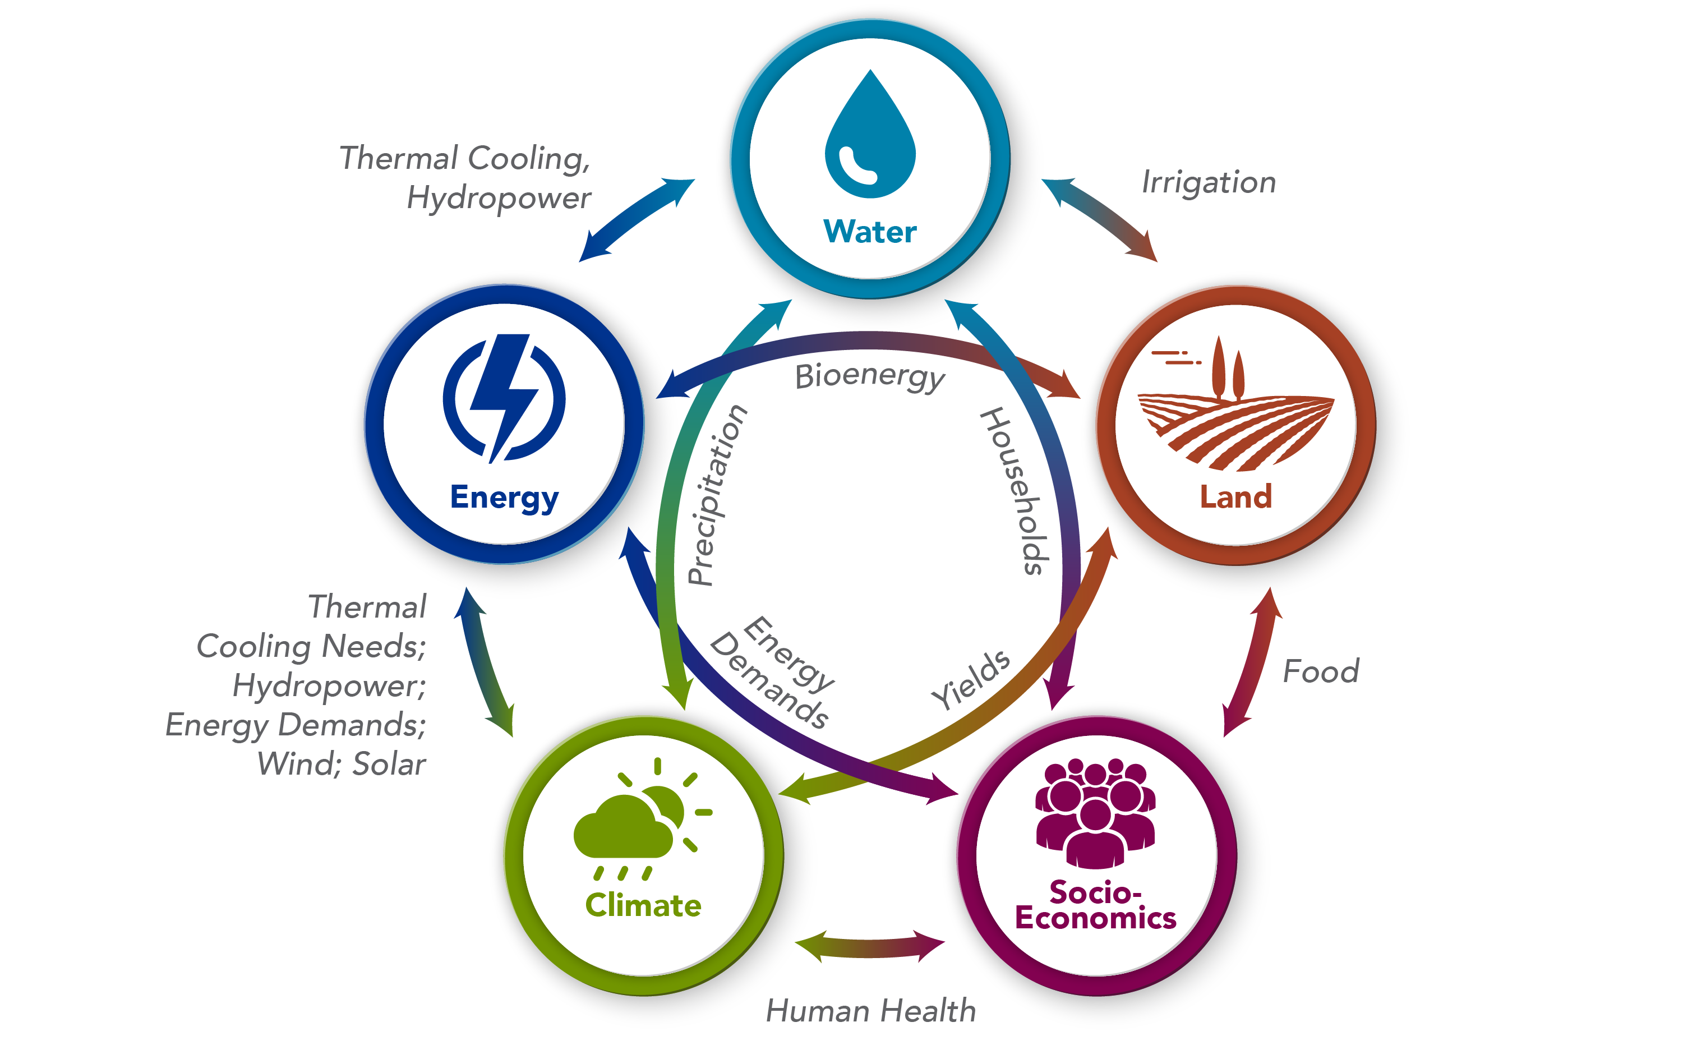
Global Change Analysis Model (GCAM)
Open-source, well-documented integrated multi-sector model, which has evolved and expanded since the 1980s
The model represents the behavior of and interactions between multiple systems/sectors
Widely used to study long-term implications of various policy scenarios on global changes in the energy, land use, agriculture, water, and other related sectors

Slide 5
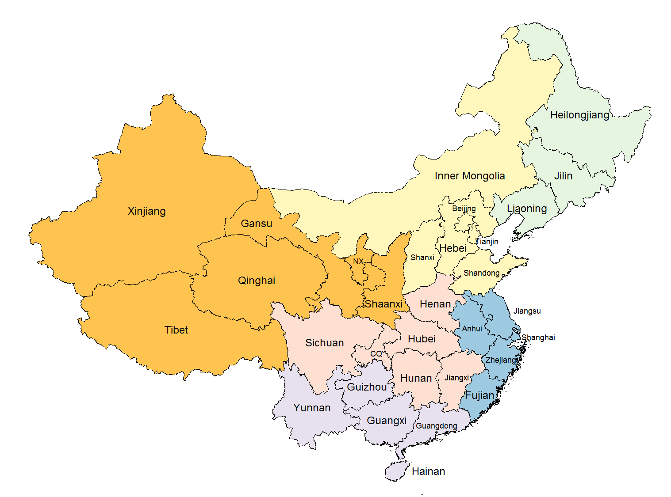
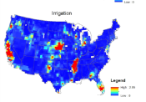
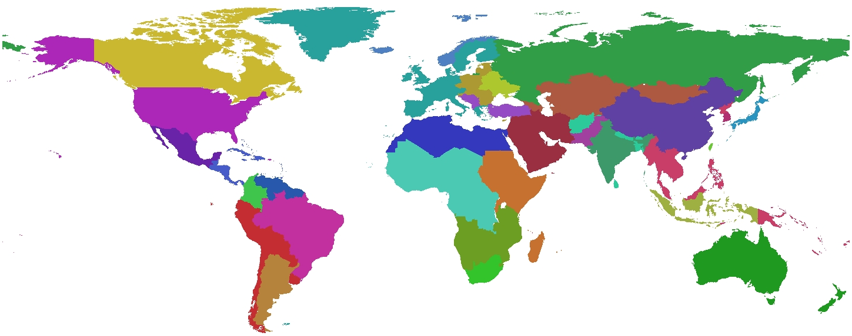
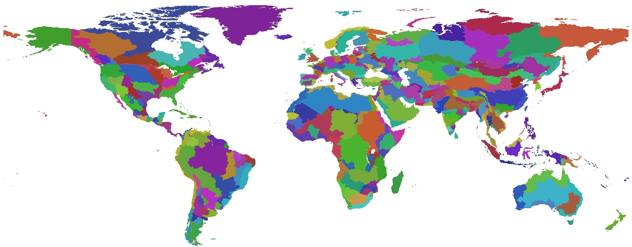
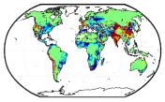
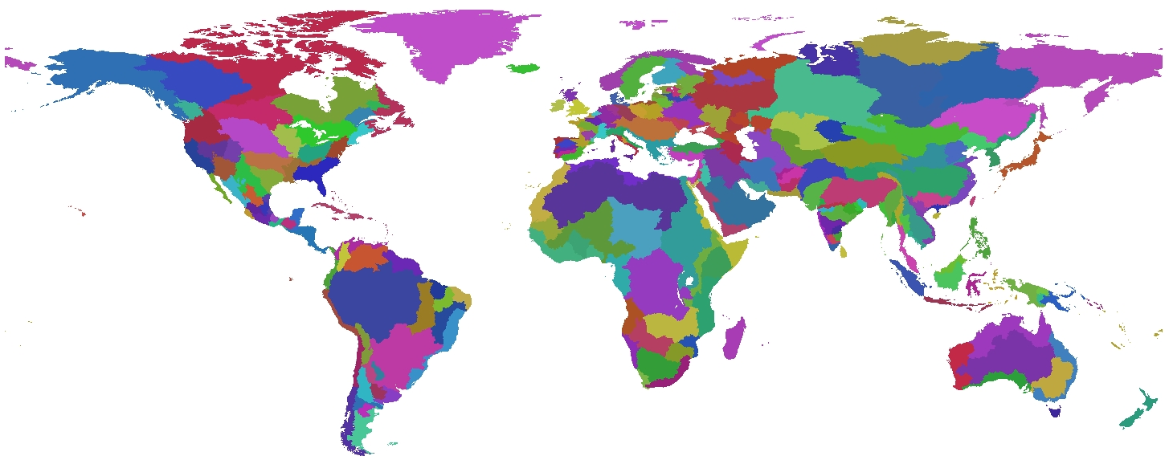
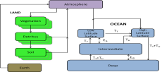
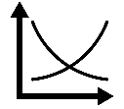
An Overview of GCAM
Flexible Scale
Global Coverage
32 Energy & Economy Regions
384 Land Regions
GCAM-USA
235 Water Basins
Market Equilibrium Solution
Reduced-Form ESM (Hector)
Community Model http://jgcri.github.io/gcam-doc/toc.html
Flexible Time Scale
GCAM Core runs at 5 years; capability to run at one year; ancillary models run at finer scale

Slide 6
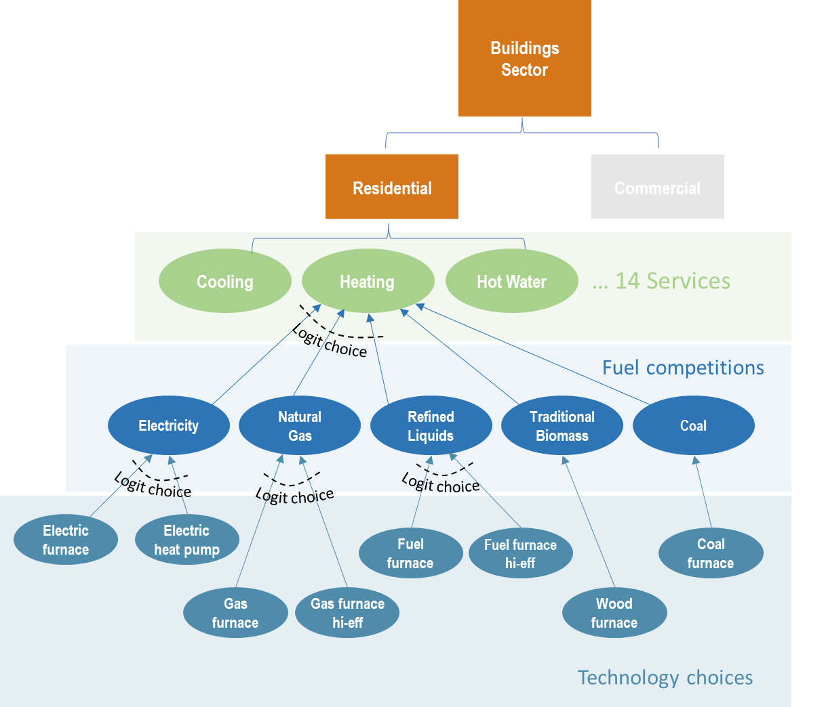
Technologies in the residential sector in GCAM-USA
In each state, buildings are categorized by ‘Residential’ and ‘Commercial’ sector.
The multiple consumers are incorporated to the ‘Residential’ sector.
A nested logit structure is used to represent competitions among fuels and technologies for each residential service.
Historical energy consumptions are calibrated using RECS and EIA state energy database; future inputs assumptions are based on the EIA Annual Energy Outlook.

Slide 7
Method of Implementing Multiple Consumers in GCAM-USA
Implement¹ income share projections² across 10 consumer groups at the state level to differentiate GDP per capita across multiple consumers
  Each income group contains one tenth of the state total population.
  Higher income groups have higher GDP per capita than lower income groups.
1. Sampedro, J. et al. Residential energy demand, emissions, and expenditures at regional and income-decile level for alternative futures. Environmental Research Letters 19, 084031, doi:10.1088/1748-9326/ad6015 (2024).
2. Casper, K. C. et al. Non-parametric projections of the net-income distribution for all U.S. states for the Shared Socioeconomic Pathways. Environmental Research Letters 18, 114001, doi:10.1088/1748-9326/acf9b8 (2023).

Slide 8
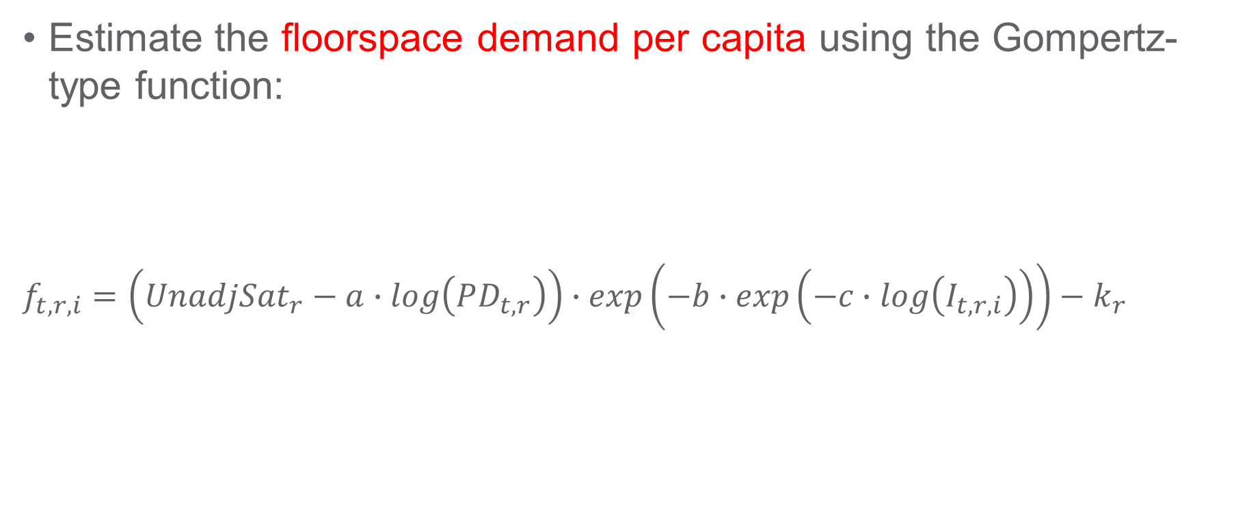
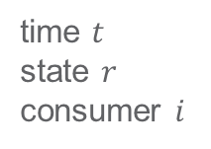
Method of Implementing Multiple Consumers in GCAM-USA
Estimate the floorspace demand per capita using the Gompertz-type function:
$$f_{t,r,i}=\left(UnadjSat_{r}−a∙log\left(PD_{t,r}\right)\right)∙exp\left(−b∙exp\left(−c∙log\left(I_{t,r,i}\right)\right)\right)−k_{r}$$
Difference between the obs. and est. per capita floorspace in the base year
Parameters estimated in econometric analysis
time $t$
state $r$
consumer $i$
Unadjusted saturation level (max floorspace demand per cap)
Population density (population divided by habitable land)
Income represented by GDP per cap

Slide 9
Method of Implementing Multiple Consumers in GCAM-USA
Estimate the floorspace demand per capita using the Gompertz-type function:
$$f_{t,r,i}=\left(UnadjSat_{r}−a∙log\left(PD_{t,r}\right)\right)∙exp\left(−b∙exp\left(−c∙log\left(I_{t,r,i}\right)\right)\right)−k_{r}$$
time $t$
state $r$
consumer $i$
Unadjusted saturation level (max floorspace demand per cap)
Population density (population divided by habitable land)
Income represented by GDP per cap

Slide 10
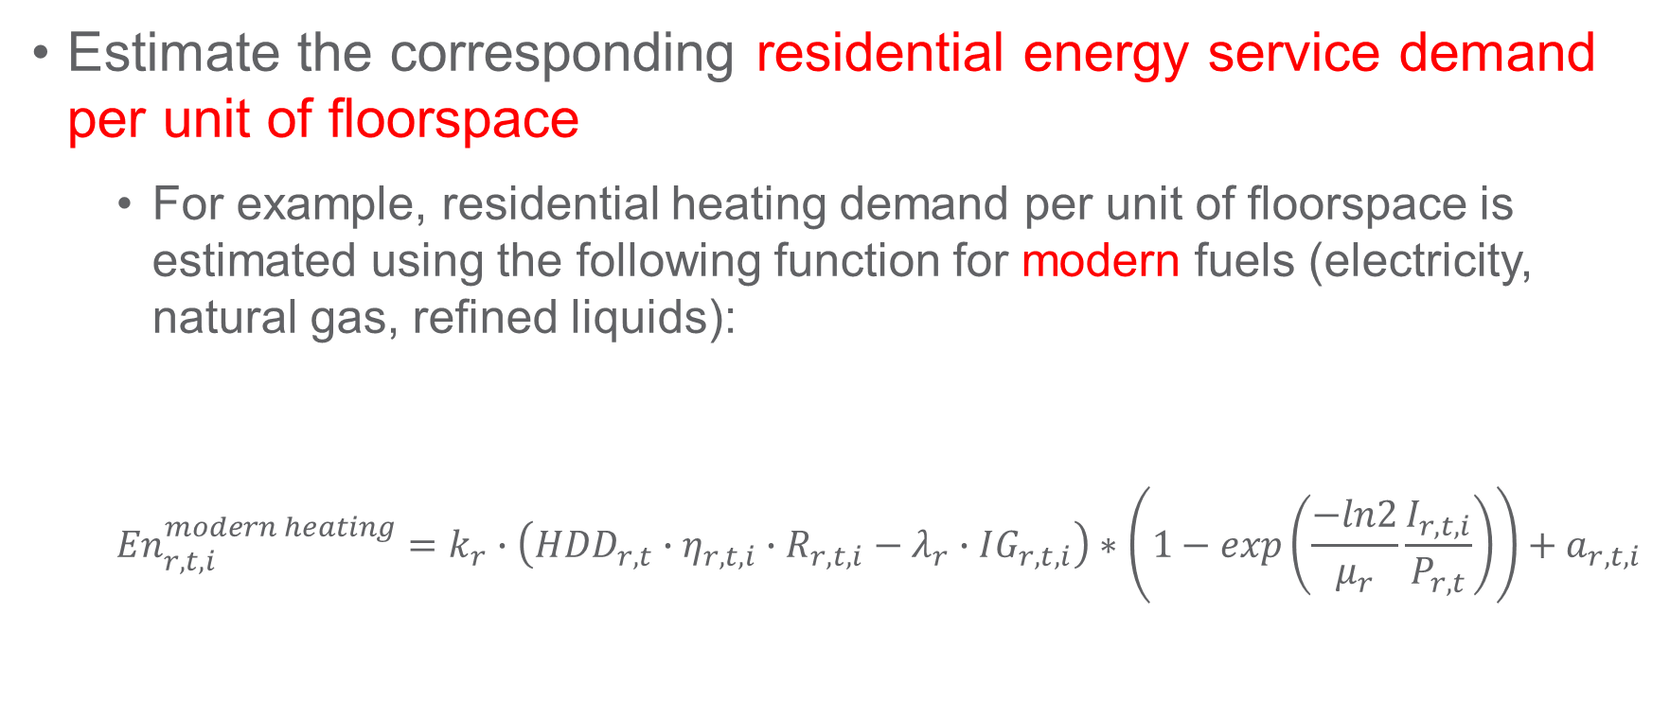
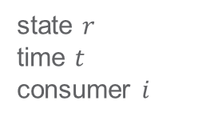
Method of Implementing Multiple Consumers in GCAM-USA
Estimate the corresponding residential energy service demand per unit of floorspace
  For example, residential heating demand per unit of floorspace is estimated using the following function for modern fuels (electricity, natural gas, refined liquids):
  $${En}_{r,t,i}^{modern heating}=k_{r}∙\left(HDD_{r,t}∙η_{r,t,i}∙R_{r,t,i}−λ_{r}∙IG_{r,t,i}\right)∗\left(1−exp\left(\frac{−ln2}{μ_{r}}\frac{I_{r,t,i}}{P_{r,t}}\right)\right)+a_{r,t,i}$$
Income/
Service Price
Floorspace/
building area
Heating
Degree Days
Building
shell
conductivity
Internal Gains and regional scaler
state $r$
time $t$
consumer $i$

Slide 11
Method of Implementing Multiple Consumers in GCAM-USA
Estimate the corresponding residential energy service demand per unit of floorspace
  For example, residential heating demand per unit of floorspace is estimated using the following function for modern fuels (electricity, natural gas, refined liquids):
  $${En}_{r,t,i}^{modern heating}=k_{r}∙\left(HDD_{r,t}∙η_{r,t,i}∙R_{r,t,i}−λ_{r}∙IG_{r,t,i}\right)∗\left(1−exp\left(\frac{−ln2}{μ_{r}}\frac{I_{r,t,i}}{P_{r,t}}\right)\right)+a_{r,t,i}$$
Income/
Service Price
Floorspace/
building area
Heating
Degree Days
Building
shell
conductivity
Internal Gains and regional scaler
state $r$
time $t$
consumer $i$

Slide 12
Model Scenarios
Model Scenarios | Decarbonization Policies
BAU: Business-as-usual | Existing state-level energy and emission policies, including IRA
NZ: Net-Zero Policy | Two national targets: 50% net-GHG emission reduction relative to 2005 level by 2030 and net-zero GHG emissions by 2050 U.S. power grid achieves clean-grid by 2035
Projections of Income Deciles at State Level
Decarbonization Scenarios
Model
(GCAM-USA*)
*with 10 income groups in each state
Metrics of Residential Energy Security

Slide 13
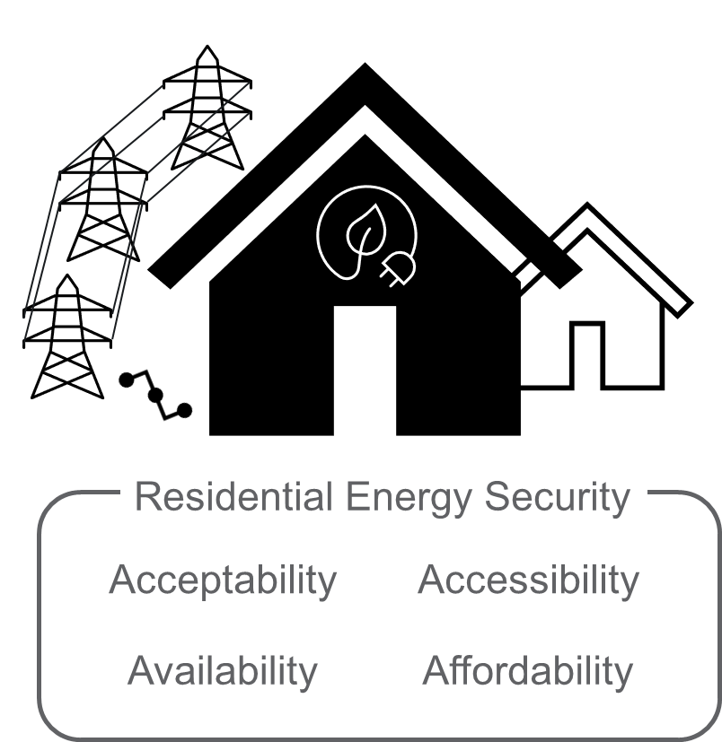
Multiple metrics are required for a full understanding of residential energy security
Residential energy security – one dimension of human well-being – describes how different consumers are impacted by changes to the energy system
We chose four metrics to demonstrate its complex and interacting nature – not a comprehensive assessment
  Energy service consumption
  Satiation gap
  Energy burden
  Service inequality
1
“In 2020, 34 million U.S. households (27% of all U.S. households) reported difficulty paying energy bills or reported that they had kept their home at an unsafe temperature because of energy cost concerns.”
– U.S. EIA
1. Wejnert-Depue, C. et al. A Conceptual Framework for Residential Energy Security in the Context of Clean Energy Transitions. Submitted.

Slide 14
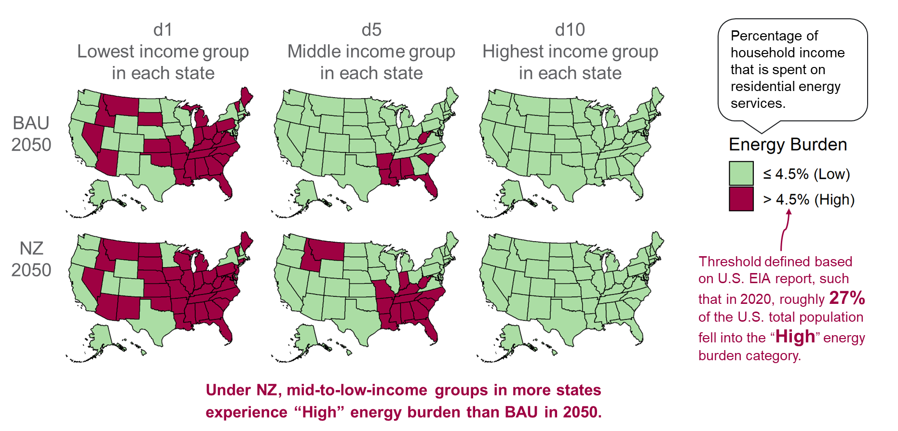
Under net-zero transition, mid-to-low-income groups in more states experience “High” energy burden than business-as-usual in 2050
Business-as-usual
2050
Net-zero Transition
2050
Residential Energy Burden
$$Energy Burden=(service price ∗service consumption)/GDP$$

Slide 15
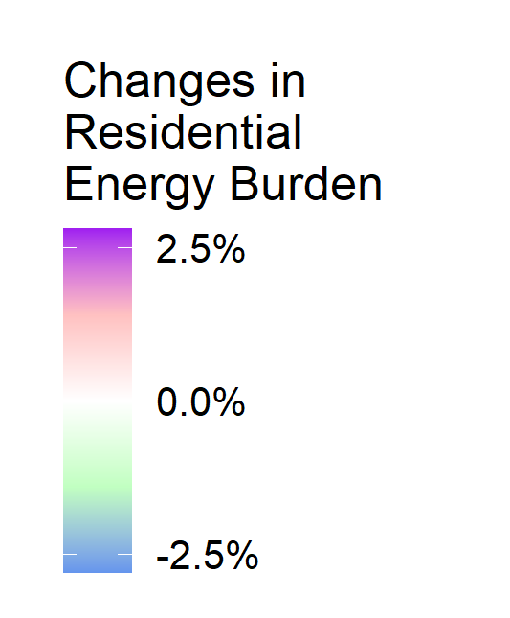
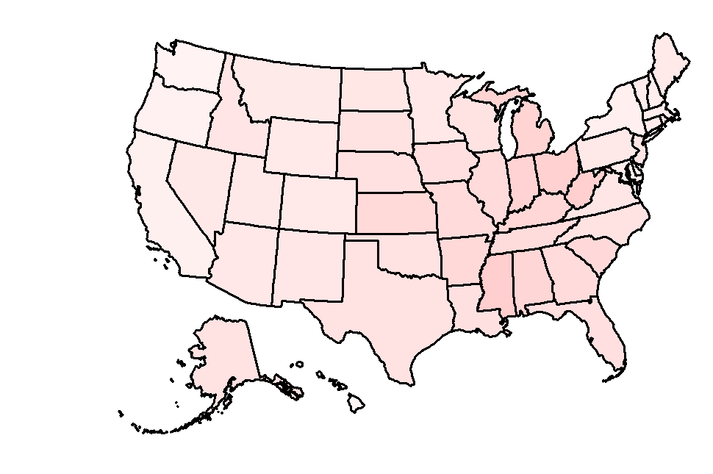

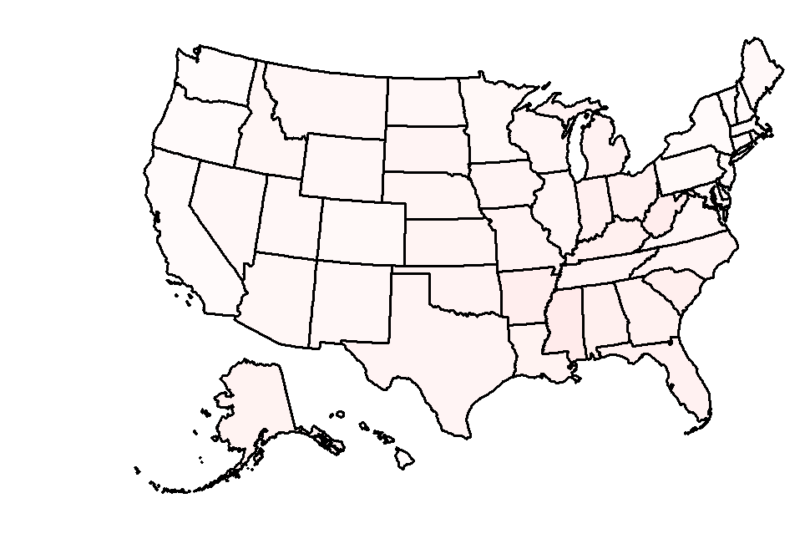
Mid-to-low-income groups could be more affected than the highest income group by the net-zero policy in terms of energy burden
d1
Lowest income group
in each state
d5
Middle income group
in each state
d10
Highest income group
in each state
NZ 2050
Minus
BAU 2050
Population weighted average
+0.6pp
+0.5pp
+0.2pp
This is absolute change in terms of percentage points (pp).
Residential Energy Burden
$$Energy Burden=(service price ∗service consumption)/GDP$$

Slide 16
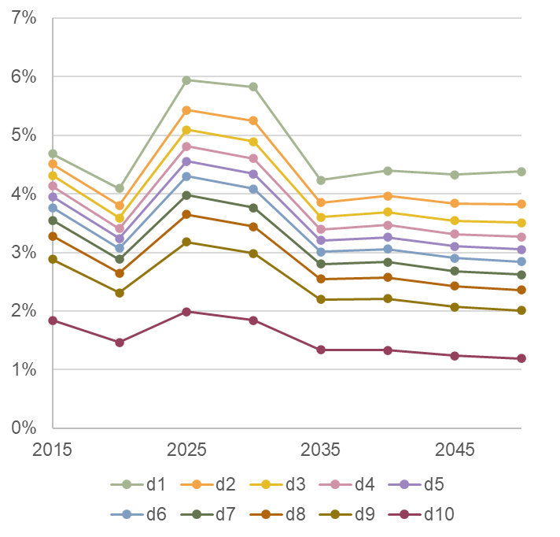
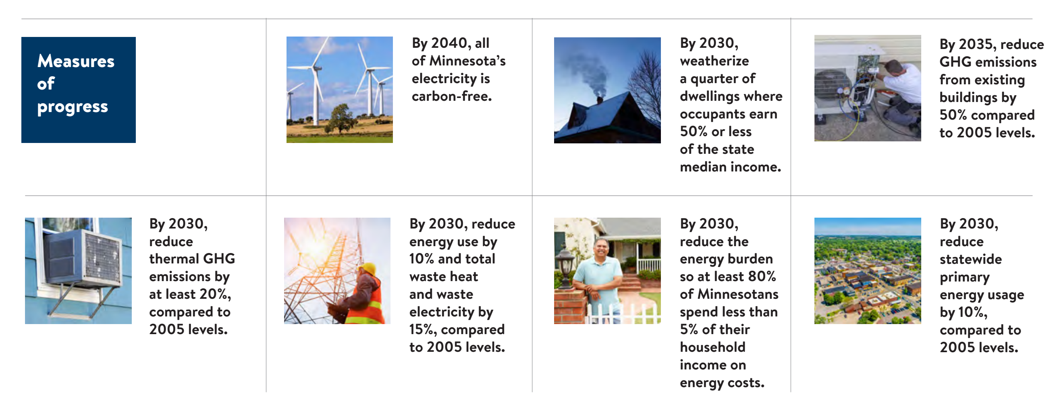
Energy burden projections under Net-Zero Transition are consistent with intermediate goals in MN Climate Action Framework
MN Residential Energy Burden over years by income decile under Net-Zero Transition
Near-term increase in energy burden due to increase in service prices.
Under net-zero transition, our projection shows 80% of MN population will have less than 5% energy burden by 2030.
2030
5%
Source: https://climate.state.mn.us/sites/climate-action/files/Climate%20Action%20Framework.pdf

Slide 17
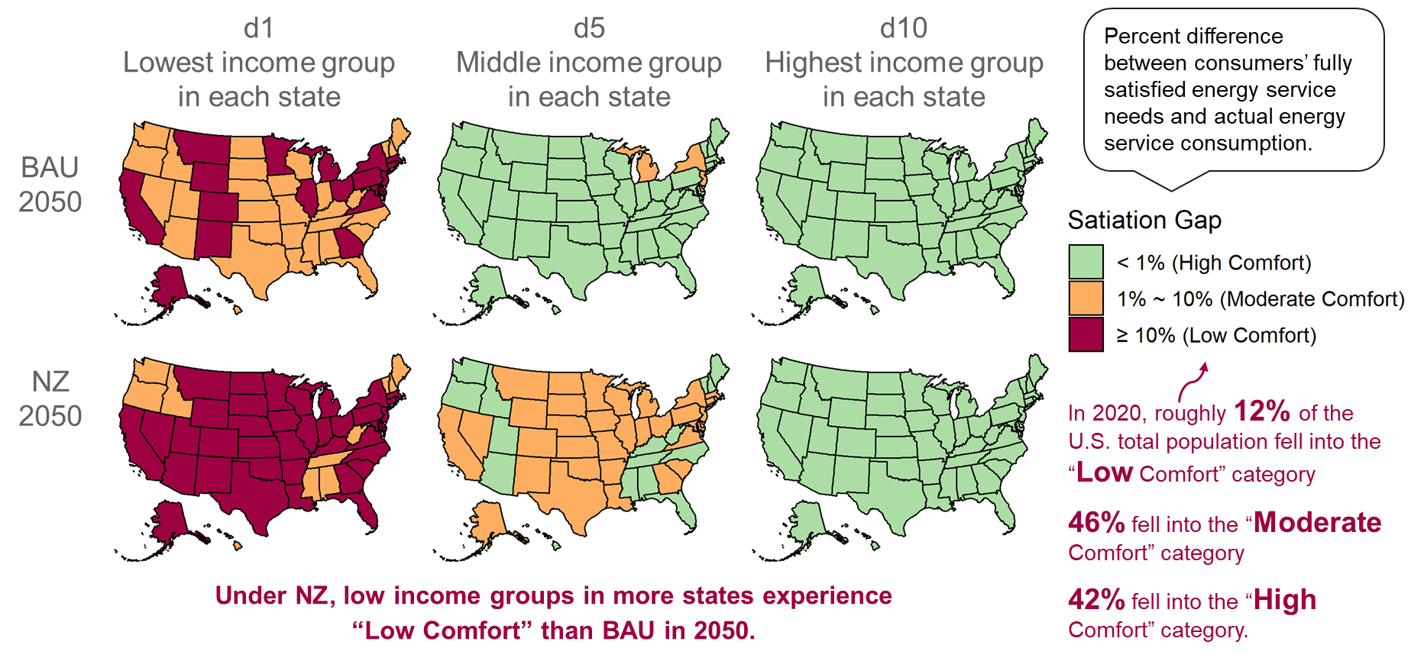
Under net-zero transition, low-income groups in more states experience “Low Comfort” than the business-as-usual in 2050
Business-as-usual
2050
Net-zero Transition
2050
Satiation Gap of Residential Modern Heating Service
$$Satiation Gap=(service consumption per floorspace)/(satiation demand per floorspace)$$

Slide 18
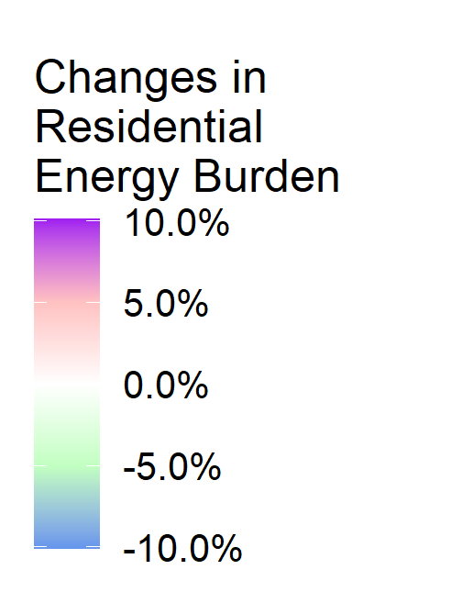
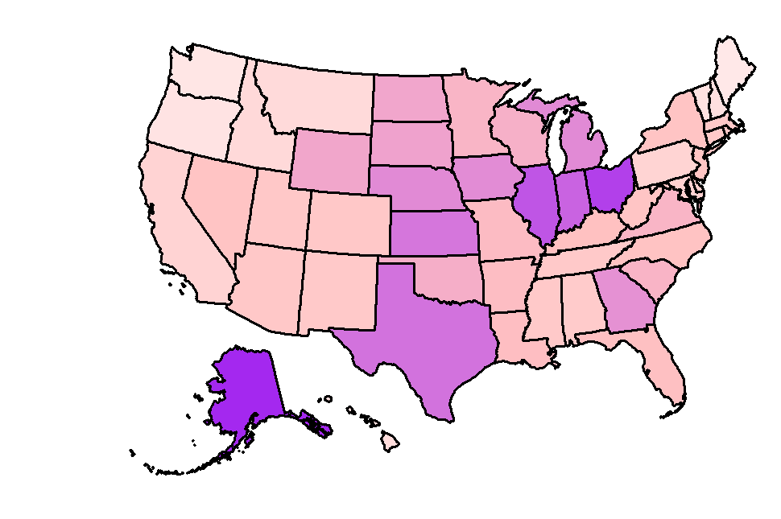
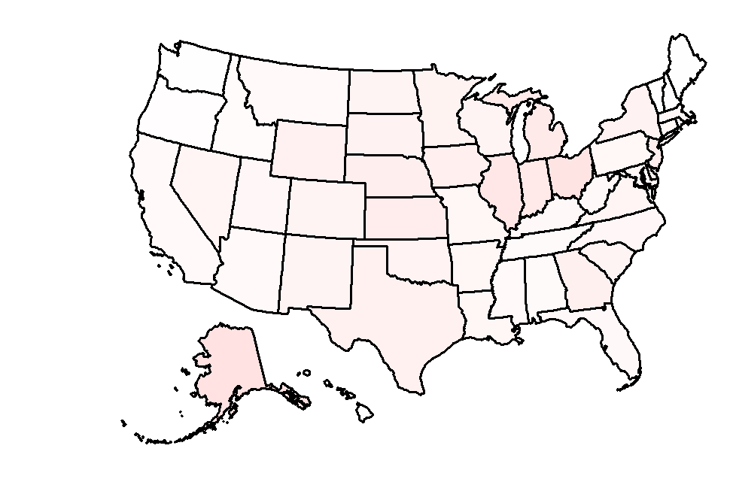
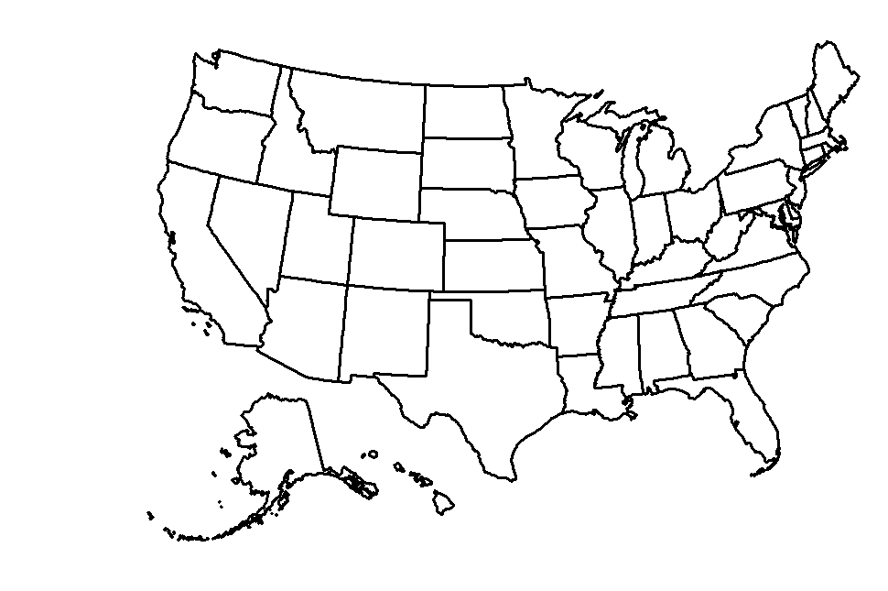
The net-zero policy leads to much higher increase in the satiation gap of modern heating service for the lowest income group than high-to-mid-income group
d1
Lowest income group
in each state
d5
Middle income group
in each state
d10
Highest income group
in each state
NZ 2050
Minus
BAU 2050
Population weighted average
+5.4pp
+0.9pp
+0.0pp
This is absolute change in terms of percentage points (pp).
Satiation Gap of Residential Modern Heating Service
$$Satiation Gap=(service consumption per floorspace)/(satiation demand per floorspace)$$

Slide 19
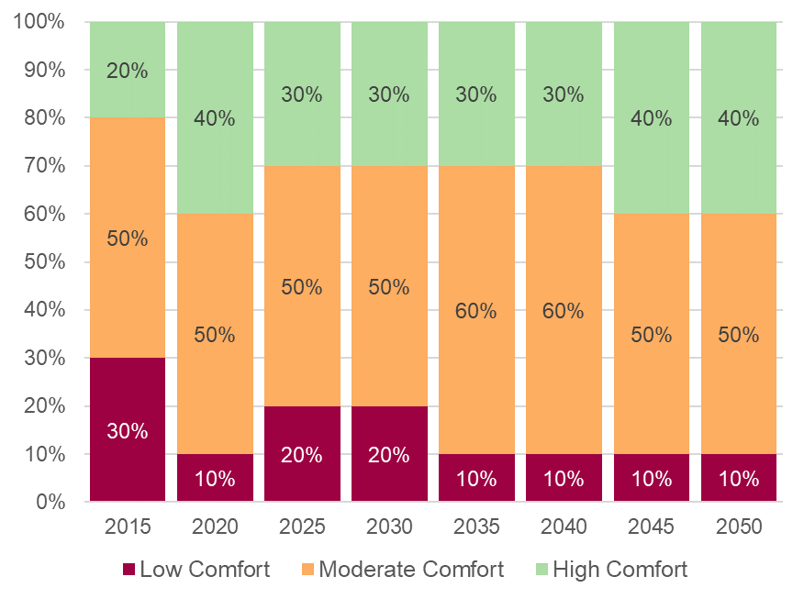
10% of MN population still keeps their homes at “Low Comfort” temperatures in 2050 under Net-Zero Transition
Percent of MN population in each comfort-level category under Net-Zero Transition
based on their modern heating service consumption

Slide 20
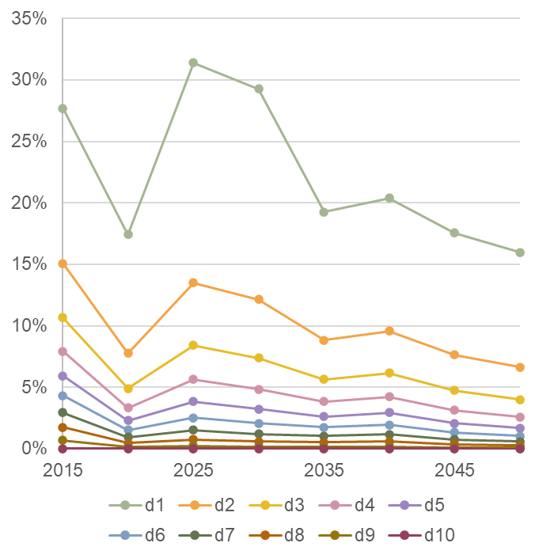
10% of MN population still keeps their homes at “Low Comfort” temperatures in 2050 under Net-Zero Transition
Percent of MN population in each comfort-level category under Net-Zero Transition
MN Satiation Gap for modern heating over years by income decile under Net-Zero Transition
based on their modern heating service consumption

Slide 21
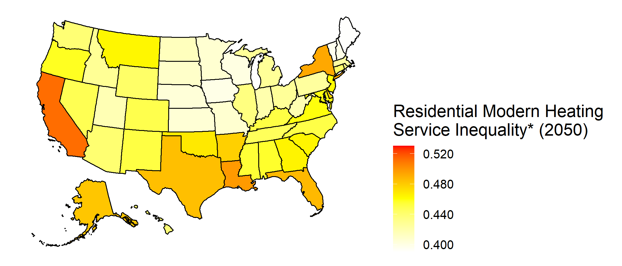
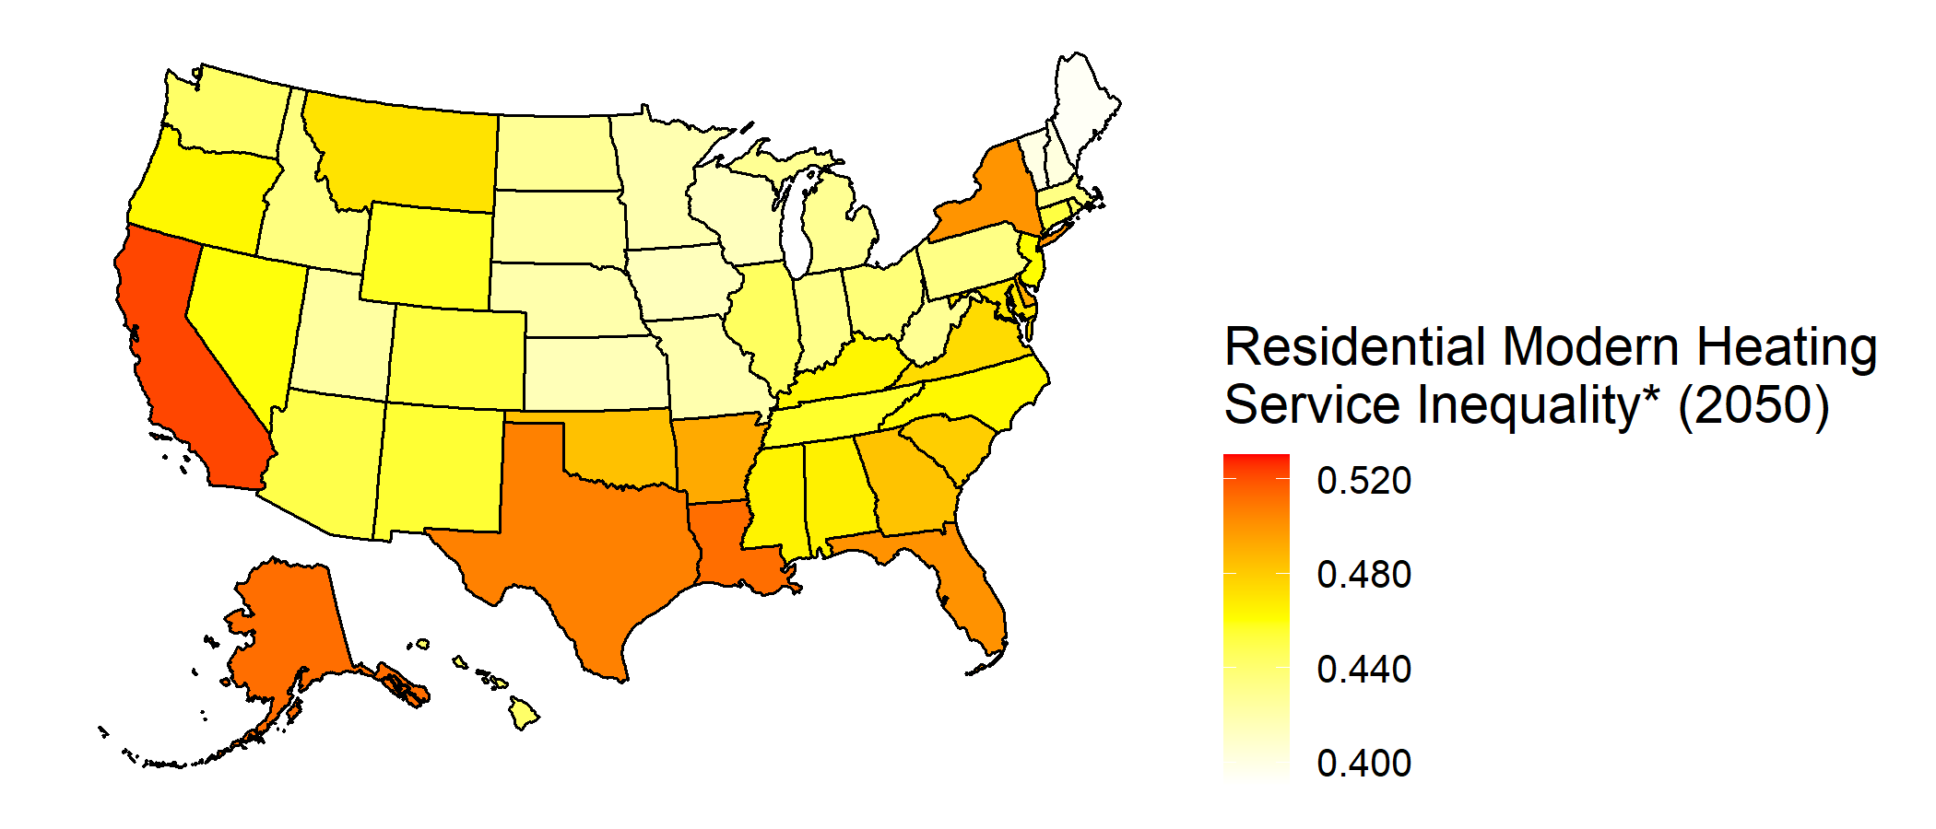
Energy inequality in residential modern heating services varies across states under the Business-as-usual
Residential modern heating service inequality in 2050
Business-as-usual
Net-Zero Transition
*Service inequality index is calculated using the service consumption of the highest income decile divided by the sum of service consumptions over the lowest four income deciles. A higher index indicates a greater degree of inequality.

Slide 22
Net-Zero Transition generally increases energy inequality among income groups in residential modern heating services
Residential modern heating service inequality in 2050
Business-as-usual
Net-Zero Transition
*Service inequality index is calculated using the service consumption of the highest income decile divided by the sum of service consumptions over the lowest four income deciles. A higher index indicates a greater degree of inequality.

Slide 23
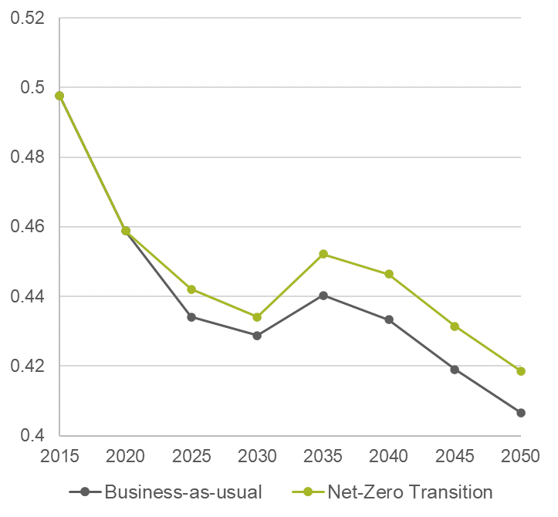
MN’s energy inequality in modern heating services shows a decreasing trend, with slightly higher inequality under the Net-zero transition than under Business-as-usual.
Residential modern heating service inequality in 2050
MN Residential modern heating service inequality over years
Net-Zero Transition
*Service inequality index is calculated using the service consumption of the highest income decile divided by the sum of service consumptions over the lowest four income deciles. A higher index indicates a greater degree of inequality.

Slide 24

Key messages
We developed an improved model to quantify decarbonization impacts on residential energy security across different income groups and states through 2050.
Beyond decarbonization policies, income growth and disparity significantly affect residential energy security.
In general, long-term decarbonization policies increase the energy burden in all states, with the most significant impact on mid-to-low income groups.
The lowest income group could be most affected by the decarbonization policies in terms of residential energy service satiation gap.
Long-term decarbonization policies also increases energy service inequality among income groups.
The results focus solely on the impacts of decarbonization policies on residential energy security metrics, excluding potential positive effects like reductions in air pollution.

Slide 25
Ying Zhang
Ying.Zhang@PNNL.gov

