Slide 1

Trade Lots & Price Quantity
Overview of Issues

Slide 2
Summary of Issue
Background
As a result of the Asset Refactoring work, foreign exchange is no longer represented as a Product combining two Cashflow payouts. Instead, a foreign exchange transaction is represented as a single SettlementPayout, with the underlier being Cash. However, for downstream purposes like reporting, there is a need to continue to use the Cashflow objects that are implied by a foreign exchange transaction.
This document seeks to address this and, in doing so, proposes to revisit the Cashflow component to leverage the new Asset type, making it more generic and aligned onto Transfer.
Proposal
Approach & Next Steps
Cashflow
Leverage the new Asset type as an attribute, so that a cashflow can represent the flow of any asset, not just cash.
Refactor to harmonise with Transfer.
Settlement Payout
Implement a function that returns one or more Cashflow from a settlement payout.
The function should be generic and work regardless of the type of Asset underlying the settlement payout, not just Cash.
Payout
Remove the Cashflow option from the Payout choice, on the basis that this type of payout is no longer populated nor used.
Summarise proposal (this document) and seek feedback and approval at the DPBE WG.
Build and release changes to the development version of CDM.

Slide 3
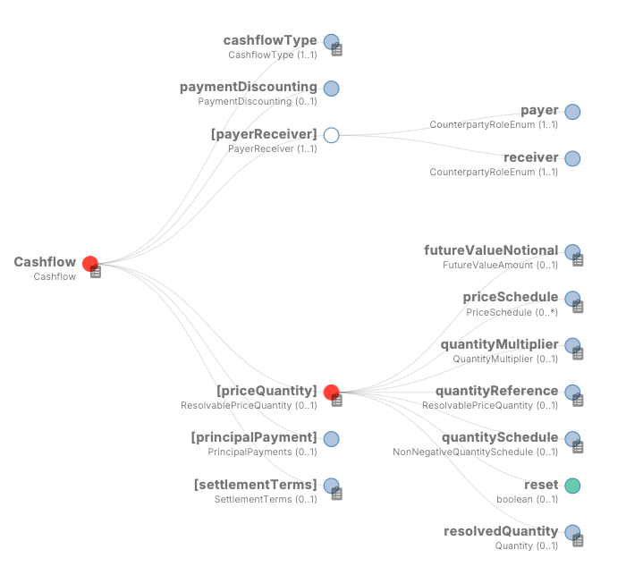
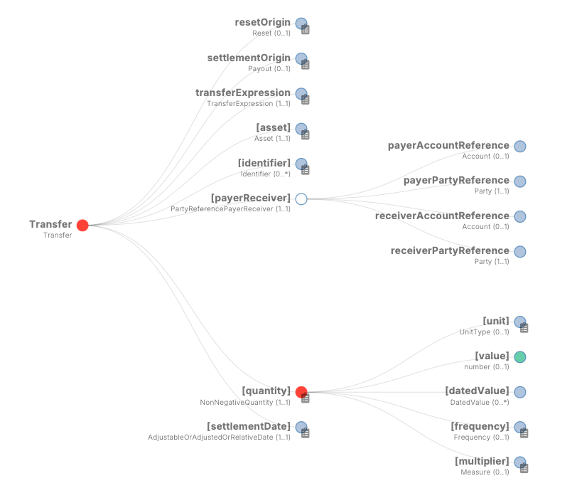
Gap analysis: Cashflow vs Transfer
Cashflow extends PayoutBase, so it inherits many attributes that may not be relevant for a simple cashflow
Some other attributes could be simplified and aligned on their equivalent in Transfer: e.g. only settlementDate is required from settlementTerms
Transfer uses asset – the same should be used in Cashflow
Should payerReceiver use the same party-agnostic type as Cashflow, and separately specify Party1 and Party2?

Slide 4
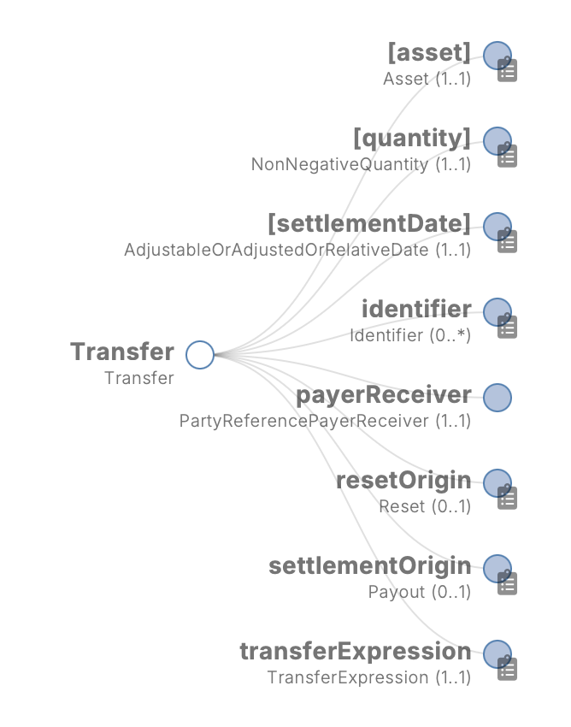
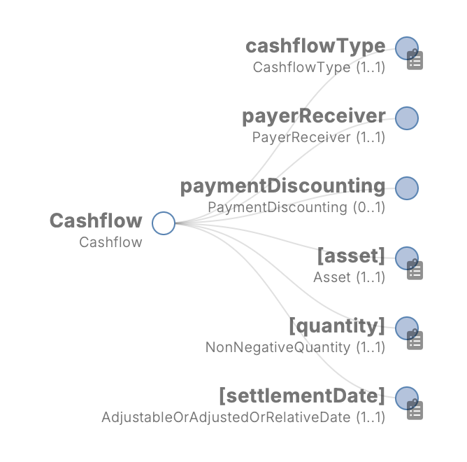
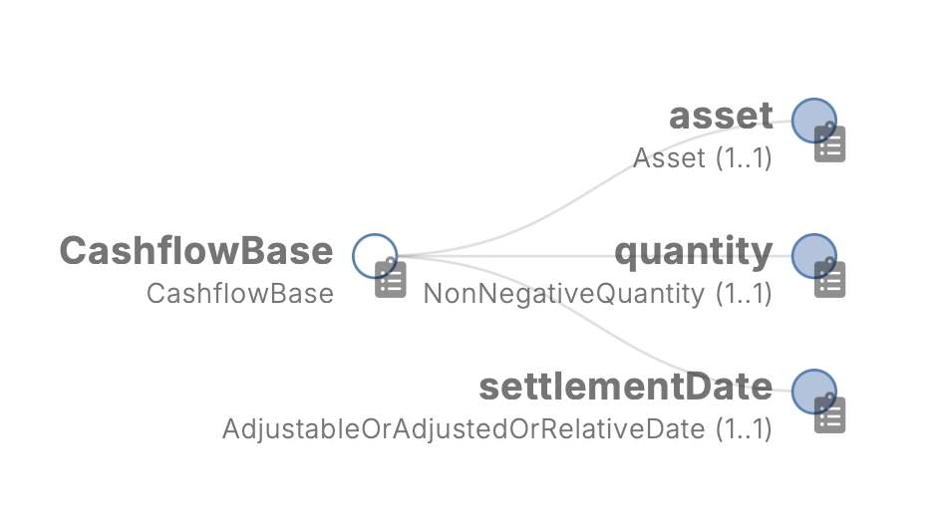
Proposal: Cashflow vs Transfer
Approach
Commonality = asset, quantity and settlement date – all built into a new CashflowBase type
Further harmonisation possible, but reserved for future iteration: cashflowType vs transferExpression, payerReceiver
Should object still be called “Cashflow”, if it’s not just cash?

Slide 5
Generating Cashflow from SettlementPayout [to be completed]

