Slide 1
OSCAL Metadata Objects

Slide 2
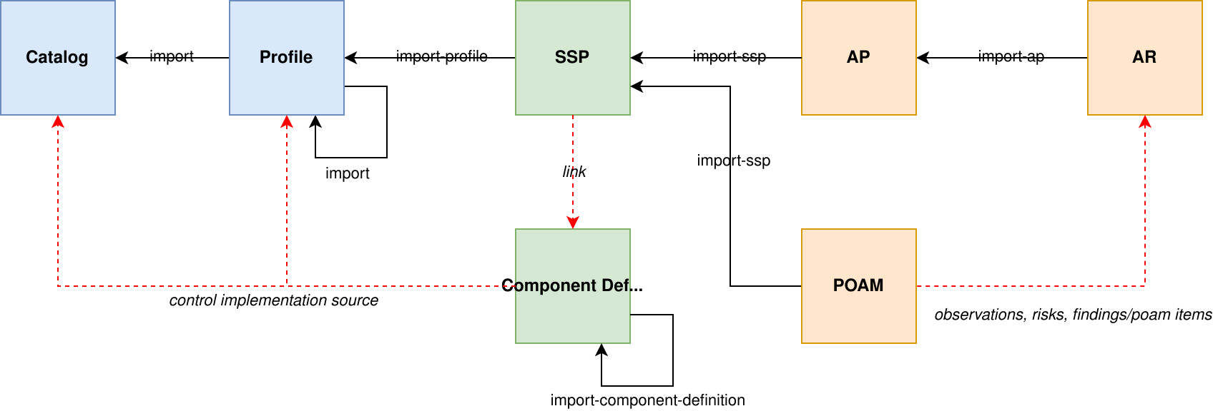
OSCAL Documents are networked
A data source document is referenced, allowing data to be imported from other OSCAL documents.

Slide 3
An example
---
system-security-plan:
uuid: ...
metadata:
…
roles:
- id: custom-role-id
title: A Custom Role
---
assessment-plan:
uuid: ...
import-ssp:
href: ssp-link
The role “custom-role-id”:
Is defined in the SSP
Can be used in the assessment plan
Doesn’t require the same role to be defined in the assessment plan!

Slide 4
What if the role is redefined?
---
system-security-plan:
uuid: ...
metadata:
…
roles:
- id: custom-role-id
title: Custom Role
---
assessment-plan:
uuid: ...
metadata:
…
roles:
- id: custom-role-id
title: Adjusted Custom Role
import-ssp:
href: ssp-link
What if the role defined in the SSP is redefined in the SAP?
The role’s contents may differ
References to the role by identifier in the SAP are ambiguous.
This same situation arises with locations, parties, and references.
How should tools handle this situation?

Slide 5
Current state
Tools handle these situation in different ways
Content authors have not followed current rule in all cases
XML and JSON Schema cannot enforce current rules
  Constraints enforcing imports are lax, but we want to fix this
  Commodity tooling for constraint-based validation are not yet widely available, but we want to fix this

Slide 6
Aligning with best practice
Documentation should be consistent with current best practice
Constraints should enforce current best practices
Tools should interoperate based on current best practices
What are the current best practices?

Slide 7
Option 1: Do nothing
Leave which role to use up to the tool to decide.
PROs:
Tools and content do not need to change
CONs:
Tool behavior will be inconsistent in data use and processing
Results produced by tools will be inconsistent
Interoperability will be limited

Slide 8
Option 2: Scope roles to the current document only
The document author defines the role(s) for use in their document.
Current defined behavior around importing roles will be disallowed in OSCAL vNext. OSCAL 1.1? OSCAL 2.0?
PROS:
Content will not need to change, unless a role used is not defined.
CONS:
Some tools will need to change.
Currently defined behavior in documentation needs to be changed

Slide 9
Option 3: Allow roles to be overridden
---
system-security-plan:
uuid: ...
metadata:
…
roles:
- id: custom-role-id
title: Custom Role
---
assessment-plan:
uuid: ...
metadata:
…
roles:
- id: custom-role-id
title: Adjusted Custom Role
import-ssp:
href: ssp-link
The local definition overrides the imported definition.
The SAP “custom-role-id” will override the SSP “custom-role-id” when a clash is found. Otherwise, roles will be imported using currently defined behavior.
Does this override apply to only the SAP? Or to the SAP and content imported from the SSP?
PROs:
Content will not need to change
CONs:
Downstream authors can change role semantics
Some tools will need to change.
Currently defined behavior in documentation needs to be adjusted

Slide 10
Option 4: Disallow identifier clashes for roles
Implement constraints that cause validation errors when roles are redefined.
PROs:
Documentation is largely consistent with this approach.
CONs:
Some content will need to change.
Some tools will need to change.

Slide 11
Which option is best?
The following options were discussed:
Do nothing (worst)
Scope roles to the current document only (simplest, flexible)
Allow roles to be overridden (flexible)
Disallow identifier clashes for roles (strictest, inflexible)
Other options?
What can we put in place for OSCAL 1.1?
Is there a different option to put in place for OSCAL 2.0?

